Slide 1
Vietnam
Unit 7
http://www.youtube.com/watch?v=P9_mED99cdk&feature=related
http://www.youtube.com/watch?v=YFlrAfKGQuU&feature=related

Slide 2
Southeast Asia’s Colonial History
France gained control of Vietnam by 1883 despite fierce resistance from the Vietnamese.
The French combined Vietnam with Laos and Cambodia to form French Indochina.
Ho Chi Minh led a growing nationalist movement in Vietnam.
During World War II, the Japanese army occupied French Indochina.
A group called the League for the Independence of Vietnam, or the Vietminh, fought the Japanese.
After World War II, the Vietminh declared independence, but the French quickly moved in to reclaim Vietnam.

Slide 3
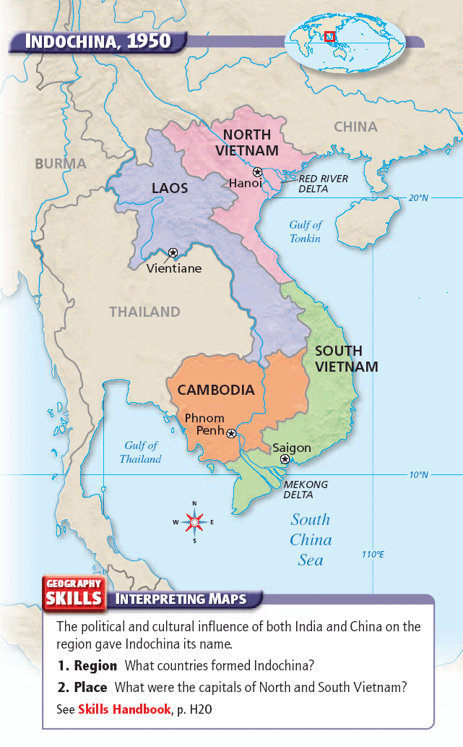

Slide 4
Colonial Vietnam
Ho Chi Minh
Real name is Nguyen That Thanh; Ho Chi Minh means “He Who Enlightens.”
Participated in tax revolts against the French.
Joined the French Communist Party.
Believed that a Communist revolution was a way Vietnam could be free of foreign rulers.
World War II
Japan occupied French Indochina.
Ho Chi Minh organized the Vietminh to fight the Japanese.
Japan surrendered to the Allies in 1945, and the Vietminh declared Vietnam to be independent.
Ho Chi Minh hoped for U.S. support of their independence.
The French reclaimed Vietnam after World War II.

Slide 5
What policies did Presidents Truman and Eisenhower pursue in Vietnam after WW II?
Saw Vietnam in terms of the Cold War struggle against communism
Supported France; unwilling to back the Vietminh because many were Communists
Truman
Communists seized China in 1949.
Communist North Korea invaded South Korea in 1950.
Communist-led revolts in Indonesia, Malaya, and the Philippines
Events
Believed in the domino theory
Sent arms, ammunition, supplies, and money to the French forces in Vietnam.
Eisenhower

Slide 6
Vietnam after World War II
The Domino Theory
Domino theory—the belief that communism would spread to neighboring countries if Vietnam fell to communism
To avoid this, the United States supported the French during the Vietnam War.
By 1954 the United States was paying more than 75 percent of the cost of the war.
The French continued to lose battle after battle.
Vietminh used guerrilla tactics effectively.
France Defeated
French soldiers made a last stand at Dien Bien Phu.
French forces hoped for a U.S. rescue, but Eisenhower did not want to send U.S. soldiers to Asia so soon after Korea.
The French surrendered on May 7, 1954.
After eight years of fighting, the two sides had lost nearly 300,000 soldiers.
The Vietminh had learned how to fight a guerilla war against an enemy with superior weapons and technology.
http://www.youtube.com/watch?v=th7tImvzutc

Slide 7
The Geneva Conference
The goal of the Geneva Conference was to work out a peace agreement and arrange for Indochina’s future.
According to the Geneva Accords, Vietnam was temporarily divided at the 17th parallel.
Vietminh forces controlled the North and the French would withdraw from the country.
General elections were to be held in July 1956 and would reunify the country under one government.
The United States never fully supported the peace agreements fearing that Ho Chi Minh and the Communists would win the nationwide election.

Slide 8
Conflict between North Vietnam and South Vietnam
President Eisenhower hoped to prevent communism from spreading to South Vietnam.
South Vietnam’s leader was Ngo Dinh Diem.
North Vietnam’s leader was Ho Chi Mihn.
While Ho Chi Minh became more and more popular in North Vietnam, Ngo Dinh Diem’s corrupt and brutal leadership began to anger many South Vietnamese.
By the late 1950s a civil war broke out in South Vietnam.
And by 1960, Ho Chi Minh expanded the effort to unify North and South Vietnam under a Communist government.

Slide 9
Growing Conflict in Vietnam
Vietnam’s Leaders
Ngo Dinh Diem became the president of South Vietnam in 1954.
Diem’s government was corrupt, brutal, and unpopular from the start.
He favored Catholics and the wealthy.
Diem cancelled the 1956 election that would unify Vietnam under one government.
Ho Chi Minh’s leadership in North Vietnam was totalitarian and repressive.
He gave land to peasants, which made him popular.
A Civil War
Diem’s opponents in South Vietnam began to revolt.
North Vietnam supplied weapons to Vietminh rebels in South Vietnam.
The Vietminh in South Vietnam formed the National Liberation Front and called their military forces the Vietcong.
The Vietcong assassinated many South Vietnamese leaders and soon controlled much of the countryside.
In 1960 Ho Chi Minh sent the North Vietnamese Army into the country to fight with the Vietcong.

Slide 10
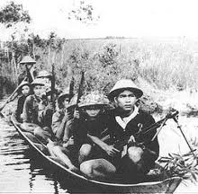
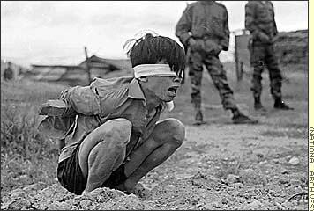
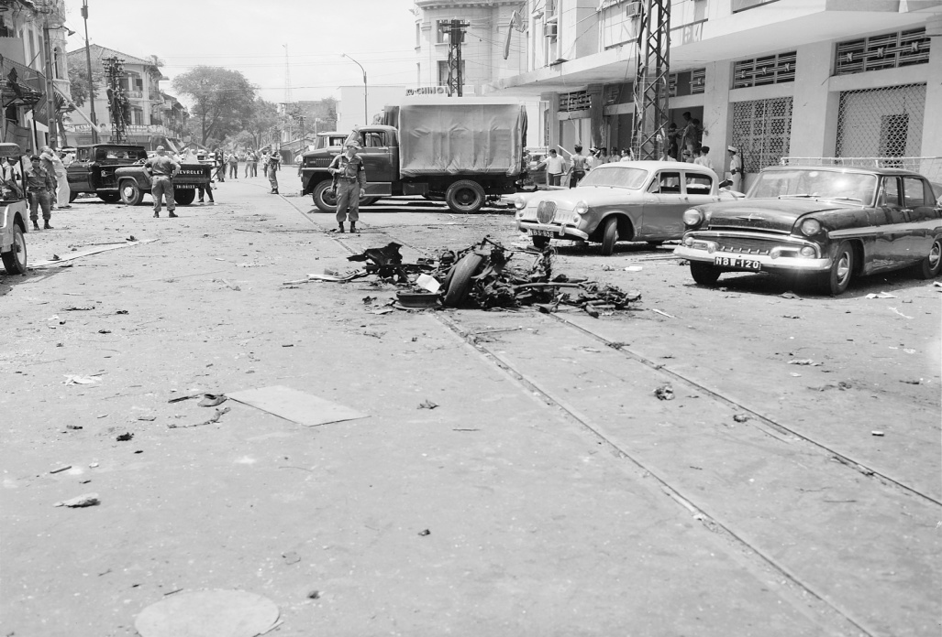
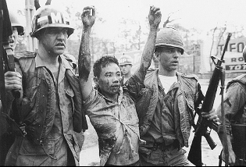
Vietcong

Slide 11
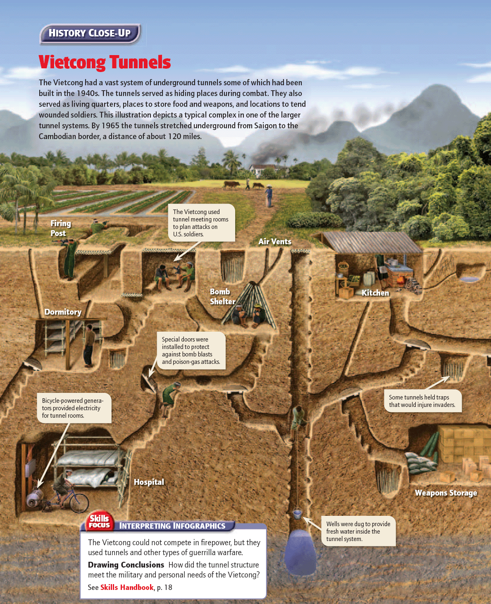

Slide 12
U.S. Involvement in Vietnam
Began sending money and weapons to South Vietnam
Military advisors sent to train South Vietnamese army
Eisenhower
Believed in the Domino Theory
Increased the number of military advisors and army special forces, or Green Berets
Advisors were not to take part in combat, but many did
Kennedy
Believed an expanded U.S. effort was the only way to prevent a Communist victory in Vietnam
Asked Congress to pass the Tonkin Gulf Resolution
Johnson

Slide 13
Increasing U.S. Involvement
Diem’s Overthrow
Diem’s government continued to grow more and more unpopular.
He arrested and killed Buddhist protesters.
U.S. leaders said they would withdraw support if Diem did not change his ways.
Diem refused to change his stand against Buddhists, and the United States began to support a plot to overthrow Diem.
In November 1963 the South Vietnamese plotters murdered Diem.
Tonkin Gulf Resolution
To increase the American military effort in Vietnam, Johnson needed to obtain authority from Congress.
Johnson asked Congress for this authority claiming that the USS Maddox had been attacked by North Vietnamese torpedo boats in the Gulf of Tonkin.
Johnson claimed this attack was unprovoked, but really the Maddox had been on a spying mission and had fired first.
The Tonkin Gulf Resolution was passed on August 7.

Slide 14
U.S. Support of the War at Home and Abroad
The Main Idea
As the United States sent increasing numbers of troops to defend South Vietnam, some Americans began to question the war.

Slide 15
Why did U.S. superiority in the air war fail to win quickly in Vietnam?
Operation Rolling Thunder
A bombing campaign over North Vietnam
Bombed military targets—army bases and airfields—as well as bridges, roads, railways, and power plants
Main target was the Ho Chi Minh Trail
Weapons of the Air War
Agent Orange—defoliant, or chemical, that destroys vegetation
Napalm—jellied form of gasoline used to create firebombs
“Cluster bombs”—sprayed sharp metal fragments when exploded
The Air War
Bombing did not succeed
Flow of goods from North to South Vietnam actually increased
Vietcong repaired bridges, had bunkers underground, and used weapons from the Soviet Union and China

Slide 16
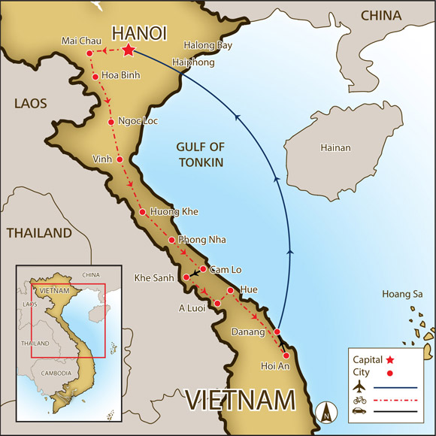
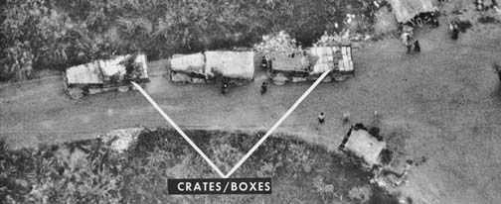
Ho Chi Minh Trail
http://www.youtube.com/watch?v=eaKlsoVvWTE&feature=related

Slide 17
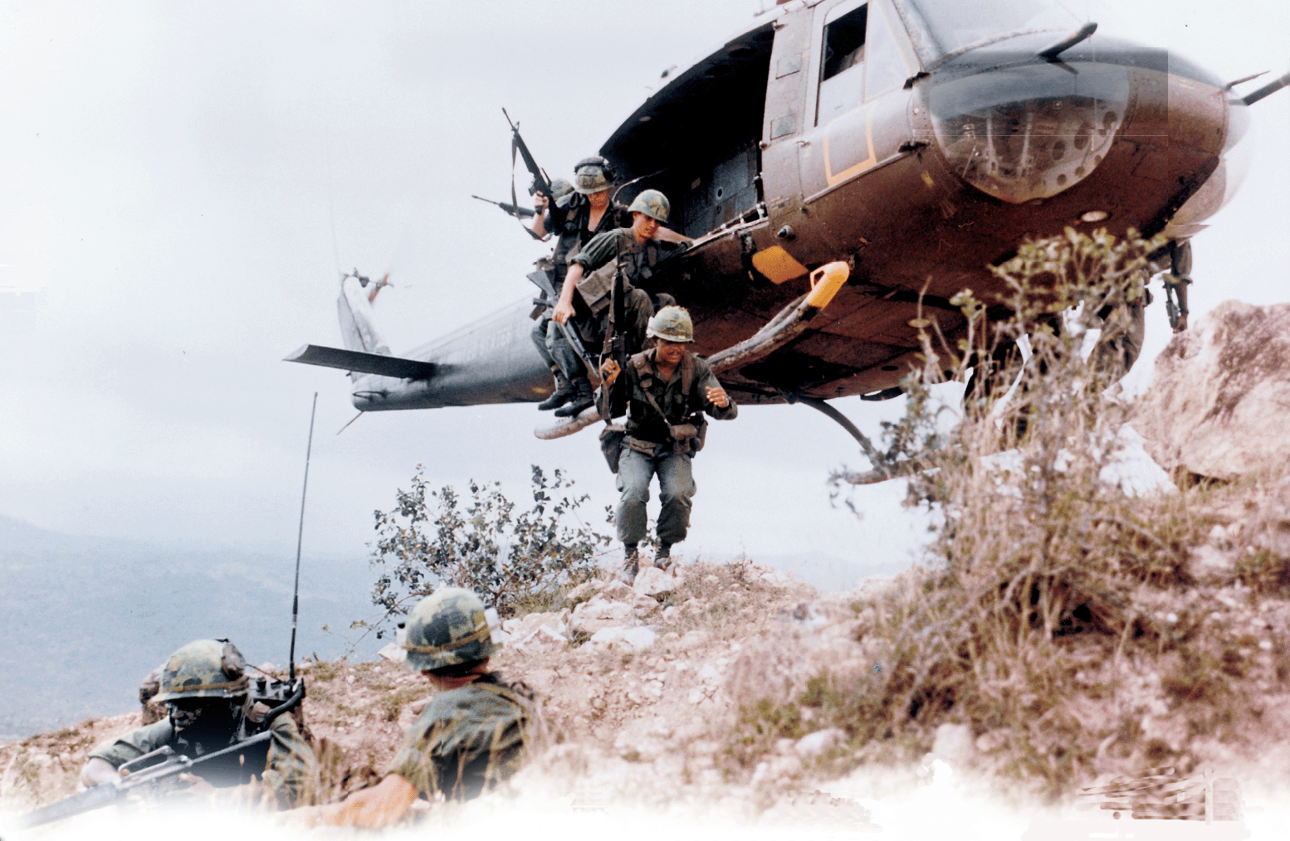
http://www.youtube.com/watch?v=KlM1-lj5x8c&feature=related

Slide 18
Difficult Ground War in Vietnam
The number of U.S. ground forces in Vietnam continued to grow.
U.S. strategy called for ground forces to go on search-and-destroy missions.
General William Westmoreland commanded the U.S. ground troops in South Vietnam.
Ground troops located the enemy and called for air strikes.
Areas that were “cleared” rarely remained that way for long.
U.S. forces implemented a program of pacification to “win the hearts and minds” of the South Vietnamese people.
Nonmilitary pacification involved construction projects.
Military pacification involved moving people out of their villages when Vietcong were nearby.

Slide 19
Declining Troop Morale
American forces in Vietnam faced many challenges.
Vietcong struck and then melted back into the jungle
Vietnamese peasants seemed peaceful during the day, but at night aided or became Vietcong.
Vietcong knew the local geography.
Nearly impossible to tell the difference between a Vietcong fighter and a civilian.
Enormous casualties inflicted upon the Communist forces did not lead to victory.
With the aid of the Soviet Union and China, North Vietnam sent a steady stream of supplies and soldiers to the South.
Vietcong continued to refill their ranks with civilians.
U.S. air strikes and the pacification program turned many peasants into Vietcong fighters.

Slide 20
U.S. Forces Mobilize for the War
More than 2.5 million Americans served in the Vietnam War.
On average, the soldiers who served in Vietnam were
slightly younger than the U.S. troops who fought in Korea and World War II, and
not as well educated.
At the start of the war, most American troops were professional soldiers—volunteers who enlisted in the armed forces.
However, the U.S. government came to depend on drafted soldiers.

Slide 21
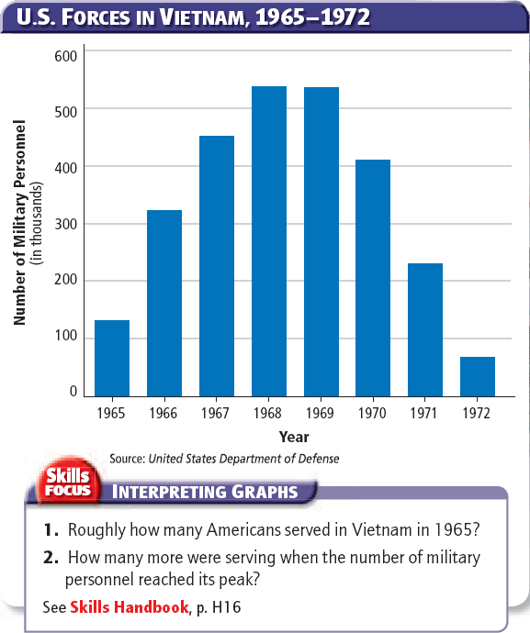

Slide 22
U.S. Forces Mobilize
The Draft
25 percent were excused for health reasons; 30 percent received deferments, or postponements of service.
College students were deferred, so men from higher-income families were less likely to serve.
A high percentage of combat soldiers were African Americans.
A draft lottery began in 1969; the draft ended in 1973.
3 percent of eligible men escaped the draft by either refusing to register or by leaving the United States.
Non-combat Positions
Most Americans in Vietnam served in non-combat positions—administration, communications, engineering, medical care, and transportation.
About 10,000 American military women served.
Some 20,000 to 45,000 more women worked in civilian capacities, many as volunteers for the Red Cross or other humanitarian relief organizations.

Slide 23
Public Opinion Regarding the Vietnam War
Media’s Impact
Reporters and television crews went on patrol with the soldiers.
Television brought scenes of firefights and burning villages into America’s living rooms.
Criticized the government’s reports about the war
Hawks and Doves
Doves—people opposed to the war
Hawks—people who supported the war’s goals
Both criticized the war effort.
Hawks wanted more troops and bombing.
Doves opposed the war for many reasons.
Antiwar Movement
Movement attracted a broad range of participants
Much antiwar activity took place on college campuses.
Most vocal group—Students for a Democratic Society.
Antiwar protesters made up a small percentage of the U.S. population.
http://www.youtube.com/watch?v=Et9w2YPf3Wk&feature=related

Slide 24
Reasons that Doves Opposed the War
Argued that Vietnam was not crucial to American national security (Ex. George Kennan)
Argued that the United States was fighting against the wishes of a majority of Vietnamese (Ex. Dr. Benjamin Spock)
Argued that the war was draining needed resources from Great Society programs (Ex. Martin Luther King Jr.)
Argued that it was unfair for African Americans to fight for democracy in a foreign land when discrimination continued at home (Ex. Civil rights activists)
Argued that Johnson’s policies were too extreme (Ex. J. William Fulbright)

Slide 25
1968: A Turning Point
The Main Idea
As the Vietnam War dragged on and increasingly appeared to be unwinnable, deep divisions developed in American society.

Slide 26
The Tet Offensive
A series of massive coordinated attacks throughout South Vietnam
Tet Offensive
In January 1968 thousands of NVA and Vietcong troops attacked a U.S. military base in Khe Sanh.
This and other rural attacks were diversions to draw U.S. and ARVN forces away from urban areas.
Khe Sanh
Main Communist offensive began on January 30, 1968, at the start of Tet, the Vietnamese New Year.
Some 84,000 Communist soldiers attacked 12 U.S. military bases and more than 100 cities across South Vietnam.
The Main
Attacks
http://www.youtube.com/watch?v=sL7N-aCtlLo

Slide 27
Effects of the Tet Offensive
General Westmoreland called the Tet Offensive a decisive defeat for the Communists.
The cities taken by the Communists were retaken.
About 45,000 enemy soldiers were killed. About 1,100 Americans and 2,300 ARVN troops also died.
The Communists showed that they were determined to keep on fighting.
The Tet Offensive showed that no part of South Vietnam was safe from attack.
The Tet Offensive caused many Americans to question whether or not the war in Vietnam could be won.
President Johnson announced that he would not seek reelection.

Slide 28
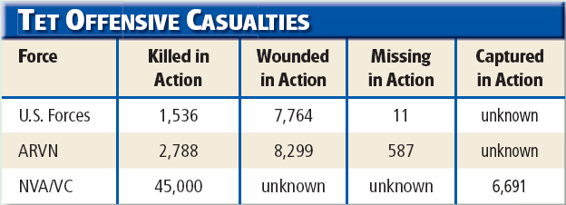

Slide 29
Effects of the Tet Offensive
Growing Doubts
Walter Cronkite broadcast a television report in which he gave his personal assessment of the situation in Vietnam.
Major national magazines such as Time and Newsweek also expressed doubts about the war and began to call for its end.
Public criticism of the government’s policies grew louder and more intense.
Leaders within Johnson’s administration began to criticize Johnson’s policies.
Robert S. McNamara began to seek ways to end the war.
Democratic Challengers
Roughly 3 out of 4 Americans opposed his policies in Vietnam.
Minnesota senator Eugene McCarthy challenged Johnson for the Democratic Party’s nomination.
New York senator Robert Kennedy entered the race.
Shaken by the divisions within his party, Johnson announced that he would not seek nor accept the office of the presidency.

Slide 30
Searching for Solutions
President Johnson denied General Westmoreland’s request for 206,000 more ground soldiers.
Johnson’s advisors could not come up with the best course for the war strategy.
Robert McNamara suggested limiting the air strikes and reversing the escalation of the war.
Johnson decided to negotiate with the North Vietnamese.
The Paris peace talks stalled over two issues: the United States wanted all NVA troops out of South Vietnam, and North Vietnam would not accept a temporary South Vietnam government that included a U.S.-backed president.

Slide 31
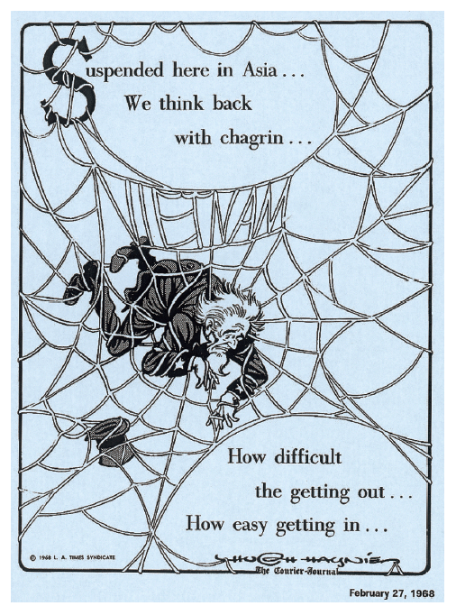

Slide 32
The Election of 1968
The Democratic Primary Fight
Vice President Hubert Humphrey entered the race and defended the administration’s policies in Vietnam.
Senator Eugene McCarthy called for a rapid end to the war.
Senator Robert Kennedy also called for an end to the war and won primaries in Indiana, Nebraska, and California.
Kennedy was shot leaving a Las Vegas hotel by Sirhan Sirhan, a Jordanian immigrant who didn’t like Kennedy’s support for Israel.

Slide 33
The Democratic Convention
Delegates at the Democratic National Convention in Chicago debated between McCarthy and Humphrey.
Outside the convention, protesters from around the country demanded an immediate end to the war.
Chicago mayor Richard Daley sent troops to maintain order but violence soon broke out.
Television crews captured violent scenes between protesters and police.
The chaos was one symptom of a growing “generation gap” over government, politics, and the Vietnam War.

Slide 34
Other Contenders in 1968
Richard Nixon
Republican
Won the nomination at the Republican National Convention
Chose Spiro Agnew as his running mate
Appealed to the patriotism of mainstream Americans
Promised “law and order”
Claimed to have a secret plan to end the war “with honor”
George Wallace
Independent
Former Alabama governor
Nominated by the American Independent Party
Opposed the civil rights movement and school desegregation and war protesters
Appealed to conservative Democratic white southerners and working class whites

Slide 35
The Election of 1968
The Campaign
Nixon led the polls for most of the campaign.
Humphrey made gains when he said the bombing in Vietnam should be stopped and that the South Vietnamese should shoulder more of the war’s responsibilities.
The peace talks in Paris made some progress when the North Vietnamese agreed to include South Vietnamese representatives.
Johnson announced an end to the bombing in Vietnam a few days before the election.
The Results
The election was very close—just 510,000 votes separated Nixon and Humphrey.
Nixon won 43.4 percent of the votes cast to Humphrey’s 42.7 percent.
Nixon won 301 electoral votes to Humphrey’s 191.
Wallace was one of the most successful third party candidates in U.S. history (46 electoral votes and 13.5 percent of the popular vote).
Nixon’s electoral margin provided him with a mandate to rule that allowed him to escalate the war in Vietnam.

Slide 36
The War Ends
The Main Idea
President Nixon eventually ended U.S. involvement in Vietnam, but the war had lasting effects on the United States and in Southeast Asia.

Slide 37
How did President Nixon’s policies widen U.S. involvement in the war?
During his 1968 campaign, Nixon pledged to end the war in Vietnam.
Nixon and his National Security Advisor Henry Kissinger devised plans to end the war.
In 1969 Kissinger began secret peace negotiations in Paris with North Vietnamese revolutionary Le Duc Tho.
The U.S. strategy aimed at achieving “peace with honor.”
Vietnamization
Laos and Cambodia

Slide 38
Widening the War
Vietnamization
Strategy of turning over more of the fighting in Vietnam to the South Vietnamese while gradually bringing U.S. ground troops home
Nixon hoped this would give South Vietnamese leaders time to create a stable, non-Communist government.
Nixon began to slowly withdraw U.S. forces from South Vietnam.
Antiwar activists opposed the plan calling for an immediate end to the war.
Nixon believed he had the backing of the silent majority of Americans.
Laos and Cambodia
At the same time, Nixon was secretly expanding the war.
He ordered the bombing of Cambodia to disrupt the flow of supplies on the Ho Chi Minh trail.
Concealed the air strikes from the American people—including members of Congress
Sent U.S. and ARVN troops into Cambodia and into Laos to destroy North Vietnamese army bases
Renewed bombing of North Vietnam
Nixon hoped to force North Vietnam to seek peace.

Slide 39
War Protests
In 1970 Nixon announced that he had ordered troops into Cambodia.
Antiwar protests intensified—especially on college campuses.
Antiwar protests erupted into violence.
Nixon believed that antiwar protesters represented only a minority of Americans.
Radical antiwar groups turned to violent measures to oppose the war.
More and more Americans began to oppose the war when they learned about the My Lai massacre and the Pentagon Papers.

Slide 40
Increasing Protests
Campus Violence
Kent State University in Ohio
4 students were killed and 9 injured
Jackson State College in Mississippi
2 students were killed and 9 wounded
Antiwar Movement
Polls showed that fifty percent of Americans opposed the war.
Coalition of clergy, trade unionists, and veterans established a nationwide day of protest called Moratorium Day.
250,000 protesters made up the largest antiwar demonstration in U.S. history.
Radical Protests
Some antiwar groups turned to violent measures.
The Weathermen set off more than 5,000 bombs and carried out the Days of Rage.
Most antiwar protesters did not support extremist groups or terrorist measures.

Slide 41
Increasing Protests
My Lai Massacre
Troops under Lieutenant William Calley killed at least 450 men, women, and children in the village of My Lai while on a search-and-destroy mission.
No Vietcong were found in the village.
The My Lai massacre was kept quiet at first, but former soldiers began talking about it.
This atrocity intensified the divisions between war supporters and opponents.
Calley was convicted of murder and sentenced to life in prison; he was paroled in 1974.
Pentagon Papers
A collection of secret government documents that traced the history of U.S. military involvement in Vietnam since the Truman years
Revealed that government officials had been misleading the American people about the war for years
Daniel Ellsberg leaked the papers to the press.
Ellsberg originally supported the war, but then concluded that few South Vietnamese civilians supported the U.S.-backed government.

Slide 42
U.S. Involvement in Vietnam Ends
Senator from South Dakota who criticized war
Insisted that the Vietnam War be brought to an immediate end
George
McGovern
Lowered the voting age from 21 to 18
McGovern hoped the ratification of this amendment would boost his election chances.
26th
Amendment
Nixon stressed law and order at home and told voters he would end the war.
Kissinger announced a breakthrough in the peace talks just weeks before the election.
The announcement helped Nixon win by a landslide.
1972
Election

Slide 43
A Peace Agreement
Nixon tried to force North Vietnam to make peace concessions by ordering the so-called Christmas bombing. It failed to work.
Officials from North Vietnam, South Vietnam, and the United States finally reached an agreement in January 1973.
The United States agreed to withdraw all of its troops and help rebuild Vietnam. Both sides agreed to release all prisoners of war.
The agreement did not settle the political future of South Vietnam—the key issue behind the war from the start.

Slide 44
The Vietnam War’s Legacy
Two years after U.S. troops were withdrawn, North Vietnamese troops invaded South Vietnam.
After a short amount of fighting, South Vietnam surrendered.
The U.S. military rushed to evacuate Americans still working in Saigon.
Some 130,000 South Vietnamese were also evacuated and flown to the United States.
After two decades of “temporary” division, Vietnam was reunited under a Communist government.
In 1975, Communist forces called the Khmer Rouge gained control of Cambodia.
Vietnam forces invaded Cambodia in 1979, overthrew the Khmer Rouge, and occupied the country till 1989.

Slide 45
The Legacy of the War
Southeast Asia
635,000 South Vietnamese died; Vietcong and NVA war dead equaled 1 million
Severe environmental damage from bombs and defoliants
More than 1.5 million South Vietnamese fled the country after the fall of Saigon.
Veterans
58,000 Americans were killed; 600 were held as POWs; 2,500 soldiers reported MIA; 300,000 wounded
Experienced a negative reception upon return
Trouble readjusting to civilian life (post-traumatic stress disorder)
Political Impact
United States failed to prevent Communists from taking over South Vietnam.
Spent more than $150 billion on the war
Changed how many Americans viewed government
Congress passed the War Powers Act in 1973.

Slide 46
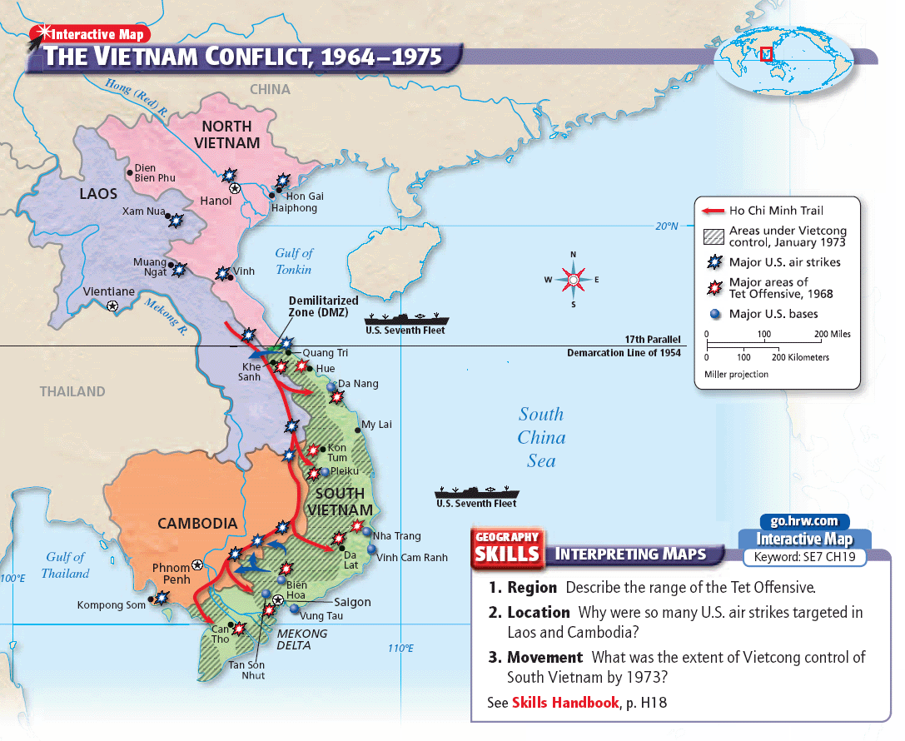

Slide 47
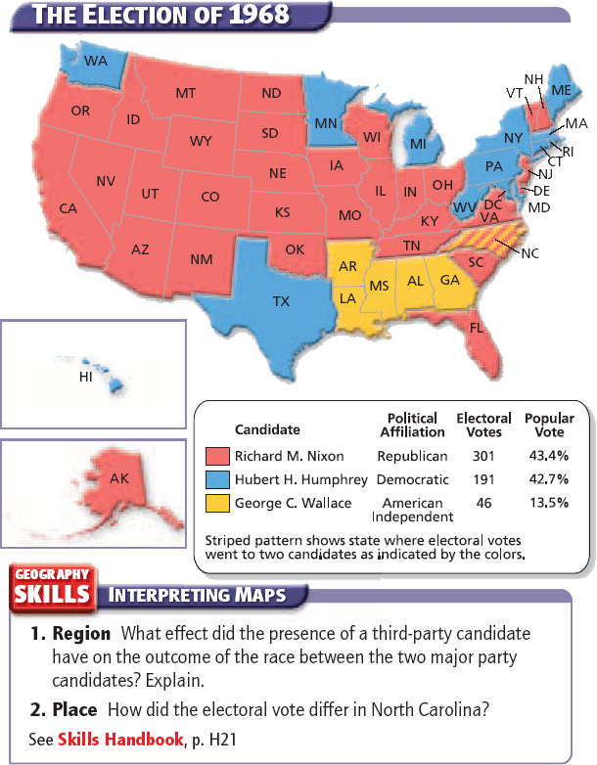

Slide 48
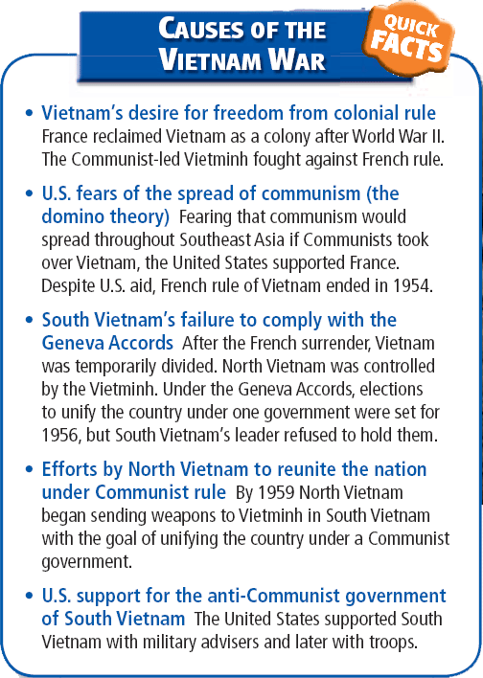

Slide 49
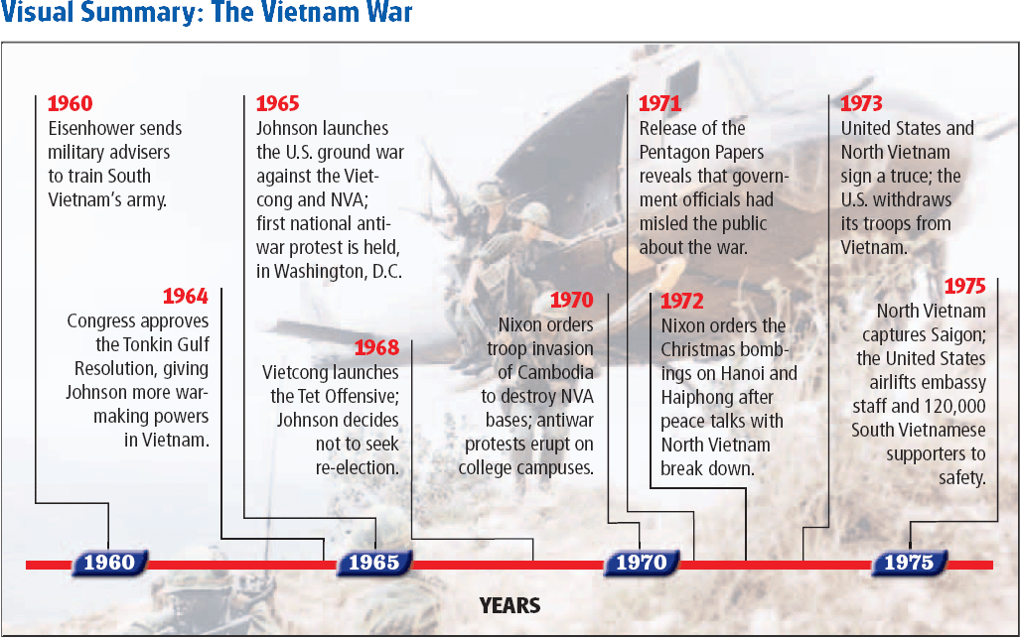

Slide 50
Click on the window to start video

