Slide 1
The Kennedy Assasination
Lesson 3: Test 13

Slide 2
I Can:
Identify the details behind the Kennedy assassination and explain how America responded to the events that unfolded.

Slide 3
Public opinion
In the fall of 1963, public opinion polls reported that Kennedy was losing popularity because if his advocacy of civil rights.
Nevertheless, most people still supported him and the polls still forecasted that Kennedy would win reelection in 1964.
Kennedy after 1963 Civil Rights Address with the NAACP delegation

Slide 4
Kennedy in Dallas
November 22, 1963: President Kennedy landed in Dallas, Texas to restore relations with their Democratic Party who opposed his civil rights legislation.
President Kennedy and his wife, Jacqueline, sat in the back seat of an open-air limousine behind Texas Governor John Connally and his wife, Nellie.

Slide 5
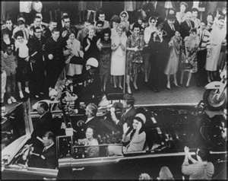
Tragedy
As the group made their way through downtown Dallas, 3 shots rang out and President Kennedy was shot in the head and neck.
He was rushed to a nearby hospital where doctors tried to revive him, but President Kennedy was dead.
As the tragic news spread through America, people reacted with disbelief questioning who had killed JFK? Why? What’s next?

Slide 6
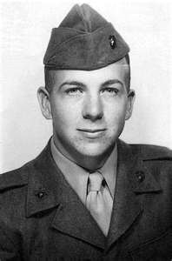
Lee Harvey oswald
The Dallas police charged Lee Harvey Oswald with the murder because palm print had been found on the rifle used to kill JFK.
Oswald also worked in the warehouse where the shots had been fired from.
Oswald was a 24-year-old ex-Marine who had received a dishonorable discharge, lived in the Soviet Union, and supported Fidel Castro.

Slide 7
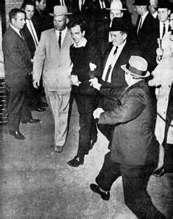
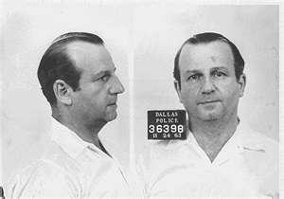
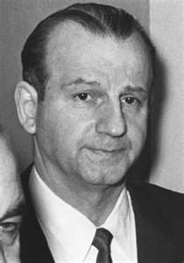
The response
On November 24, as America watched live television coverage of Oswald being transferred between jails, a nightclub owner named Jack Ruby shot and killed him
This bizarre chain of events led many to believe that Oswald had been part of a conspiracy.

Slide 8
Warren commission
As a result, in 1963, the Warren Commission investigated Kennedy’s murder concluding that Oswald had acted on his own.
However, a later reinvestigation in 1979 proved that Oswald was, indeed, part of a conspiracy and that two more people may have shot at the president.
Conspiracy theories hold that this could have been a plot by anti-Castro Cubans to a Communist-sponsored attack, to a conspiracy by the CIA.

Slide 9
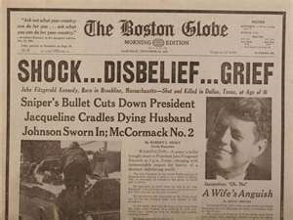
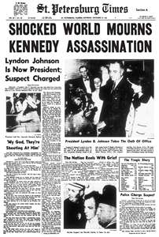
Aftermath in America
All work stopped for Kennedy’s funeral as America mourned his death.
The assassination and televised funeral became a historic event and Americans who lived through it can still recall what they were doing when they first heard the news.
To this day, questions still surround the events as people wonder if Oswald really did kill Kennedy and if it was, indeed, part of a conspiracy.

Slide 10
Crazy facts: Kennedy & Lincoln
Both Lincoln and Kennedy were concerned with civil rights.
Lincoln was elected president in 1860, Kennedy in 1960.
Both were slain on a Friday, in the presence of their wives.
Both were shot from behind and in the head.
They were both succeeded by Southern Democrats named Johnson, who held seats in the U.S. Senate.
Andrew Johnson was born in 1808, Lyndon Johnson in 1908.
John Wilkes Booth was born in 1839. Lee Harvey Oswald was born in 1939.
Booth and Oswald were Southerners favoring unpopular ideas.
Both presidents lost children through death while in the White House.
President Lincoln’s secretary whose name was Kennedy, advised him not to go to the theater.
Kennedy’s secretary, whose name was Lincoln, advised him not to make the trip to Dallas.
John Wilkes Booth shot Lincoln in a theater and ran to a warehouse.
Lee Harvey Oswald shot Kennedy from a warehouse and ran to a theater.
The names Lincoln and Kennedy each contain seven letters.
The names Andrew Johnson and Lyndon Johnson each contain 13 letters.
Both Johnsons were opposed for re-election by men whose names start with “G.”
Both assassins were killed before they could be brought to trial.

