Slide 1
The Cold War Continues
Lesson 2: Part 2
Test 12

Slide 2
“I Can”
Identify the ways in which the Cold War continued to affect the United States and the rest of the world.

Slide 3
Fear of Communist Influence
In the early years of the Cold War, many Americans feared the security of the United States because of the recent spread of communism throughout the world.
Even the Cincinnati Reds changed their name to the Cincinnati Redlegs throughout the 1950s.

Slide 4
Fear of Communist Influence
In March 1947, President Truman established the Federal Employee Loyalty Program and Loyalty Review Board to investigate government employees and dismiss those found to be disloyal to the U.S.
Between 1947 and 1951, 3.2 million employees were investigated. 212 were dismissed as security risks while 2,900 resigned because they didn’t want to be investigated or felt that the investigation violated their constitutional rights.

Slide 5
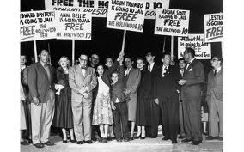
Hollywood
The House Un-American Activities Committee (HUAC) was also established to investigate Communist influence in the movie industry.
Some refused to cooperate with the investigation, because they saw it as unconstitutional.
They became known as the Hollywood Ten and were sent to prison.
Hollywood then created a “blacklist” of people condemning them for having a Communist background. Consequently, over 500 actors, writers, producers, and directors were out of a job.

Slide 6
The McCarran Act
In 1950, Congress felt that the previous steps taken did not go far enough in the hunt for communists and passed the McCarran Internal Security Act .
This act made it unlawful to plan any action that might lead to the establishment of a totalitarian dictatorship in the U.S.
Though Truman vetoed the bill, Congress enacted it anyway.

Slide 7
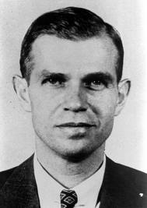
Spy Cases
Adding to this fear, Alger Hiss, a former State Department Official was accused of passing government documents, convicted of perjury, and went to jail.
In addition, after learning that the Soviets had exploded an atomic bomb much earlier than expected, suspicions rose that someone had leaked information about the atomic bomb to the Soviets.
Ethel and Julius Rosenberg helped Klaus Fuchs give the Soviets information about the atomic bomb helping them to create their own. The two were convicted of espionage and sentenced to death.

Slide 8
McCarthyism
The most famous anti-Communist activist was Republican Senator Joseph McCarthy from Wisconsin.
McCarthy needed a winning issue to help him gain reelection in 1952.
To do this, he took advantage of the American fear of Communism and charged that Communists were taking over the government.
This tactic became known as McCarthyism—accusing people of disloyalty without providing evidence.

Slide 9
McCarthyism
McCarthy claimed that 205 Communists in the State Department.
He accused the Democratic Party of allowing Communist infiltration into the government.
In 1954, he made accusations against U.S. Army which resulted in a Senate investigation.
However, the public soon recognized his bullying tactics and baseless accusations costing McCarthy the support of the public.

Slide 10
McCarthy Video
http://player.discoveryeducation.com/index.cfm?guidAssetId=7FFAADD9-97D6-41FB-85D6-DA752D5C681A&blnFromSearch=1&productcode=US
Turn in your book to pg. 620

Slide 11
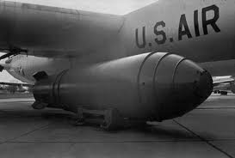
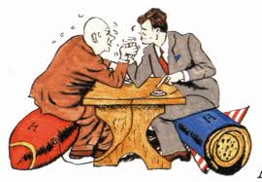
The Arms Race
After the Soviet Union exploded its first atomic bomb in 1949, the U.S. and the U.S.S.R entered into a deadly arms race to see which country could be the first to produce a Hydrogen bomb.
On November 1, 1952, the United States won the race when it exploded the first H-bomb.
Turn in book to pg. 631.

Slide 12
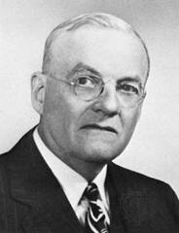
Brinkmanship
During this time, Dwight D. Eisenhower had become president and with his strong anti-communist secretary of state, John Foster Dulles, undertook a stance known as brinkmanship.
Brinkmanship refers to the United States’ willingness to go to the edge of all-out war as the country trimmed its army and navy, expanded the air force and built up their nuclear weapons.

Slide 13
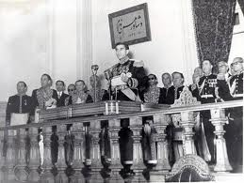
The Middle East & Latin America
1951: Iran’s prime minister Mohammed Mossadegh, nationalized Iran’s oil field.
The British protested by refusing to buy Iranian oil which diminished the Iranian economy.
The U.S. feared that Mossadegh might seek Soviet assistance. In response, the CIA gave millions to anti-Mossadegh supporters helping return the pro-American Shah of Iran to power who returned control of Iranian oil fields to Western companies.
The CIA also helped overthrow the Guatemalan government who they feared had Communist sympathies.

Slide 14
The Warsaw Pact
After Stalin died in 1953, U.S. relations with the Soviets began to get better.
However, West Germany was allowed to rearm and join NATO which resulted in the Soviet Union forming its own military alliance—the Warsaw Pact—which linked them with seven Eastern European countries.

Slide 15
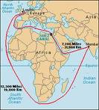
The Suez War
Great Britain and the U.S. agreed to help Egypt finance construction of a dam. However, when Egypt’s leader, Nasser, accepted aid from the Soviets too, the U.S. retracted their offer.
Nasser responded by nationalizing the Suez Canal, the Egyptian waterway that was owned by France and Great Britain—who were outraged.
He refused to allow Israeli ships pass through the canal and all three countries responded by sending troops.
The UN intervened to stop the fighting and persuaded the three to withdraw and allowed Egypt to keep control of the Canal.

Slide 16
The Eisenhower Doctrine
To counterbalance the rise of Soviet prestige in the Middle East, President Eisenhower issued a warning in January 1957 known as the Eisenhower Doctrine. He stated that the United States would defend the Middle East against an attack by any communist country.

Slide 17
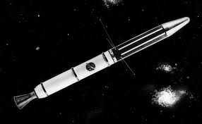
The Space Race
On October 4, 1957, the Soviets launched Sputnik, the world’s first artificial satellite.
America was shocked and quickly began funding their own space program so that U.S. scientists could catch up to the Soviets.
On January 31, 1958, the U.S. launched its first satellite, Explorer 1.

Slide 18
Space Race Video Clip
http://player.discoveryeducation.com/index.cfm?guidAssetId=2C674F56-E14D-404B-8955-C0C6321C9B06&blnFromSearch=1&productcode=US

