Slide 1
Taking on Segregation
Lesson 1: Test 14

Slide 2
I Can:
Identify the actions taken against segregation in the 1950s & 1960s and explain how they worked to shape America then and now.

Slide 3
The Segregation System
Civil Rights Act of 1875: all persons shall be entitled to the full and equal employment of the accommodations of inns, public conveyances on land or water, theaters, and other places of public amusement.
1883: the all-white Supreme Court declared the act unconstitutional.
Plessy v. Ferguson (1896): Supreme Court rules that this “separate but equal” law did not violate the 14th Amendment, which guarantees all Americans equal treatment under the law.
Consequently, states passed Jim Crow laws aimed at separating the races.

Slide 4
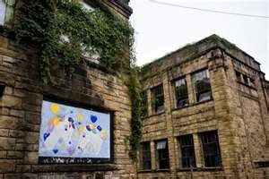
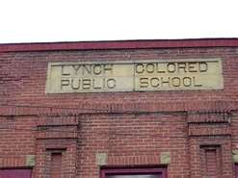
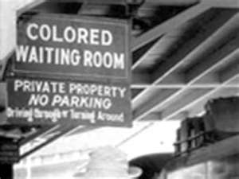
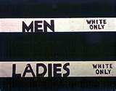
Jim Crow Laws
Forbade marriage between blacks and whites
Established many restrictions on social and religious contact between the races.
Separate schools, streetcars, waiting rooms, railroad coaches, elevators, witness stands, and public restrooms.
The facilities provided for blacks were always inferior to those for whites.

Slide 5
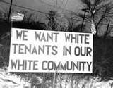
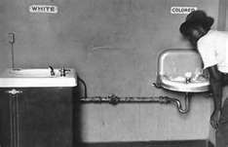
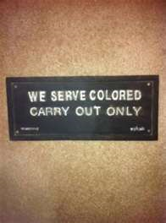
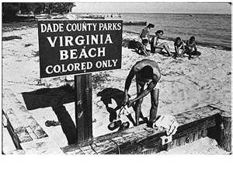
20th Century Segregation
After the Civil War, some African Americans tried to escape Southern racism by moving north.
However, they experienced racial prejudice and segregation there as well.
Housing was mostly only available in all-black neighborhoods.
Most white workers also resented the competition for jobs.

Slide 6
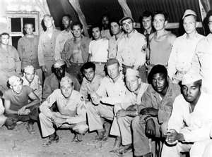
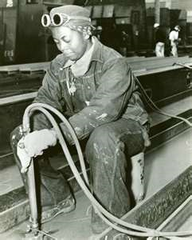
A Developing Civil Rights Movement
WWII set the stage for the civil rights movement.
White male laborers were away at war which opened up new job opportunities for African Americans.
The desperate need for fighting men called for nearly one million African Americans to serve in the armed forces—which caused many African American veterans to return from the war determined to fight for their own freedom.
Also, during the war, Civil rights organizations actively campaigned for voting rights and challenged Jim Crow laws.

Slide 7
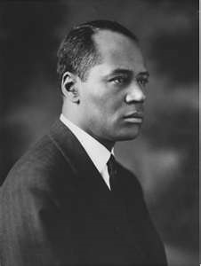
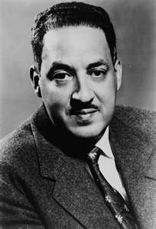
Challenging Segregation in Court
The NAACP Legal Strategy
Brown v. Board of Education
Howard University law professor Charles Hamilton Houston led the NAACP legal campaign.
He focused on inequality of segregated public education.
1938: places a team of law students under Thurgood Marshall who would go on to win 29 out of 32 Supreme Court cases.
May 17, 1954: Marshall’s greatest victory with Brown v. Board of Education of Topeka.
Supreme Court unanimously ruled that segregation in schooling was an unconstitutional violation of the 14th Amendment’s Equal Protection Clause.

Slide 8
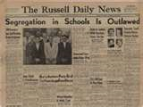
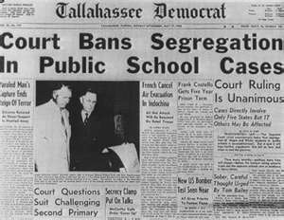
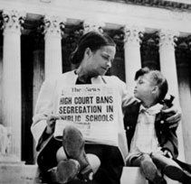
Mixed Reaction to Brown
Within 1 year, more than 500 school districts had desegregated.
However, in many areas where African Americans were a majority, whites resisted desegregation.
1955: Supreme Court rules again with Brown II ordering school desegregated to be implemented “with all deliberate speed.”
President Eisenhower refuses to enforce compliance considering the task impossible.

Slide 9
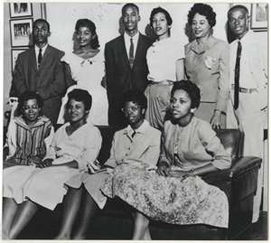
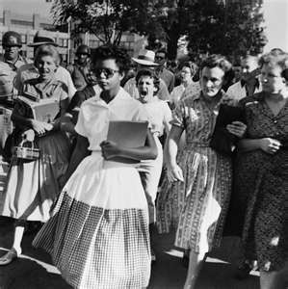
Crisis in Little Rock
Arkansas:
First Southern state to integrate state universities
Scout troops & labor unions ended Jim Crow practices
Little Rock citizens elect school board members that publically back desegregation and school superintendent makes plans for desegregation soon after Brown
However, Governor Orval Faubus publically supported segregation.
September 1957: orders National Guard to turn away the “Little Rock Nine”—nine African American students who had volunteered to integrate Little Rock’s Central High School.
A federal judge orders him to let them into school.
15-year-old Elizabeth Eckford faced an abusive crowd as she walked to school.

Slide 10
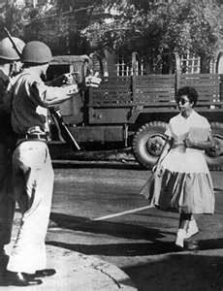
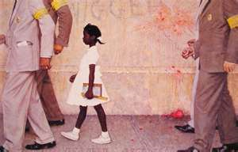
Crisis in Little Rock
Crisis in Little Rock forced Eisenhower to act.
He placed the Arkansas National Guard under federal control and ordered 1000 paratroopers into Little Rock to supervise school attendance.
However, this did not prevent the daily harassment by whites all year.
September 9, 1957: Congress passed the Civil Rights Act of 1957—the first civil rights law since Reconstruction—giving the attorney general greater power over school desegregation and the federal government authority over violations of African American voting rights.

Slide 11
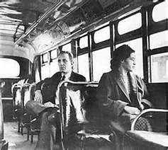
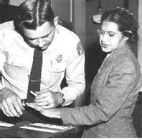
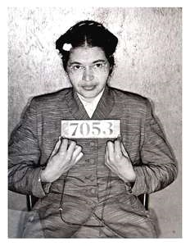
Boycotting Segregation
December 1, 1955—Montgomery, Alabama: Rosa Parks took a seat in the front row of the “colored” section of a Montgomery bus.
When ordered to move so that a white man could have her seat, she refused to move and was arrested.
In response, the leaders of the African American community formed the Montgomery Improvement Association to organize a bus boycott.
They elected 26-year-old pastor Martin Luther King, Jr. to lead the group.

Slide 12
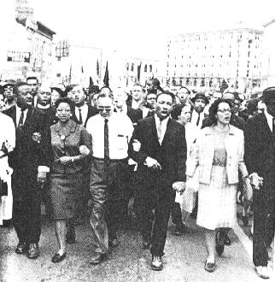
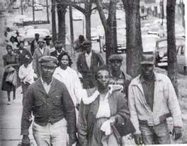
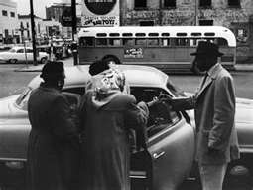
Walking for Justice
African Americans filed a lawsuit.
For 381 days, they refused to ride the buses in Montgomery instead car pooling or walking.
The gathered support from the black community, outside groups like the NAACP, United Auto Workers, and Montgomery’s Jewish community along with sympathetic white southerners.
Finally, in 1956, the Supreme Court outlawed bus segregation.

Slide 13
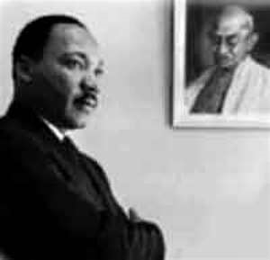
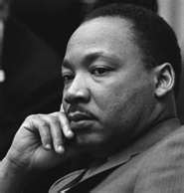
Martin Luther King and the SCLC
The African American community utilized non-violent resistance which King called “soul force.”
He based his ideas on Jesus-from whom he learned to love one’s enemies, Thoreau-from whom he took the concept of civil disobedience, Philip Randolph-from whom he learned to organize massive demonstrations, and Gandhi-from whom he learned to resist oppression without violence.
He even remained nonviolent in the face of the violence that erupted after the Brown decision.

Slide 14
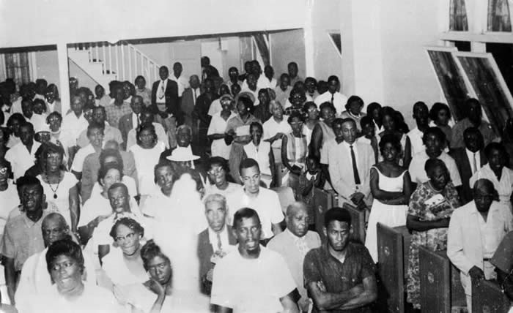
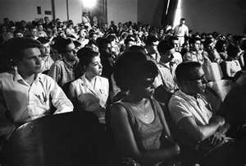
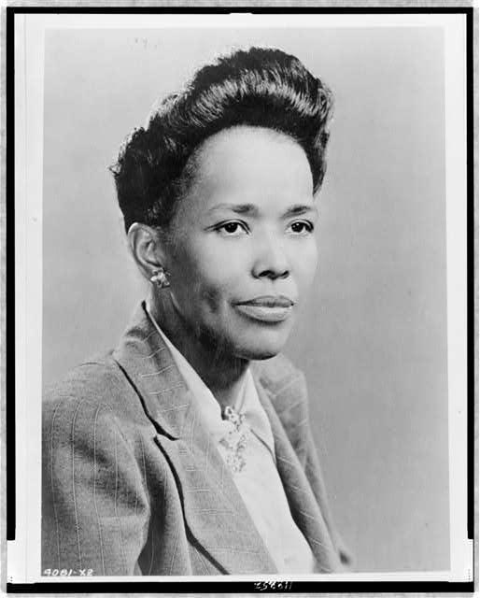
From the Grassroots Up
Next, King and other ministers and civil rights leaders founded the Southern Christian Leadership Conference in 1957 to stage protests, demonstrations, and gain support of African Americans of all ages to build a momentous movement.
However, by 1960, many college students felt that the pace of change was moving too slow.
Determined to challenge the system, with the help of the SCLC’s first director Ella Baker, they organized the Student Nonviolent Coordinating Committee (SNCC) in hopes of harnessing the energy of student protestors.

Slide 15
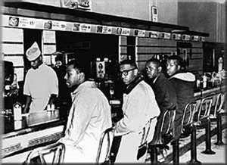
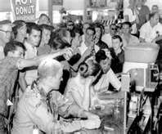
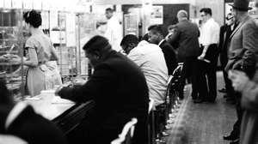
Demonstrating for Freedom
SNCC adopts King’s nonviolence idea in part but called for a more confrontational strategy to reshape the civil rights movement.
They were influenced by the Congress of Racial Equality (CORE) to use sit-ins in which African American protestors sat down at segregated lunch counters and refused to leave until they were served.
February 1960: SNCC staged their first sit-in at Woolworth’s in Greensboro, NC which was broadcasted on TV.
Despite verbal and physical abuse, the movement continued, spreading to the North.
By late 1960, students had desegregated lunch counters in 48 cities in 11 states. They endured arrests, beatings, suspension from college, and tear gas and fire hoses, but the army of nonviolent students refused to back down.

