Slide 1
Southwest Asia
TOP TEN

Slide 2
1. Dead Sea
Dead Sea
landlocked, saltwater lake
lowest place on the Earth’s surface at 1,312 feet below sea level
9 times saltier than the ocean

Slide 3
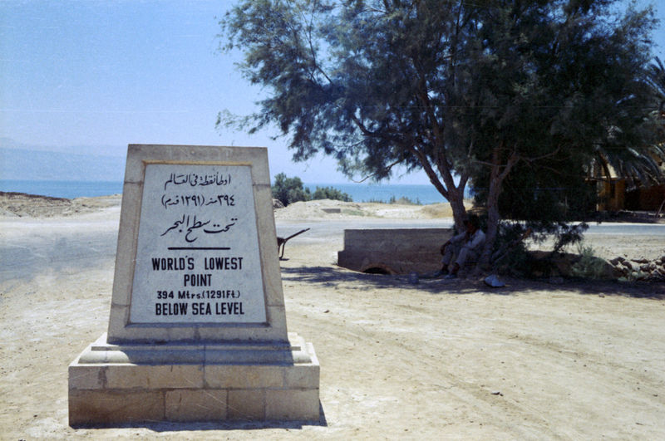

Slide 4
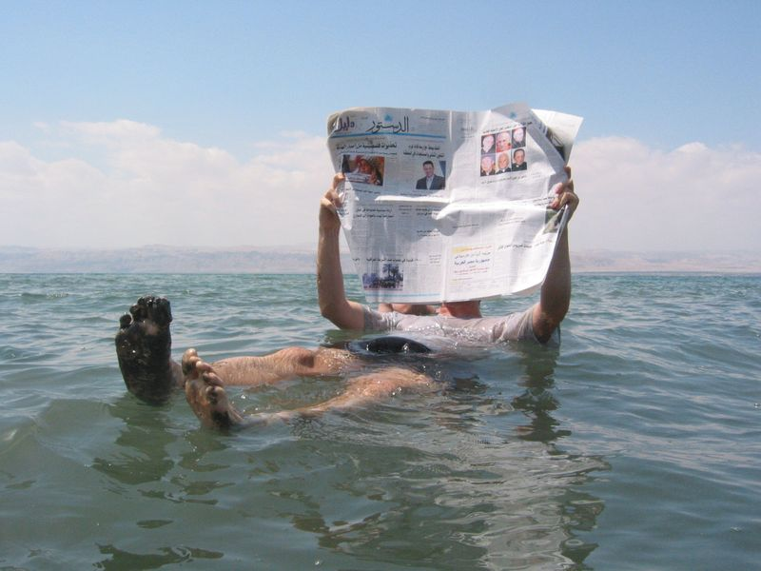

Slide 5
2. Tigris & Euphrates Rivers
Supported ancient river valley civilizations Mesopotamia “land between two rivers”
Sumerian civilization – one of the 1st major civilizations (developed one of the 1st forms of writing)
Originate in the mountains of eastern Turkey & flow southeast through Syria & Iraq
Area believed to be the first place to practice domestication of plants & animals (farming & livestock)

Slide 6
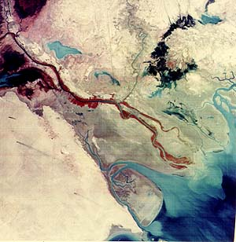
Tigris & Euphrates

Slide 7
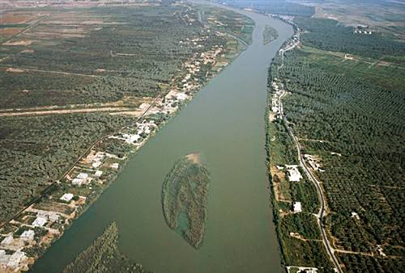
Tigris River

Slide 8
Euphrates River

Slide 9
3. OIL
The most important natural resource (after water) in the region is petroleum
½ of the world’s oil reserves are found in the region
Region produces about 30% of the world’s supply
Saudi Arabia is one of the world’s top producers of crude oil
Wealth from oil has brought about a great deal of industrial growth
Only about 5% of the oil is actually refined in the region
Most is exported in crude form to industrialized countries

Slide 10
OIL – cont.
Region grew in global importance as oil became more important globally
Large increases in oil prices allow oil-producing nations to put money into other projects like water development
1960 – OPEC (Organization of Petroleum Exporting Countries) was formed
Control worldwide oil prices and production quotas

Slide 11
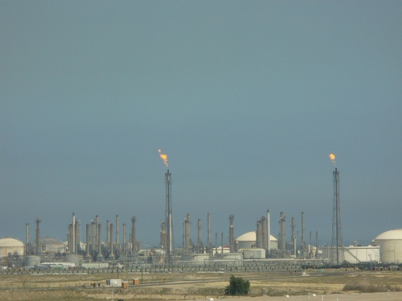
Oil Field in Kuwait

Slide 12
4. Deserts
Deserts cover about 50% of the region
Lebanon, Cyprus, & Turkey are the only countries without a desert
Deserts in this region have limited sand dunes; more extensive are rocky gravel areas called “desert pavement”, mountains, & exposed barren rock

Slide 13
Deserts – cont.
Desert areas are largely unpopulated.
Exception, the cities where oil-related industries provide jobs.
Nomadic herders (Bedouins) who move from place to place in the desert live in or near desert oases.

Slide 14
Deserts – cont.
Rub' al Khali (Empty Quarter) – Saudi Arabia
¼ of the total land area of the Arabian Peninsula
Largest area of sand in the region – about the size of Texas
Sand dunes that are as high as 800 feet
10 years may pass without rain
Temps may exceed 150º F

Slide 15
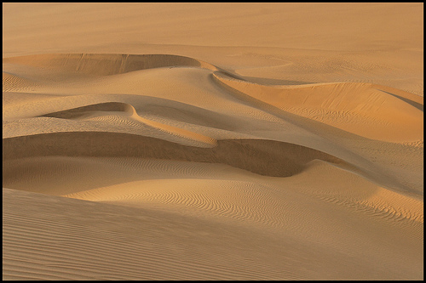
Rub' al Khali

Slide 16
Deserts – cont.
Negev Desert – Israel
An-Nafud – Arabian Peninsula
Syrian Desert

Slide 17
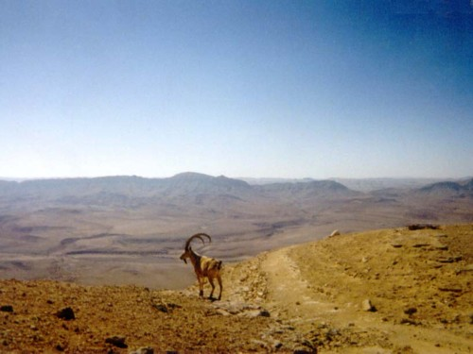
Negev Desert

Slide 18
An-Nafud Desert

Slide 19
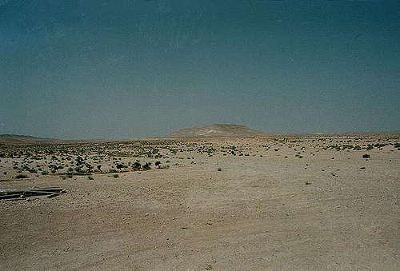
Syrian Desert

Slide 20
5. Population
Most populated countries are Turkey & Iran (each has more than 60 million people).
Bahrain is the most densely populated (2,400 people per square mile).
Population total of about 263 million.

Slide 21
6. Major Languages
Arabic
Hebrew – Israel
Turkish – Turkey & Cyprus
Greek – Cyprus
Pushtu – Afghanistan
Farsi - Iran

Slide 22
7. Islam
Developed in Arabia around C.E. 600
Monotheistic religion that is based on the teachings of its founder – Muhammad
Two main branches – Sunni and Shi’ite
The majority are Sunni Muslims, only about 20% are Shi’ite Muslims
Another smaller minority branch is Sufi’ism – the mystic aspect of Islam
Islam spread from C.E. 650-900 throughout a vast empire from Pakistan to North Africa and Spain
2 holy cities are Mecca and Medina in Saudi Arabia

Slide 23
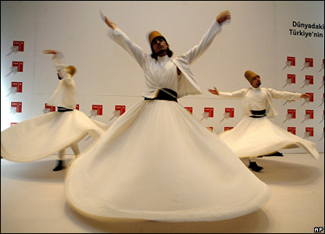
Sufi’ism

Slide 24
Islam - cont.
Majority of Muslims speak Arabic, except in Turkey (Turkish) and Iran (Farsi)
Followers are called Muslims
The Koran is the holy book of the Muslims
The Koran is believed to be a record of the word of Allah as it was revealed to his prophet, Muhammad
Muslims believe that it is a sin if the Koran is read in any language other than Arabic

Slide 25
Islam – cont.
The Koran outlines the Five Pillars (basic duties) of Islam
1. Pray 5 times daily facing Mecca
2. Payment of alms (1/40 of one’s wealth)
3. Fast from sunrise to sunset during the holy month of Ramadan, which is the 9th month of the Islamic year
4. Make a pilgrimage, hajj, to Mecca (if able)
5. State the belief “There is no God but Allah, and Muhammad is the Messenger of Allah”

Slide 26
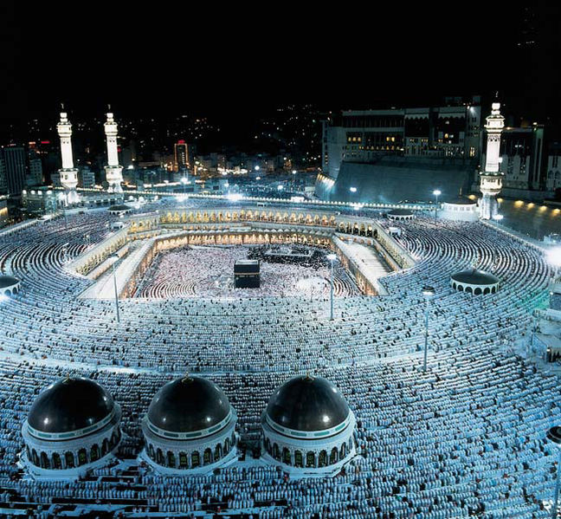

Slide 27
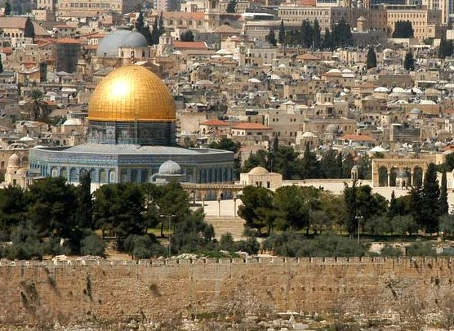
Dome of the Rock - Jerusalem

Slide 28
8. Judaism
Religion of people known as the Hebrews
Hebrews lived along eastern shore of the Mediterranean Sea
Established the kingdoms of Judah and Israel around 1000 B.C.E.
Five holy books, together known as the Torah, recorded early history of the Hebrews and their religion

Slide 29
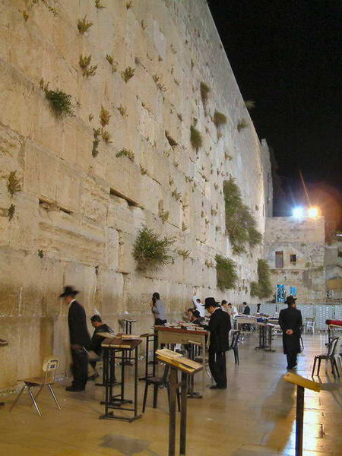
Western Wall
Also called the Wailing Wall. Holiest site in Jerusalem for Jews. It is a portion of the Second Temple which was constructed after the Jews returned to their homeland in 538 B.C. It is the only remaining piece of the Second Temple, which was destroyed by the Romans in A.D. 70.

Slide 30
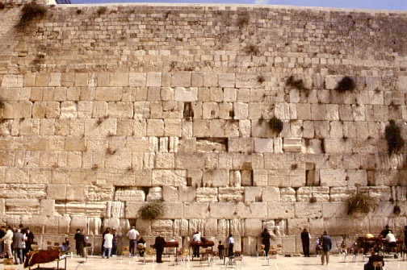

Slide 31
9. Christianity
Religion developed around C.E. 30 in the same region as Judaism (at that time the region was known as Palestine)
Religion is based on the teachings of Jesus, a Jew who traveled through Palestine spreading his beliefs
Jesus was threatening to some people; he was tried and crucified in Jerusalem

Slide 32
Christianity – cont.
Followers are called Christians
The Bible is the holy book of the Christians
Jerusalem is considered by Christians to be a holy city – sacred location of the final suffering & crucifixion of Jesus

Slide 33
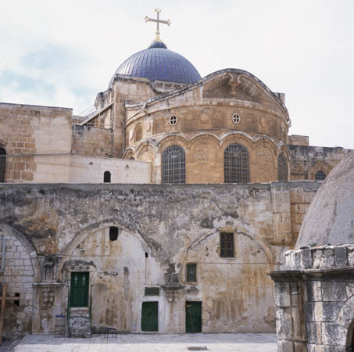
Church of the Holy Sepulchre –built on the site that includes both Golgotha, or Calvary, where Jesus was crucified, and the tomb (sepulchre) where he was buried.

Slide 34
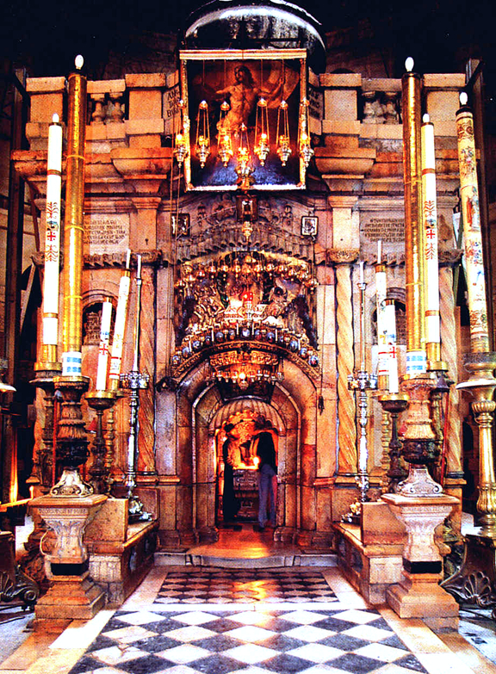
Tomb of Christ in the Church of the Holy Sepulchre

Slide 35
10. A History of Unrest
Israeli Jews trace roots to the Hebrews, who settled the region in ancient times and believed God had given them the land as a permanent home
Over time, wars and persecutions drove many of the Jews out of the area
Israel was founded as a Jewish homeland in 1948
Arabs of the region, did not want a Jewish state on territory that had been their homeland for centuries
Conflict broke out between the Arabs and Jews and still continues today

