Slide 1
SOUTH ASIA
Top Ten

Slide 2
1. Mountains
Himalayas
More than 1,500 miles long & hundreds of miles wide
Mount Everest – world’s highest peak at 29,028 feet
Nearly 2 dozen peaks each rising 24,000 feet or above

Slide 3
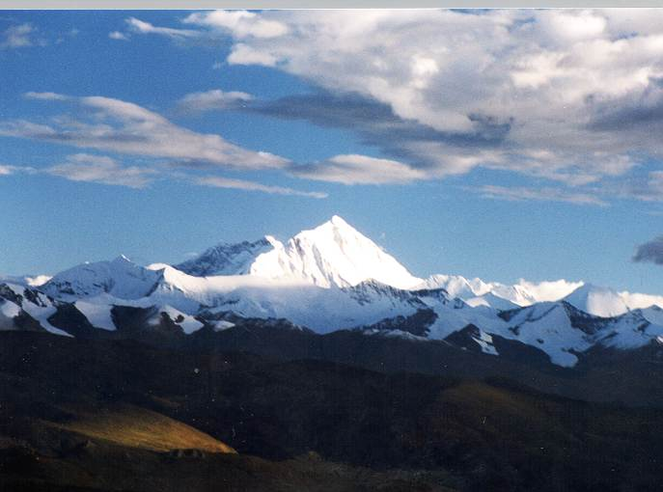
Mount Everest

Slide 4
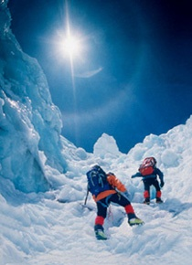
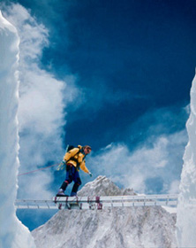
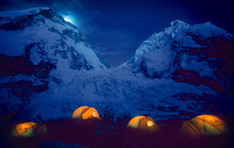
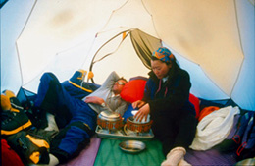
Climbing Mt. Everest

Slide 5
Mountains
Karakoram Mountains – along with the Himalayas create a barrier between the Indian subcontinent & the rest of Asia, home of the 2nd highest peak in the world – K2
Vindya Mountains – central India
Eastern Ghats & Western Ghats – Deccan Plateau

Slide 6
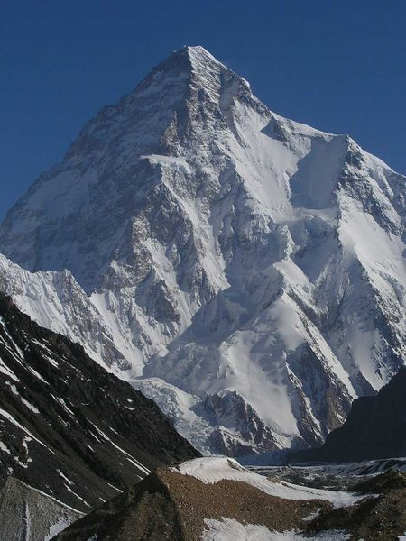
Karakoram Mountains
K2

Slide 7
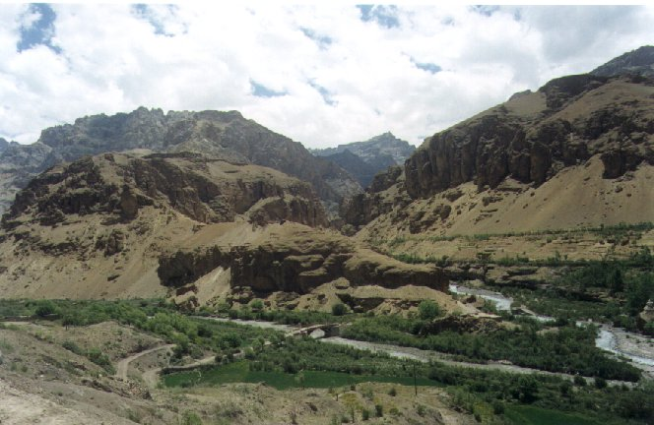
Vindhya Mountains

Slide 8
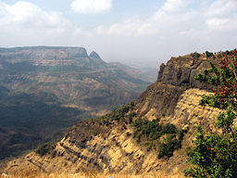
Western Ghats

Slide 9
2. River Systems
Rivers play a key role in supporting life in South Asia
3 Great River Systems:
The Indus – flows through Pakistan and empties into the Arabian Sea
The Brahmaputra
The Ganges
These 2 flow east & eventually join to form a broad delta along the Bay of Bengal

Slide 10
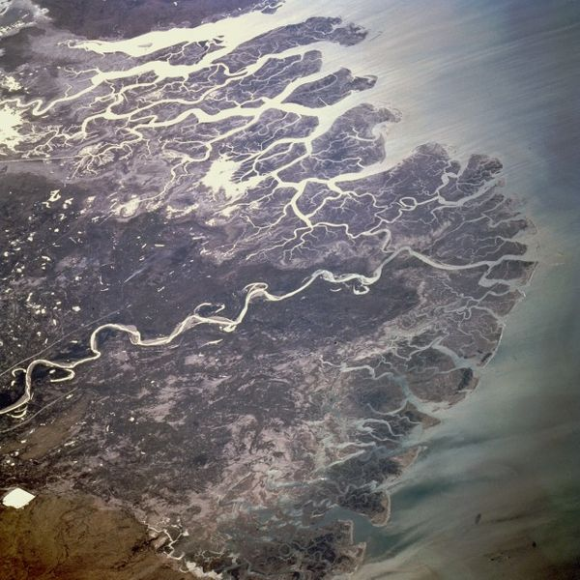
Indus River Delta, photo: NASA

Slide 11
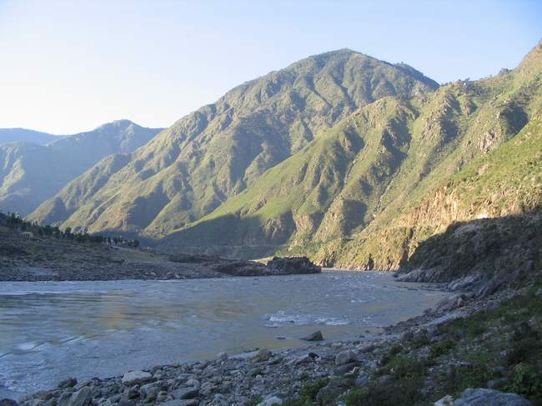
Indus River - Pakistan

Slide 12
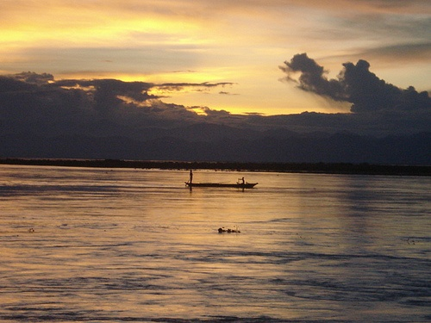
Brahmaputra River

Slide 13
Ganges River – A Sacred River
Provides water for drinking, farming, & transportation
Spiritual significance
According to Hindu beliefs, the Ganges brings life to its people, they worship the river as a goddess, & believe water has healing powers

Slide 14
The Ganges
In some places wide stone steps lead down to the river
Pilgrims come from all parts of the world to drink & bathe in its waters
Also scatter ashes of deceased family members on the river

Slide 15
The Ganges – Pure??
One of the most polluted rivers in the world
Millions of gallons of raw sewage and waste flow into the river everyday
Bodies of dead animals and even human corpses can be seen floating in the water
Water is poisoned by toxic chemicals & deadly bacteria

Slide 16
The Ganges
Thousands who bathe or drink become ill with hepatitis, typhoid, & cholera
1986, Govt. tried to restore the health of the river, but progress has been slow
Many Hindus believe that water is too holy to be harmed by pollution

Slide 17
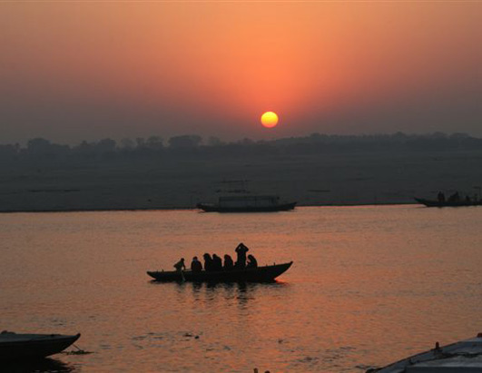
The Ganges

Slide 18
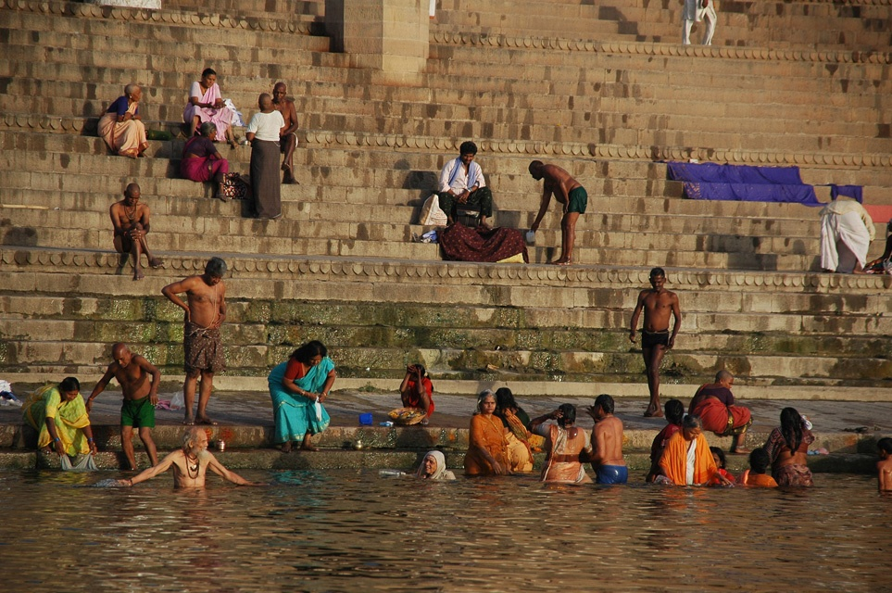
The Ganges

Slide 19
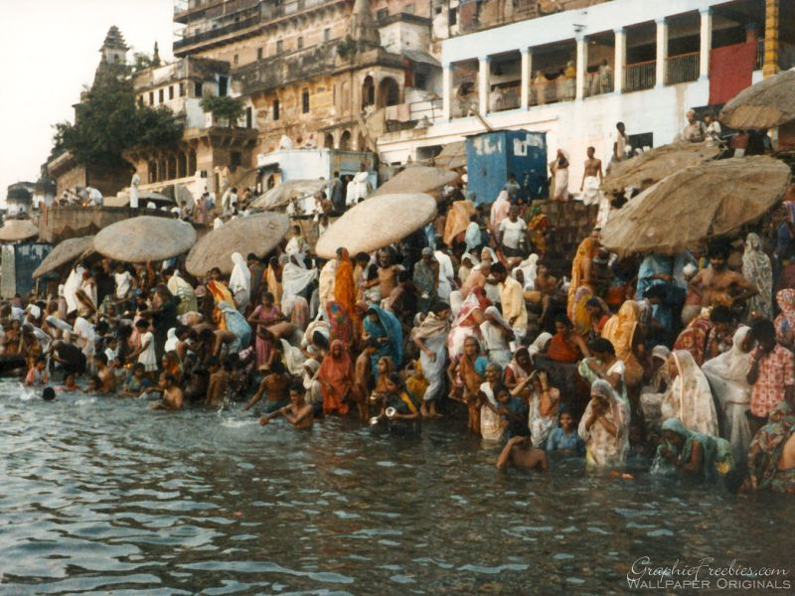
The Ganges

Slide 20
3. Monsoons
Seasonal winds greatly affect the climate of South Asia
October – May, the winter winds blow from the north and northeast and are dry
As summer nears, temps gradually rise. The heated air also rises, which triggers a change in the wind direction.

Slide 21
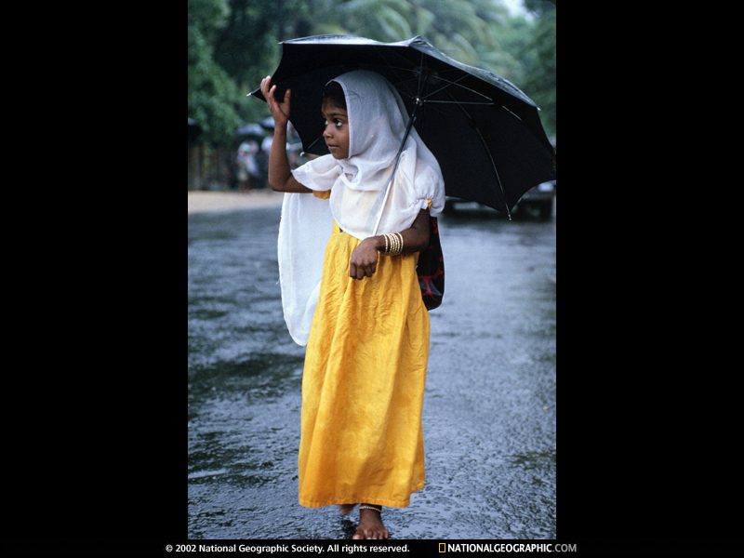
Monsoons

Slide 22
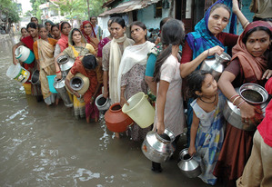
Monsoons

Slide 23
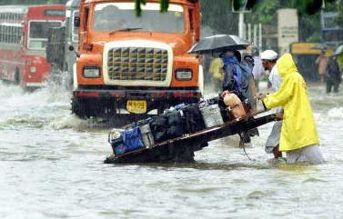
Monsoons

Slide 24
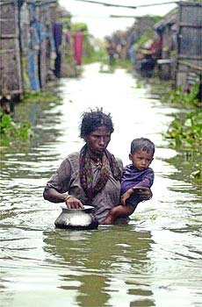
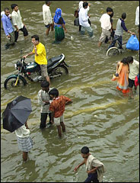
Monsoons

Slide 25
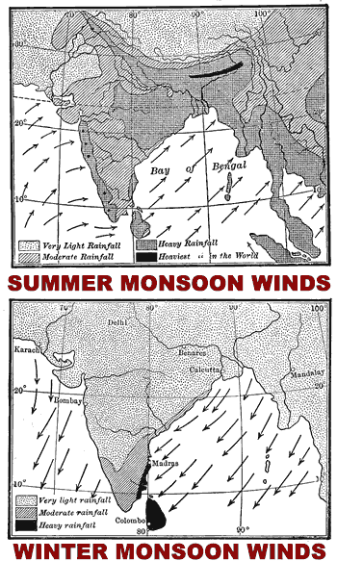
Monsoons
June – September, winds blow from the Indian Ocean in the south & southwest, carrying warm, moist air
Heavy rains provide the region with the largest portion of its yearly precipitation
Rainfall is heaviest in the eastern part - some spots average 450 inches of rain a year

Slide 26
Monsoons
The rainfall is crucial to the millions that live in the region.
They wait & watch for the monsoon crossing the subcontinent
The growing season is dependent on the monsoon rains.
However, the monsoons often cause disastrous floods that ruin crops & kill livestock & people.

Slide 27
4. Population
Approximately 1.5 billion people live in South Asia
Population density – 760 people per sq. mile
7 times the world average
If the rate of growth continues, the population could double in 40 years
India – ½ the size of the continental U.S. with more than 1.1 billion people
Bangladesh – 2,454 people per square mile
Causes serious problems such as not enough food to feed all the people.

Slide 28
5. Urbanization
% of South Asians living in urban areas is relatively low (15-28%)
Many are migrating to urban areas in search of better jobs & higher wages
Cities are becoming overcrowded
Strain on public facilities such as schools & hospitals

Slide 29
Largest Cities in South Asia
Calcutta, India
Mumbai (Bombay), India
Delhi, India
Dhaka, Bangladesh
Islamabad, Pakistan

Slide 30
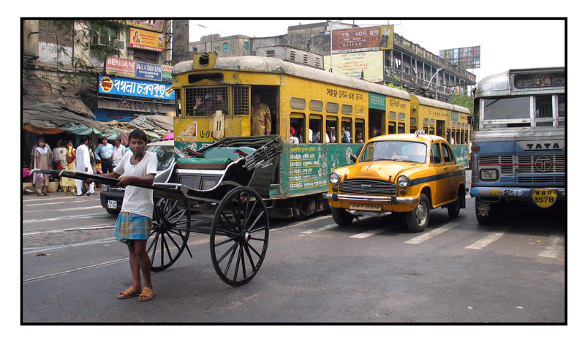
Calcutta, India

Slide 31
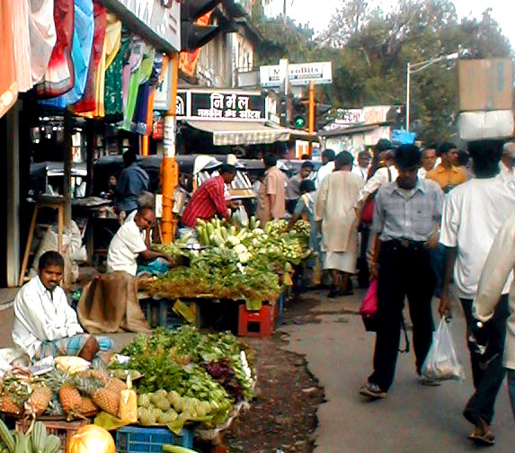
Mumbai (Bombay), India

Slide 32
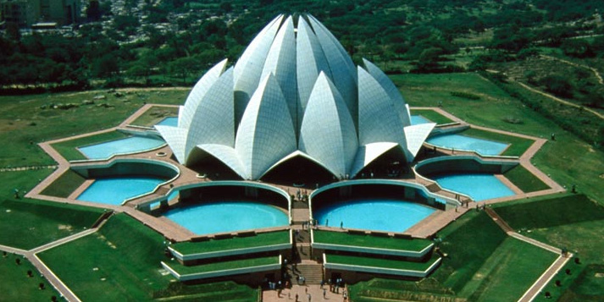
Delhi, India
Known in India as the "Lotus Temple", the Bahá'í House of Worship is one of the most famous landmarks in Delhi.

Slide 33
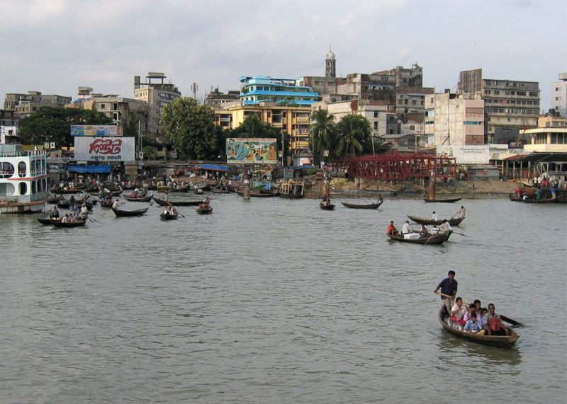
Dhaka, Bangladesh

Slide 34
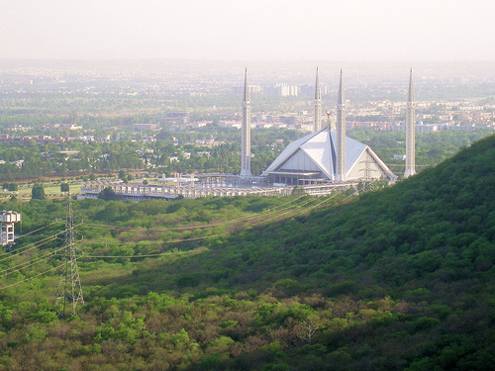
Islamabad, Pakistan

Slide 35
6. Caste System
According to Hindu belief, each person is born into a caste & has a certain moral duty, known as dharma, that is specific to that caste
A person can move into a different caste only through reincarnation
While the system brought social order, it also caused discrimination & limited people’s ability to improve their lot in life

Slide 36
7. Religion - Hinduism
Grew out of Aryan culture & incorporated the caste system
Polytheistic religion – recognize many gods & goddess
A way of life & a set of beliefs
Every individual must live according to his or her own dharma, or moral duty
All good actions are rewarded and bad deeds are punished according to the law of karma

Slide 37
Religion - Hinduism
Samsara - Reincarnation – people are reborn repeatedly until they have overcome all their weaknesses & earthly desires
At that point, they are released from the cycle of rebirth and reach Moksha, a state of changeless bliss
Hinduism sees all of the world’s religions as different paths toward the same goal

Slide 38
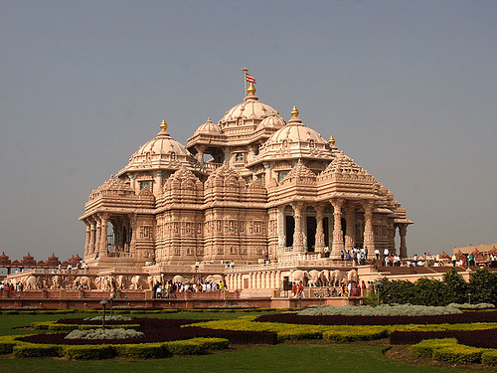
The Akshardham Hindu temple in Delhi, India

Slide 39
8. Religion - Buddhism
Approximately 563 BCE, in present-day Nepal, a prince was born – Siddhartha Gautama
He had everything he could want, but because of his awareness of human suffering he went on a pilgrimage
After years of spiritual searching & meditations, he perceived the true nature of human existence for the 1st time
He became known as Buddha, or the Awakened One

Slide 40
Religion - Buddhism
Buddha spent the rest of his life trying to teach people they are suffering because they are overly attached to material things
To escape the chain of desire & suffering which leads to endless rebirth, one must live by certain rules
No religious rituals
By following Buddha’s guidelines, people could enter a state of great insight, calm, & happiness called Nirvana

Slide 41
9. Today’s Governments
Current governments in South Asia include democracies and monarchies
India – federal parliamentary republic
Sri Lanka & Bangladesh – parliamentary systems
Pakistan – president elected indirectly by the legislature
Bhutan & Nepal – constitutional monarchies

Slide 42
10. Struggling Economies
Large, rapidly growing populations
½ of the people of India live in poverty
Bangladesh – one of the poorest countries in the world
Most rely on subsistence farming to make a living in India, Bangladesh, & Pakistan
Struggle to grow enough crops to feed their families

