Slide 1
Early US History

Slide 2
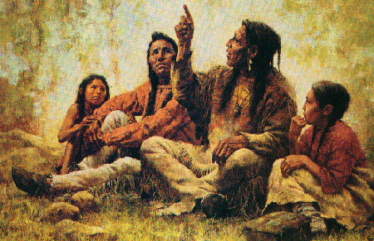
The Story Begins
America was first inhabited by _______________ from ____________ via land bridge
Native Americans slowly descended from ______________ to cover all of North America.
From ______________________ to more complex civilizations.
Much of U.S. _________________ named for “Indian” tribes in the regions.

Slide 3
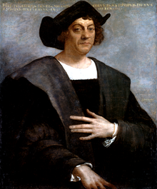
A New World
________________________sailed for Spain.
Tried to reach the far east by sailing ____________.
Landed in the _______________ and thought near ____________.
He had actually discovered a new __________________.
He has been called cruel by recent historians.

Slide 4
Conquistadors
__________________________who wished to get rich.
Often __________________ in their quest
Motives:
  _______________ and Fortune
  Gain new lands for ________________
  World power (_______________________)
  Spread ___________________________
Hernan Cortez vs. the _______________

Slide 5
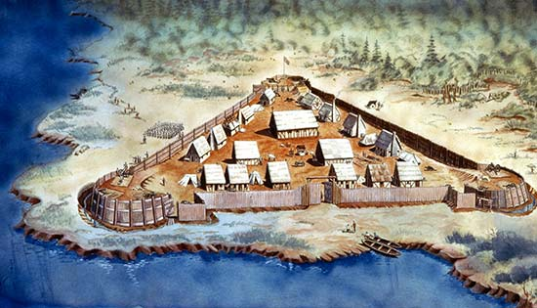
Settlement
Spaniards had discovered ________________________ in the New World during the 15th and 16th centuries.
However, _____________________had become THE power of Europe by the 16th century.
1585 – ________________ was the first British colony in Americas.
1607 – ________________, VA – first permanent British Settlement.

Slide 6
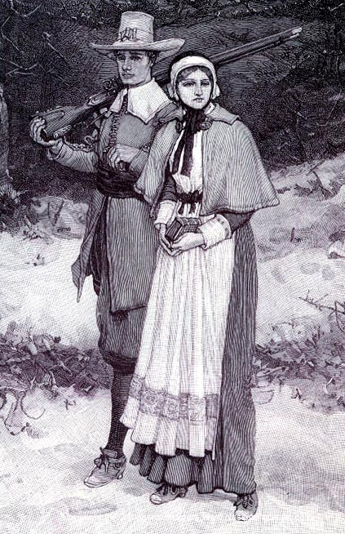
British Colonies
Jamestown nearly collapsed from ___________________.
More interested in ___________ than food.
_____________________ became the “new gold”
Nearly all of the rest of the colonists came for __________________ freedom.
Pilgrims (Puritans) landed at ___________________. (1620)

Slide 7
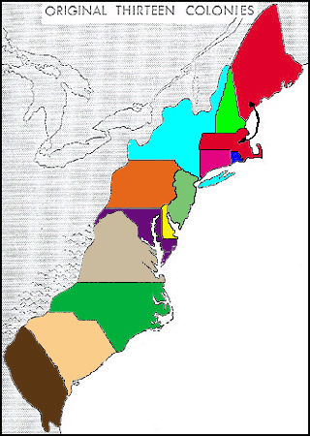
Early Colonies
British colonies divided into 3 regions.
____________________
____________________
____________________
Colonies existed for the _____________________ gain of the ____________________ government.
The economic system was _________________________ – competition between nations for gold.

Slide 8
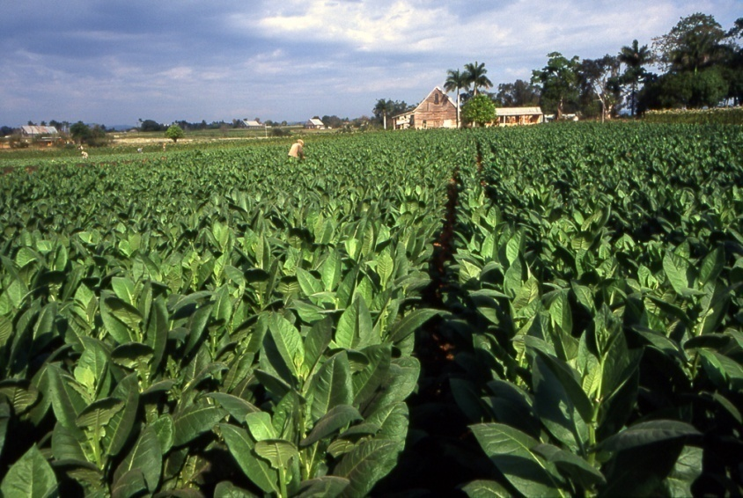
Colonial Economics
We had an _______________________ economy.
________________________was grains and beef, fishing, shipbuilding.
Middle colonies grew ______________ and built ships.
Southern colonies grew ________________________
_______________________________________________________.

Slide 9
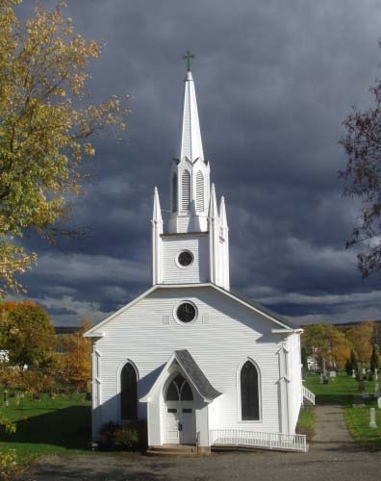
Religion in American Colonies
____________________________colonies were most religious.
Puritans had ______________ moral codes. (the Bible)
Middle colonies were also very religious, but more _____________________.
Southern colonies least religious – strongest influence was ____________________________
1740’s – Religious revival in America – _____________________

Slide 10

Religious Dissenters
Not everyone wanted to participate in ______________________.
__________________________was ostracized from the Massachusetts Bay Col.
Roger Williams founded __________________________ as a colony of religious tolerance. (Baptists)
All Christian denominations were welcomed – ____________________.

Slide 11
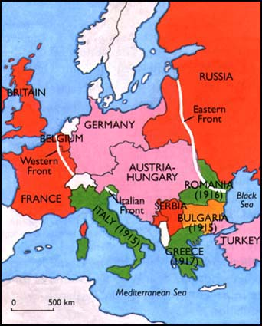
French and Indian War
Actually known as the _____________________in Europe.
___________________ was the main battlefield.
The _________________________aligned to stop Westward movement by the British ____________________.
British soldiers ________________colonial militiamen.
Colonel ____________________ was defeated in his only battles.
British won!!

Slide 12
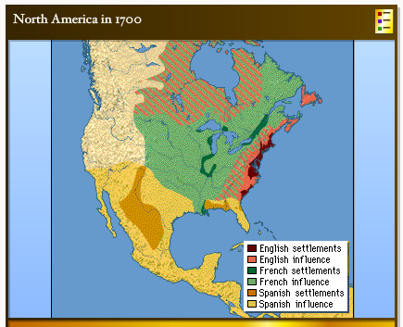
Results of Fr. And Indian War
__________________was the greatest power in the world.
The British incurred a huge _______________.
British citizens had their _____________________by Parliament.
There is nothing to block colonial _______________________.
Colonists thought they were _______________!

Slide 13
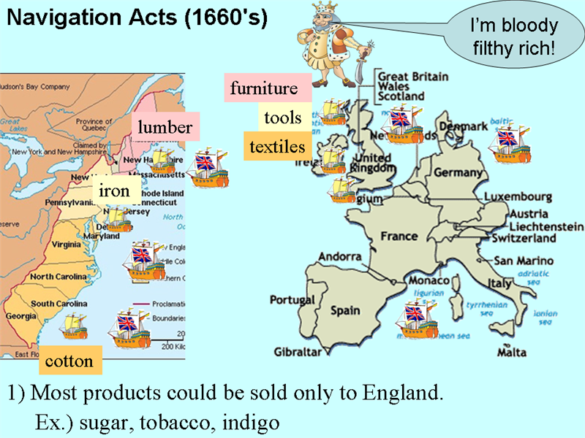
British / Colonial Tension
_______________________
_________________________
_________________________
_________________________.
Almost all colonial goods were “________________”.
The ______________________sent reps to make sure trade was not with other countries.
______________________ and merchants were ___________.

Slide 14
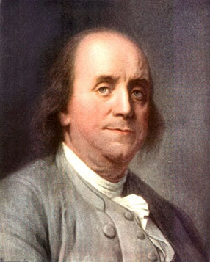
Colonial Influences
Most of the _________________ colonists were _______________________.
They were all products of the _______________________.
The Enlightenment was an offshoot of the _______________________.
Rousseau, __________________, Voltaire, _______________, Diderot, etc… wrote about the ____________________.
Many __________________ were feeling used

Slide 15
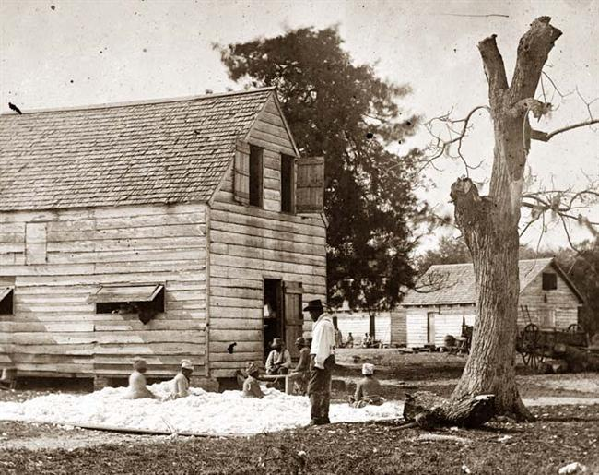
Southern Labor
______________________were tried as a labor force in the South.
Agreed to work for # of yrs. In return for ____________________________
_______________ slaves died from disease too easily.
Indentured servants often ___________ – Bacon’s Rebellion.
Slaves from _____________ sold by _________________ became the answer.

Slide 16
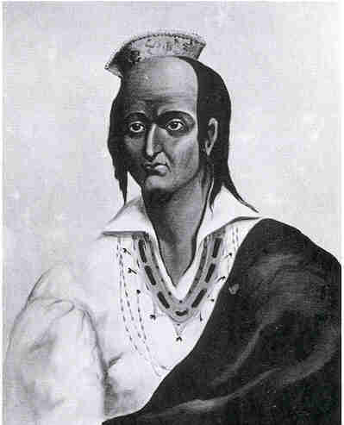
Colonists and Indians
Some Natives had begun to _____________________ into Euro colonies.
However, most ______________ were broken by ____________ in America.
King __________ (Metacom) aligned many tribes against the colonists.
______________________was deadly for the colonists, but very deadly for him.
Metacom was _____________, ____________, and ________________.

Slide 17
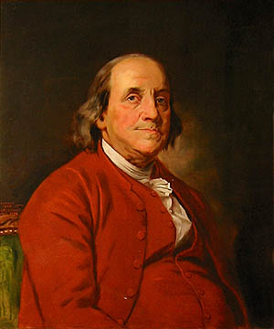
Ben Franklin
He was most _____________ and _______________ of all colonials.
Accomplishment:
  Lightning (electricity)
  ___________________
  ___________________
  Franklin Stove
  Published, “______________________________________”

Slide 18
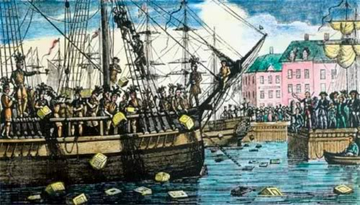
British Debt
_________________ built huge debt in winning war.
They thought __________________ should have to help pay.
Colonists _______________.
Several _________ were tried
____________
____________
____________
Finally – ______________________!! – No more West!

Slide 19
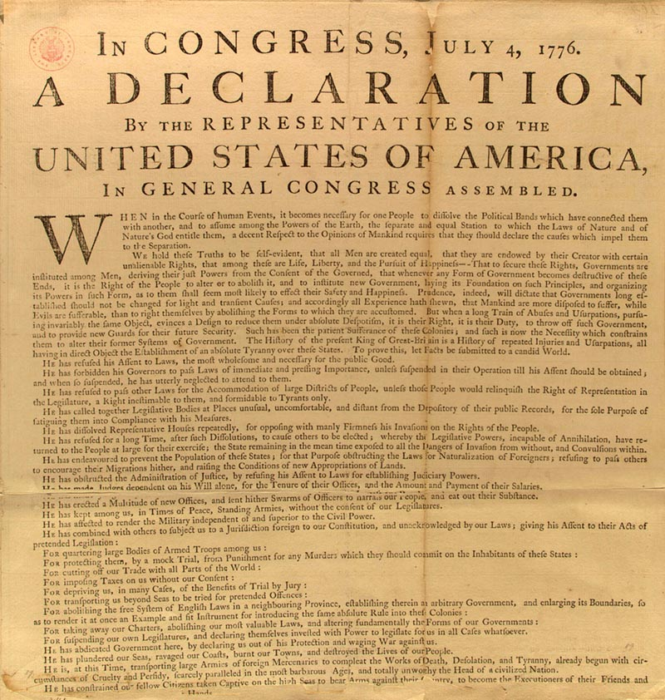
Declaration of Independence
Thomas Jefferson was asked by the Cont. Congress to draft formal letter of independence.
It was written to King George III
It was really written to ask for allies.
GB was a BA and others may want to join us.
It included a long list of grievances.

Slide 20
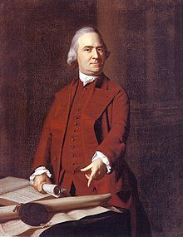
Road to Revolution
Boston Tea Party
Committees of Correspondence started to spread propaganda thru colonies.
British gov’t tried to govern a people they had allowed to govern selves.
Merchants begin bypassing Br. Trade.
Thomas Paine – Common Sense.

Slide 21
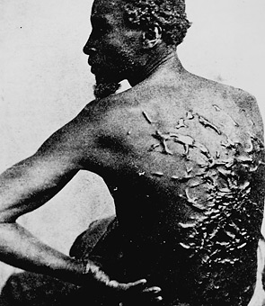
Slavery in America
Indian slaves and indentured servants from Europe had not proved effective.
Slaves were bought from European merchants or the Caribbean.
Triangular Trade was de-humanizing and deadly.
South was more dependant on slavery than other regions.

Slide 22
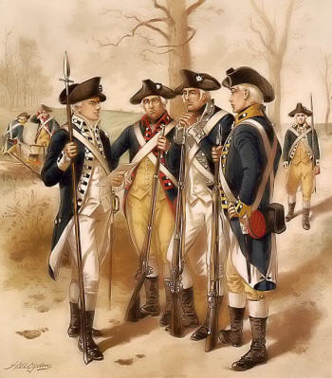
Revolutionary War
George III hired Hessian soldiers to fight colonists.
George Washington was commander of Continental Army.
All colonists had to do was extend the war.
Battle of Saratoga was first major win – secured France as ally.
Battle of Yorktown was the death-nail of the British.
We Win!!!!!!!

