Slide 1
The Great Society
Lesson 4: Test 13

Slide 2
I Can:

Slide 3
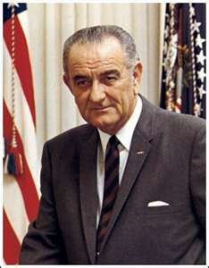
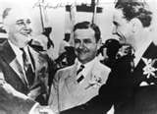
LBJ’s Path to Power
Lyndon Baines Johnson grew up in a middle class family in Blanco County, Texas.
LBJ entered politics in 1937 as a U.S. House Representative quickly establishing himself as a “New Dealer” and imitating FDR’s leadership style.
Finally, in 1948, LBJ won the Democratic primary election for the Senate.

Slide 4
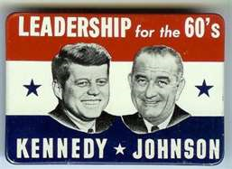
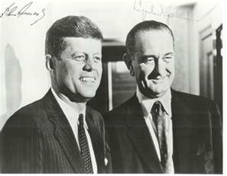
A Master Politician
1955: Johnson becomes Senate majority leader.
His legendary ability to persuade senators to support his bills became known as the “LBJ treatment.”
Such treatment helped pass the Civil Rights Act of 1957: a voting rights measure that was the first civil rights legislation since Reconstruction.
LBJ’s ability to get legislation passed and his Southern Protestant Background got the attention of JFK who asked Johnson to be his running mate helping him to win the 1960 presidential election.

Slide 5
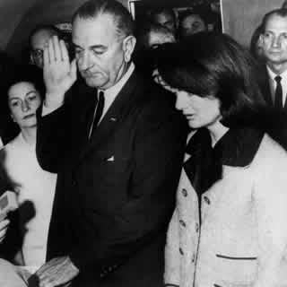
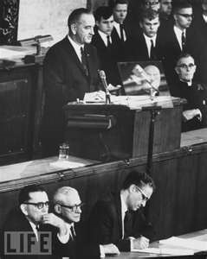
Johnson’s Domestic Agenda
Just two hours after Kennedy was killed, Johnson took the oath of office aboard Air Force One.
Five days into his administration, he urged Congress to pass the civil rights and tax-cut bills that Kennedy had sent to Capitol Hill.
February 1964: Congress passed a tax reduction of over $10 billion into law stimulating economic growth.
July 1964: Johnson pushed the Civil Rights Act of 1964 through Congress by persuading Southern senators to stop blocking its passage. The act prohibited discrimination based on race, religion, national origin, and sex granting the federal government the power to enforce its terms.

Slide 6
The War on Poverty
1964: LBJ declares an “unconditional war on poverty in America” proposing legislation to help Americans prosper.
August 1964: Congress enacted the Economic Opportunity Act which provided $1 billion for youth programs, antipoverty measures, small-business loans, and job training.
EOA created:
Job Corps Youth Training Program
VISTA-Volunteers in Service to America
Project Head Start (an education program for underprivileged preschoolers)
Community Action Program that encouraged poor people to participate in public-works programs.

Slide 7
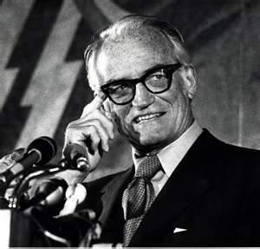
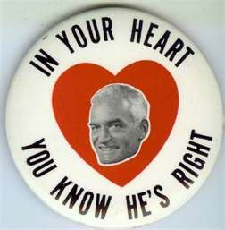
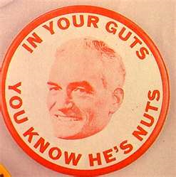
1964 Election
Republicans nominated conservative senator Barry Goldwater of Arizona to oppose Johnson.
He maintained that the federal government should not try to correct social and economic wrongs like poverty, discrimination, and lack of opportunity.
He also threatened the use of nuclear weapons on Cuba and North Vietnam.
However, America was in agreement with President Johnson’s policies. As a result, LBJ won the election by a landslide and the Democrats increased their majority in Congress.

Slide 8
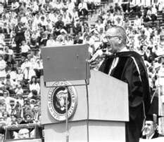
Building the Great Society
LBJ had a vision for America called the “Great Society.” He outlined a legislative program that would end poverty and racial injustice and create a higher standard of living, equal opportunity, and promote a richer quality of life for all.
By 1969, Congress had passed 206 of his measures.
LBJ at University of Michigan giving this speech.

Slide 9
Building the Great Society
Education
Healthcare
LBJ considered education “the key which can unlock the door to the Great Society.”
The Elementary and Secondary Education Act of 1965 provided more than $1 billion in federal aid to help public and parochial schools purchase textbooks and new library materials.
LBJ and Congress changed Social Security by establishing Medicare and Medicaid.
Medicare provided hospital insurance and low-cost medical insurance for almost every American 65 or older.
Medicaid extended health insurance to welfare recipients.

Slide 10
Building the Great Society
Housing
Immigration
Built 240,000 units of low-rent public housing
Helped low- and moderate-income families pay for better private housing
Established the Department of Housing and Urban Development (HUD)
Appointed Robert Weaver, the first African-American cabinet member in American history, as Secretary of HUD.
Immigration Act of 1924 and National Origins Act of 1924 established immigration quotas that discriminated strongly against people from outside Western Europe—especially eastern Europeans and Asians.
Immigration Act of 1965 opened the door for many non-European immigrants to settle in the United States by ending quotas based on nationality.

Slide 11
Building the Great Society
The Environment
Consumer Protection
Rachel Carson’s Silent Spring exposed the dangers of pesticides.
Water Quality Act of 1965: required states to clean up rivers.
The government also sought out the worst chemical polluters.
Congress passed major safety laws like the truth-in-packaging law that set standards for labeling consumer goods.
Congress also established safety standards for automobiles and tires after Ralph Nader’s book, Unsafe at Any Speed, criticized the mobile industry for ignoring safety concerns.

Slide 12
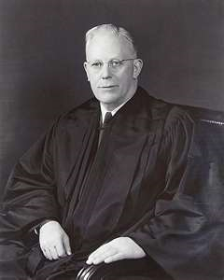
Reforms of the Warren Court
The Supreme Court of the 1960s took an activist stance on leading issues with Chief Justice Earl Warren.
The Warren Court:
Banned state-sanctioned prayer in public schools
Declared state-required loyalty oaths unconstitutional
Limited the power of communities to censor books and films
Said that free speech included the wearing of black armbands to school by antiwar students.
Changed federal and state reapportionment and the criminal justice system.

Slide 13
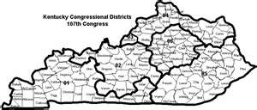
Congressional Reapportionment
Reapportionment: the way in which states redraw election districts based on the changing number of people in them.
By 1960, 80% of Americans lived in cities and suburbs. However, many states had failed to change their congressional districts which gave voters in rural areas more representation and more power than those in urban areas.

Slide 14
Congressional Reapportionment
Baker v. Carr (1962)
Reynolds v. Sims (1964)
Stated that the government had the right to tell states to reapportion their districts for more equal representation and that they should be redrawn so that districts were equal in population.
This extended the principle of “one person, one vote” to state legislative districts.
Both of these decisions led to a shift of political power throughout the nation from rural to urban areas.

Slide 15
Rights of the Accused
Mapp v. Ohio (1961):
Evidence seized illegally can not be used in state courts (the exclusionary rule).
Gideon v. Wainright (1963):
Required criminal courts to provide free legal counsel to those who could not afford it.
Escobedo v. Illinois (1964):
An accused person has a right to have a lawyer represent during police questioning.
Miranda v. Arizona:
All suspects must be read their rights before questioning.

Slide 16
Impact of the Great Society
People disagree on whether the changes made in the Great Society made the nation better or worse.
LBJ extended the power and reach of the federal government more than any other post WWII president.
The “war on poverty” did help. The number of poor people fell from 21% of the population in 1962 to 11% in 1973.
LBJ’s tax cut spurred the economy. However, funding the Great Society caused for a growing budget deficit.
A conservative backlash arose as a new group of Republican leaders were put into power.
Also, the increase of Communist forces in Vietnam began to overshadow the goals of the Great Society.

