Slide 1
The KOREAN War
Lesson 2: Part 1: Test 12

Slide 2
“I Can”—
Identify the causes of the Korean War and the grounds for U.S. involvement.
Explain how the events of the war lead to outcome and how that outcome has continued to impact Korea today.

Slide 3
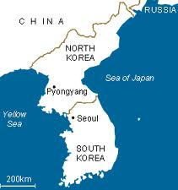
the situation
Before WWII, Japan had control of Korea.
But, at the end of WWII, Japanese troops north of the 38th parallel (38˚ North latitude) surrendered to the Soviets.
Japanese troops to the south of the line surrendered to the Americans.
Korea developed into two nations: one with a communist government and one with a democratic.

Slide 4
the division
North Korea
South Korea
Democratic People’s Republic of Korea
Occupied by Communists
Government Leader: Kim il Sung
Government based in Pyongyang
The Republic of Korea
Occupied by the United States
Government Leader: Syngman Rhee
Government based in Seoul (Korea’s traditional capital)

Slide 5
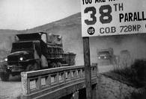
the plan
Also after WWII, the U.S. had withdrawn most of their troops.
As a result, the Soviets assumed that the U.S. would not fight to defend South Korea and began preparations to support North Korea with tanks, planes, and money to try and take control of the entire peninsula and unite the country.

Slide 6
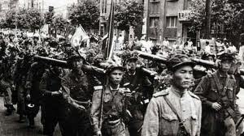
the attack
June 25, 1950: North Korea crossed the 38th parallel in a surprise attack that developed into a conflict known as the Korean War.
In response, South Korea asked the United Nations to stop the invasion and when put to vote, it passed.

Slide 7
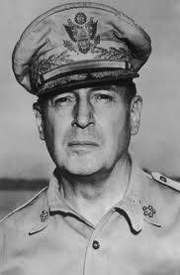
the response
June 27, 1950: President Truman sent American forces in to back South Korea.
Overall, 16 nations sent approx. 520,000 troops to help.
The combined forces of all 17 nations were put under the command of General Douglas MacArthur.

Slide 8
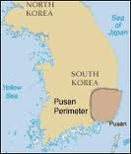
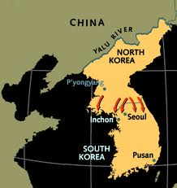
the counterattack
Within just a month, North Korean forces had pushed South Korea and their allies into a small defensive zone near Pusan.
Then, on September 15, 1950, MacArthur launched a surprise amphibious landing at Inchon while the rest of South Korea’s forces moved north from Pusan.

Slide 9
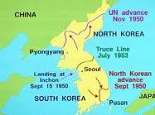
the result
This caused half of the North Korean troops to surrender while the rest fled back into North Korean territory.
UN forces continued to push North Korea to the Chinese border, bombing bridges on the Yalu River.

Slide 10
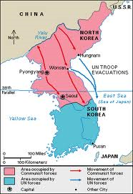
the Chinese
This did not go over well with the Chinese. Consequently, in late November of 1950, China joined the war in support of North Korea.
They pushed the UN army southward and by January 1951, all UN and South Korean forces had been forced out of North Korea and the Chinese captured Seoul.
The result: a stalemate.

Slide 11
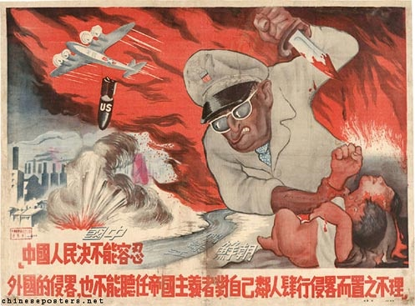
the suggestion
In 1951, to bring an end to the stalemate, MacArthur suggested a nuclear war against China.
President Truman rejected the idea in fear of starting WWIII.
Instead, South Korean forces decided to advance again and retake Seoul making the situation identical to what it had been before fighting ever began.

Slide 12
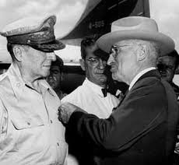
the dispute
MacArthur vs. Truman: believing that his suggestions were correct, MacArthur spoke and wrote privately to newspaper and magazine publishers and Republican leaders publically criticizing President Truman’s policies.

Slide 13
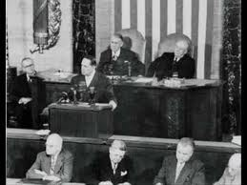
the president’s response
In response, President Truman fired MacArthur on April 11, 1951.
Initially, the American public was shocked and outraged at the treatment of this wartime hero. He even received a military hero’s welcome when he returned to the U.S.
However, after taking a closer look at the situation, the public decided that Truman had done the right thing.

Slide 14
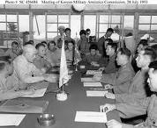
the settlement
The Soviet Union suggested a cease-fire on June 23, 1951. After a year of discussion and decisions, the two signed an armistice to end the war.
At best, the agreement was a stalemate. Communism had been contained without the use of atomic weapons.
However, Korea was still a divided nation and a cease-fire line along with a demilitarized zone was established at the 38th parallel.

Slide 15
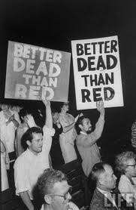
the effects
54,000 American casualties
$67 billion in expenditures
American rejection of Democratic party in 1952
Election of Republican President Dwight D. Eisenhower.
Increased fear of communism

Slide 16
Chronological Spectrum Activity
Guidelines:
1. Be quiet! Other classes are working!
2. Leave & enter the classroom quietly.
3. Do not take anything with you.
Each person will be given a card labeled with an incident that occurred during the Korean War.
Next, we are going to go out in the hallway and make a human timeline by determining which event goes where in relation to the others.
Purpose: This will help you to see a visual representation of the events of the Korean War and help you to comprehend those events as you discuss and determine the order of the events.

