Slide 1
Kennedy & The Cold War
Lesson 1: Test 13

Slide 2
I Can:
Identify the confrontations between the United States and the Soviet Union and explain America’s response to those confrontations.

Slide 3
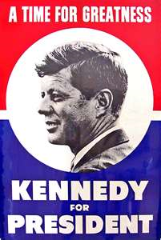
1960 Presidential Election
The situation: the economy was in a recession. In addition, the Soviets had launched Sputnik I in 1957, developed long-range missiles, and aligned with Cuba.
This lead Americans to believe that their military was falling behind that of the Soviets and that the United States might be losing the Cold War.

Slide 4
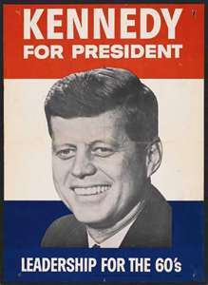
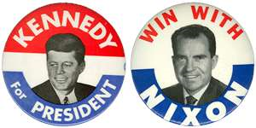
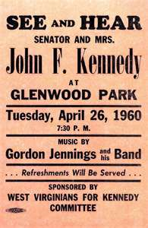
Kennedy VS Nixon
Candidates: On the Republican ticket was Vice President Richard Nixon who hoped to win by playing on Eisenhower’s popularity.
The Democratic Party nominated Massachusetts senator John F. Kennedy who promised active leadership “to get America moving again.”
Both candidates had similar positions on policy issues. However, with the help of television and his stance on civil rights issues, Kennedy rose to the top.

Slide 5
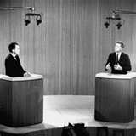
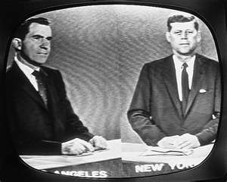
Televised Debates
Many Americans were skeptical about Kennedy for two reasons: He was only 43 which lead people to believe he was inexperienced, and he was Roman Catholic which triggered a fear of papal influence or closer ties between church and state.
However, Kennedy tackled these issues by disproving them in the first televised debates between two presidential candidates.
In fact, Nixon thought he would benefit from the televised debates, because he thought it would reveal Kennedy’s inexperience. Instead, Kennedy spoke and looked better than Nixon helping him to win the election.

Slide 6
Televised Debates
http://player.discoveryeducation.com/index.cfm?guidAssetId=FCB719A7-3553-4D56-BD7C-3E9D2A7C8A36&blnFromSearch=1&productcode=US

Slide 7
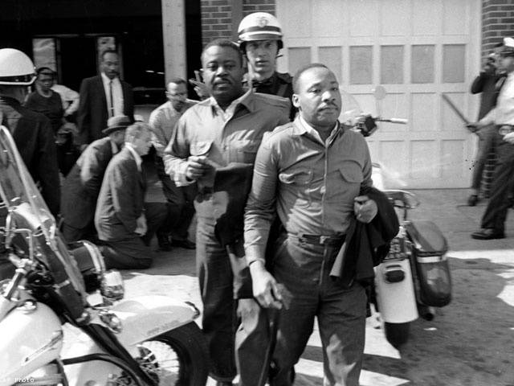
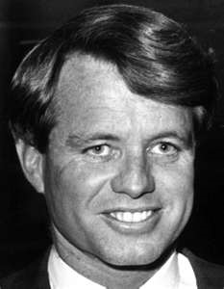
Kennedy & Civil Rights
In October of 1960, Reverend Martin Luther King, Jr. was arrested along with 33 other African-American demonstrators for sitting at a segregated lunch counter in Atlanta, Georgia.
Neither Eisenhower nor Nixon intervened. However, Kennedy called King’s wife to express his condolences while Robert Kennedy, JFK’s brother, convinced the judge to release King from jail.
Doing this won the votes of African Americans helping Kennedy to carry key states in the Midwest and South.

Slide 8
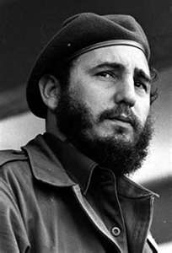
Foreign Policy Takes Priority
Holding that the Eisenhower administration had not done enough about the Soviet threat, Kennedy turned his focus to the Cold War from the very beginning.
The first test of Kennedy’s foreign policy came in Cuba.
Just before JFK took office, on January 3, 1961, President Eisenhower cut off diplomatic relations with Cuba because of the revolutionary leader Fidel Castro.

Slide 9
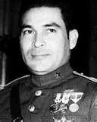
Cuba
Initially, Castro promised to implement democracy in Cuba helping him to gain power as he fought to overthrow dictator Fulgencio Batista from 1956 to 1959.
The U.S. recognized the new government in the beginning. However, Castro seized three American and British oil refineries damaging the relations between us and Cuba.
He also broke up commercial farms into communes that would be worked by formerly landless peasants.

Slide 10
Cuba
As a result, the American sugar companies that controlled 75% of the crop land in Cuba appealed to the U.S. government for help.
Congress responded by enacting trade barriers against Cuban sugar.
It was not long after this when Castro openly declared himself a communist welcoming aid from the Soviets.
It was at this point that Castro began to suppress anyone who was in disagreement with him—especially politically.
As a result, about 10% of Cuba’s population went into exile escaping mostly to the United States—specifically in Miami, Florida where a counterrevolutionary movement took shape.

Slide 11
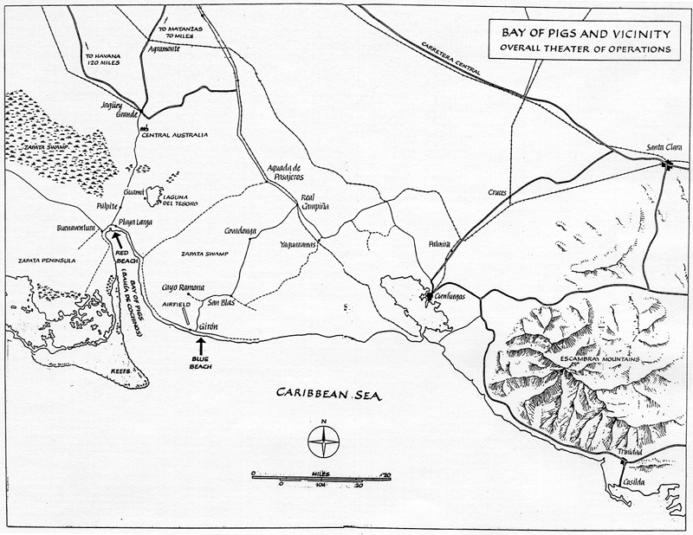
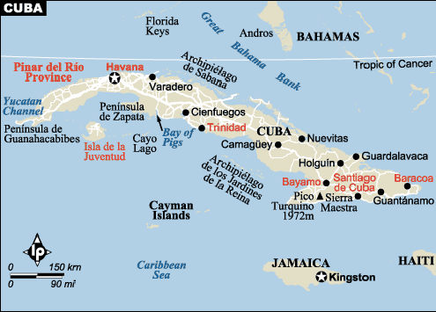
The Bay of Pigs
In March of 1960, President Eisenhower gave the CIA permission to secretly train Cuban exiles for an invasion of Cuba hoping to trigger a mass uprising that would overthrow Castro.
Kennedy learned of the plan just nine days after his election and reluctantly approved it.

Slide 12
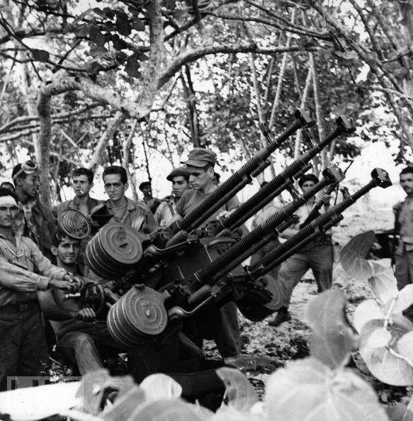
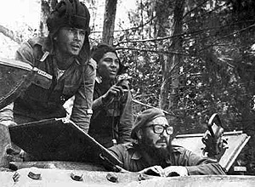
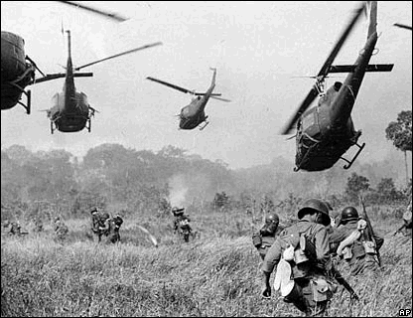
The Bay of Pigs
On April 17, 1961, around 1500 Cuban exiles, with the support of the U.S. military, landed on the Bay of Pigs—nothing went as planned.
An air strike that was supposed to eliminate the Cuban air force failed.
A small advance group that was sent to distract Castro’s forces never arrived.
When the main unit landed, it lacked American air support and were met by 25,000 Cuban troops who had the support of Soviet tanks and jets.
The result: defeat. Some invaders were killed while others were imprisoned.

Slide 13
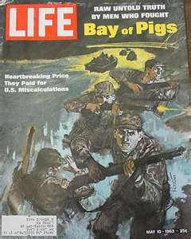
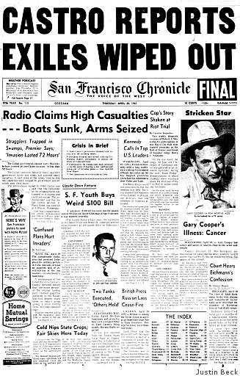
The Bay of Pigs
This disaster left Kennedy embarrassed, however, he publically accepted the blame for the failure.
He also negotiated with Castro for the release of the imprisoned survivors paying a ransom of $53 million in food and medical supplies.

Slide 14
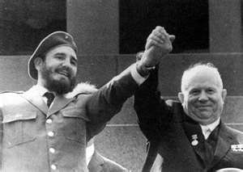
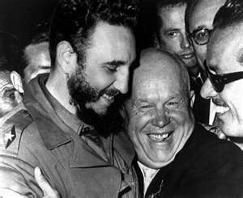
The Cuban Missile Crisis
After the incident at the Bay of Pigs, Castro continued to welcome Soviet aid.
Summer 1962: After promising to defend Cuba with Soviet arms, Soviet Premier Nikita Khrushchev increasingly sent weapons including nuclear missiles.
In response, President Kennedy issued a warning that America would not tolerate offensive nuclear weapons in Cuba—so close to home.

Slide 15
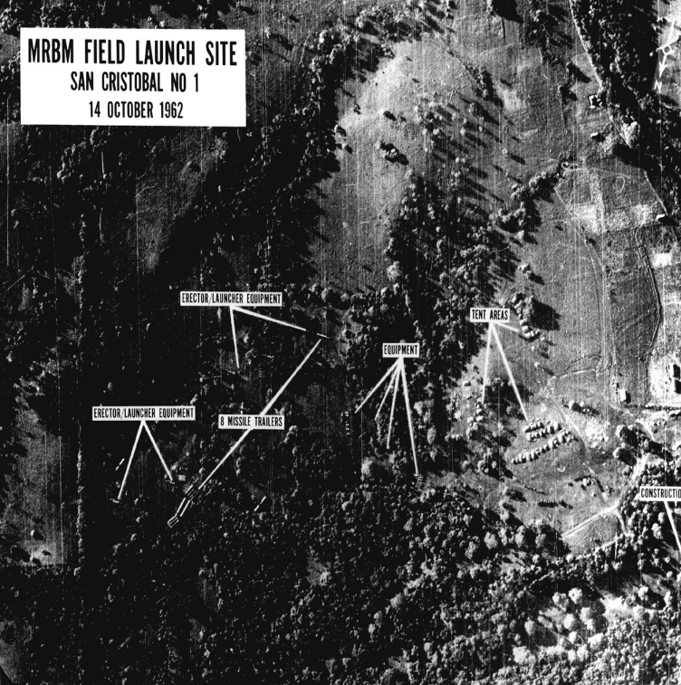
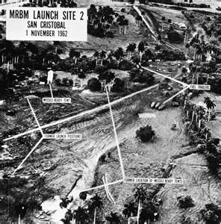
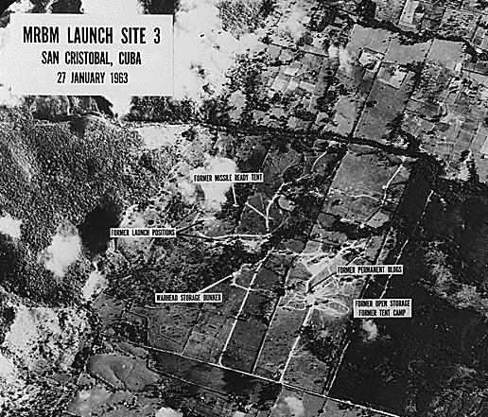
The Cuban Missile Crisis
October 14, 1962: photographs taken by American planes revealed Soviet missile bases in Cuba some of which were ready to launch—and could reach the U.S. in minutes.
October 22, 1962: Kennedy publicizes the information making it clear that any missile attack from Cuba would trigger an all-out attack on the Soviet Union.
For the next six days, America waited terrified of the possibility of a nuclear war.
Book page 675.

Slide 16
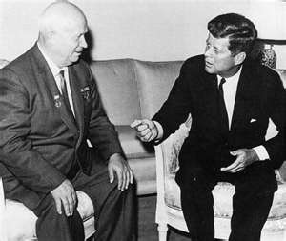
The Cuban Missile Crisis
Crisis Averted: the first break came when Soviet ships stopped suddenly to avoid a confrontation at sea.
Next, Khrushchev offered to remove the missiles if America promised not to invade Cuba. The United States also secretly agreed to remove missiles from Turkey.
The leaders agreed and the crisis was over.

Slide 17
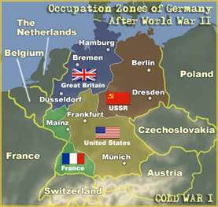
The Berlin Crisis
In 1961, the city of Berlin was in great turmoil.
In the past 11 years, almost 3 million East Germans fled to West Berlin because it was free from Communist rule.
As a result of losing 20% of its population, the country’s economy was significantly weakened.

Slide 18
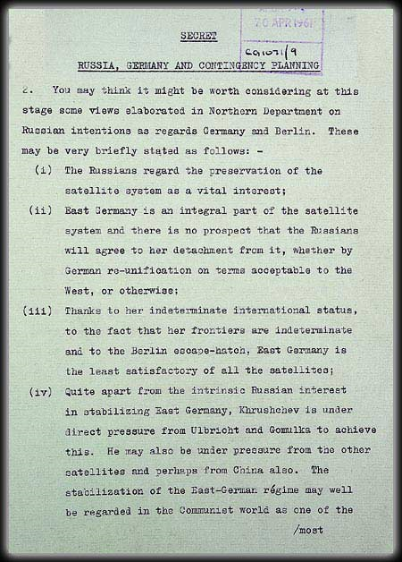
Khrushchev’s Solution
Recognizing the necessity for a solution to this problem, at a summit meeting in June 1961, Khrushchev threatened to sign a treaty with East Germany that would enable that country to close all the access roads to West Berlin.
However, Kennedy refused to relinquish U.S. access to West Berlin and, with his determination and America’s superior nuclear striking power, prevented Khrushchev from closing the air and land routes between West Berlin and West Germany.

Slide 19
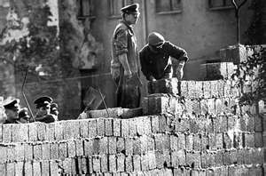
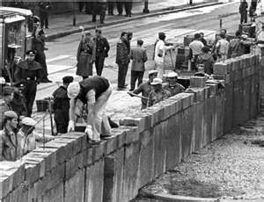
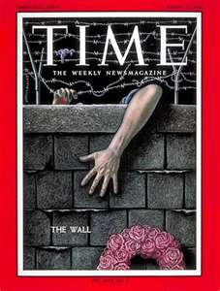
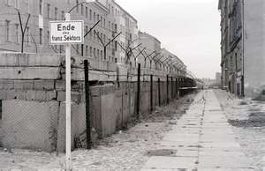
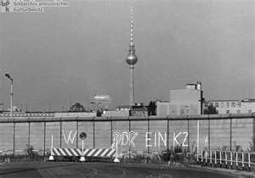
Khrushchev’s Solution
August 13, 1961: In response, Khrushchev directed East German troops to begin building the Berlin Wall separating East Germany from West Germany.
The wall was 15 feet high stretching 110 miles around the city. It was made of brick, barbed wire, cement, and steel, complete with patrols, flood lights, electric fences, and vehicle traps,
The Berlin Wall ended the Berlin crisis but increased Cold War tensions and became an ugly symbol of Communist oppression.
Show political cartoon on Elmo.

Slide 20
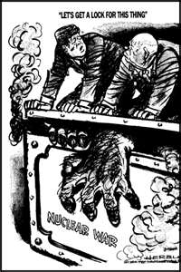
Trying to Ease Tensions
Both Kennedy and Khrushchev realized how close they were to a nuclear disaster.
As a result, Kennedy looked for a way to tone down his hard-line stance.
In 1963, he announced that the two nations had established a hot line between the White House and the Kremlin—a dedicated phone line that allowed the two leaders to communicate instantly should another crisis arise.
Later that year, the U.S. and U.S.S.R also agreed to a Limited Test Ban Treaty barring nuclear testing in the atmosphere.

