Slide 1
Industrialization, Immigration, and Gilded Age
1870 - 1900

Slide 2
Industrial Revolution
In the year 1800, _______ or more of the Am. population made money from agriculture.
People lived in the area they were born until they ______________ (for the most part).
________________ were large so the work got done.
When the ___________________, they went to bed. There was no light to work any longer.
Life in the ____________ was much the same.

Slide 3
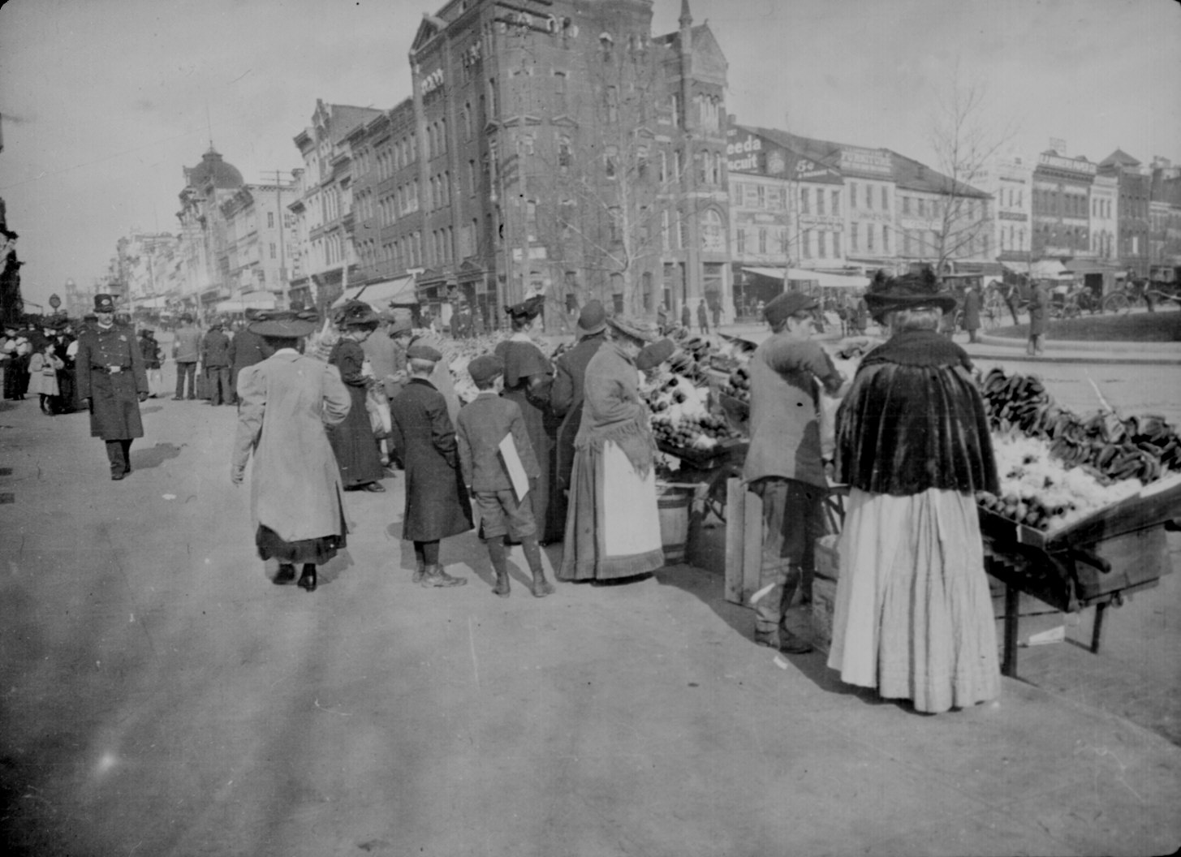
1900’s
More and more people began moving to the ____________.
________________ were coming to America in larger numbers than ever before.
Where were the immigrants coming from?
_____________ Europe
_____________ Europe
_____________ Europe

Slide 4
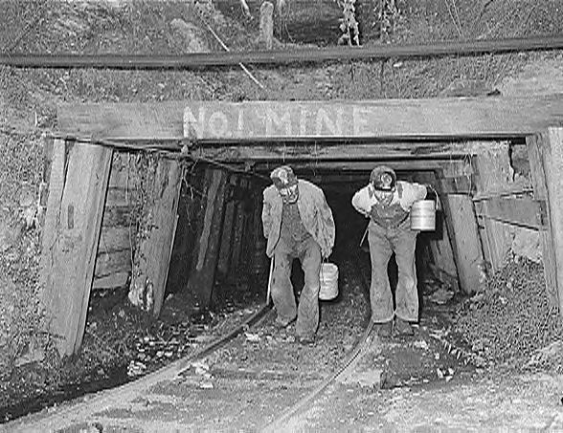
Why Did We Industrialize?
We had a __________ society.
We had available _____________.
We had an abundance of ____________________
We had ______________ support.
We had an ____________ workforce.

Slide 5
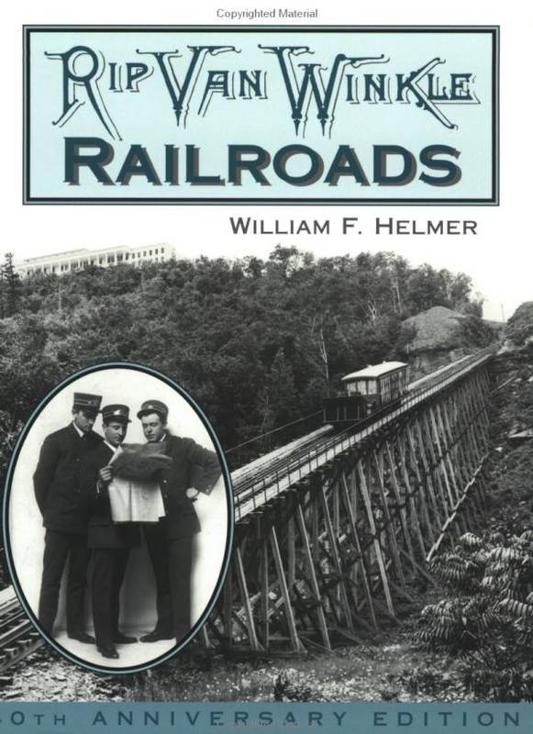
Railroads and Industrialism
Gov’t gave miles of land to _______________________
Rail was already all over the NE, but it expanded to the _____________.
Central Pacific and Union Pacific built the 1st ______________________ RR.
Because of more rail, the sale of more ____________.

Slide 6
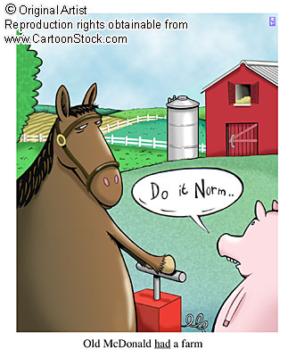
Building the Railroads
Often dangerous work done by _____________
__________________ as well as back-breaking labor.
Random explosions from ____________ dynamite.
________________ were killed each year.

Slide 7
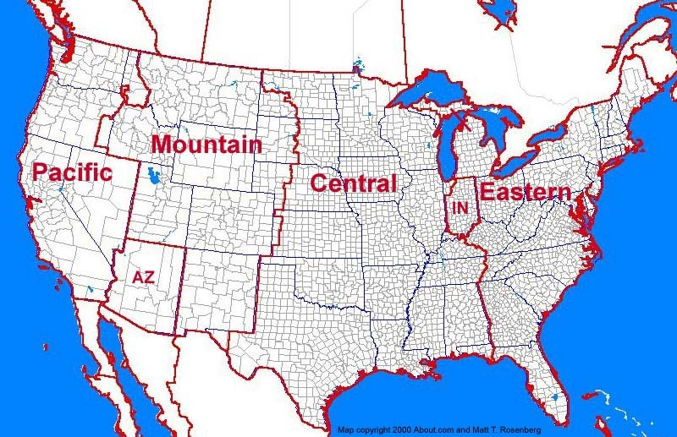
Railroads and Time Zones
Because of the rail schedule, ____________ was now important.
Traveling West w/ the _________ allowed for “time zones”.
Business could now be done on a uniform ___________________.

Slide 8
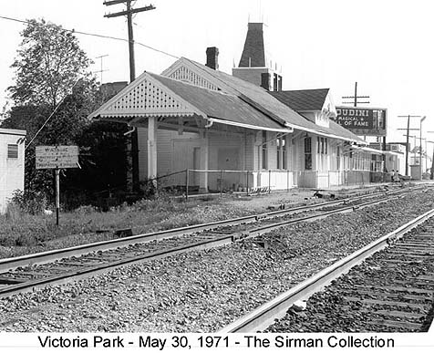
Economic Impact of the Rail
Entire ____________ were built around RR stations.
Without the station, there was no _______________.
Some towns got _________ off of the rail while others failed.
____________________ experienced both!!

Slide 9
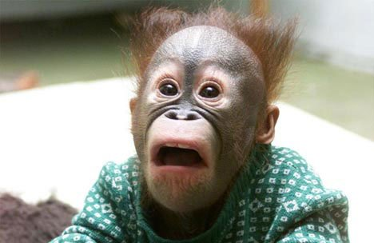
Scandals in the RR Industry
With millions of $ going to RR, _________________ followed.
Despotic tycoons used their lines to __________ and _____________ entire towns.
_______________________-scandal rocked the White House
Some RR policies led to violence – ______________ strike is example.

Slide 10
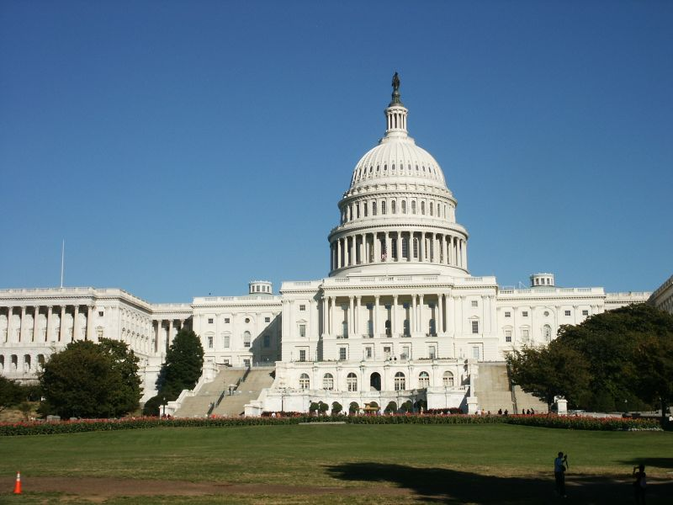
Legislation
The __________________ sought laws to force oversight of RR
The _________________________-created a commission to do just that – oversight
However, it lacked ____________.
They could ________ a company for bad policy, but really couldn’t do anything about it.
_________________ Anti-trust Act – no teeth

Slide 11
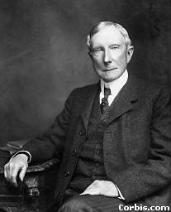
Vertical Integration
Process by which a company control entire ____________ of an industry.
For instance, buy _______________ mines, then buy _________ factories, then buy railroads.
No one can stop them by holding out on _______________.

Slide 12
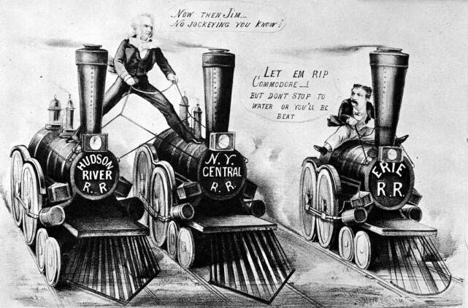
Horizontal Integration
Another way to drive out ________________
_______________all competitors.
If they don’t sell, _____________ them.

Slide 13
Social Darwinism
Charles Darwin’s, “___________________” was well-known.
Industrialists applied its principles to _______________.
Basically, only the _______________ survive.
The weaker businesses naturally will _____________.
Gov’t job – __________

Slide 14
Economic Principles
Economists were trying to figure out how to _________________ this new economy.
One principle they understood was the ____________________. What goes up must come down. Boom and bust.
They also understood that the more one produced, the _________________________.
This is known as _______________________.

Slide 15
Labor
Workers suffered very difficult ________________ conditions.
___________ work days (12 – 14 hrs.)
___________ factories – unsafe
Very low ____________ – company store
No job _______________ – get hurt; get fired
______________ Labor – less $, easily manipulated

Slide 16
Labor
Workers tried to _____________, but were rarely successful.
___________________ were formed like the American Federation of Labor. Wanted more _____________, fewer _____________.
It was only for the ________________ worker.
______________________ contracts were used to keep the union out of the factory.
Workers went on strike in _________ towns.

Slide 17
Government Response
Anytime unions called for general strikes (work stoppage), ____________________ fought back.
Often, the federal government would be called on to act if there was ________________.
Typically, the government backed ___________________.
Why??

Slide 18
Inventions
Factory system allowed for _____________ production.
______________________ was an improvement to the factory system.
______________ (generator) allowed for electricity on job site.
Telegraph and telephone improved __________________.
_____________ light bulb was huge. Why?

Slide 19
Producers and Consumers
The industrial _________ was aided by food ___________ coming from the mid-West
In turn, the growing __________ provided industry with workers and ___________.
Many of these ______________ were immigrants who worked for low pay.
_____________ benefited from this new economy, but some more than others

Slide 20
Building a Business
Not everyone wanted to risk everything to get _____________.
Corporations allowed for ________________.
You could buy part ownership and share in the ________________________.
Often times, corporations raised more ____________ by selling _______________.

Slide 21
Robber Barons / Captains of Industry
Cornelius Vanderbilt – __________________
Andrew Carnegie – ______________________
JP Morgan – ______________________
John D. Rockefeller – ___________________

Slide 22
Where are we in 1877?
America…
is now industrialized
has expanded out West.
is still an agrarian society.
is an emerging economic power
continues to welcome immigrants in large numbers.
may not be what it seems.

Slide 23
Gilded Age (1877 – 1900) or so
Mark Twain referred to this time pd. as the Gilded Age.
What does it mean to be gilded?
It is a thin layer of gold over a worthless metal.
It was not a pretty picture of America.

Slide 24
Politics of Business
More and more Americans became wealthy during this time. How?
One could inherit great fortunes.
One could make great fortunes.
The number of wealthy climbed in America, but the number of poor climbed higher.
Too many people on bottom rung.

Slide 25
Laissez-faire Policies
In the late 1800’s, most gov’t policies helped business grow. Why?
Strong economy.
More people working.
Gov’t aided business by staying out of business.
Laissez-faire meant that gov’t would leave business to businesses.

Slide 26
Politics of Business (part 2)
Railroads benefited from gov’t loans and grants.
They also supported political leaders.
Relationship between the two may have been a conflict of interest.
The Spoils system was used locally and on federal level.
Elected officials repaid supporters.

Slide 27
Competing Parties
Republicans
Mainly in NE and MW
Supported high tariffs
Wanted pensions for Union soldiers.
Gov’t aid to RR
Limits on immigration
Enforcement of Blue laws
Democrats
Silver backed money
Lower tariffs
Higher farm prices
Less gov’t aid to business
Fewer blue laws

Slide 28
Reforms
Republicans “waved the bloody shirt” for years to get elected.
Then, rewarded civil service jobs to friends (as did Dems)
Rutherford B. Hayes broke the tradition and offended his party.
Strengthened the country, but weakened the Republicans.

Slide 29
Election of 1880
Republicans were split
Party loyalists
Half-breeds – reform spoils system
Stalwarts – Keep the same (spoils)
Garfield – halfbreed won the nomination and election.
Was assassinated in 1881.
Arthur became Pres. and ended spoils

Slide 30
Pendleton Civil Service Act
At the pressing of Arthur, Congress passed this act.
Civil Service jobs were to be awarded on merit, not party affiliation.
This effectively ended the spoils system started under Jackson.

Slide 31
Cleveland Takes Office
Dem. Pres. Cleveland took office in 1884.
To regulate unfair business practices, Congress created the ICC.
It failed to have teeth to force RR to comply to the laws.
The economy was floundering.

Slide 32
Harrison Wins in 1888
Cleveland was defeated by Harrison.
He presided over the first billion $ Congress
Surpluses turned into deficits.
Harrison pleased his Republican friends by raising tariffs.
How do high tariffs help a hurting economy?

Slide 33
Coxey’s Army
Cleveland won again in 1892.
Unemployment was a problem and people marched on Washington.
Led by Jacob Coxey, they were arrested for trampling the grass.

