Slide 1
East Asia
TOP TEN

Slide 2
1. Mount Fuji
Japan
Mount Fuji
Volcanic – classified as active with a low risk of eruption
Surrounded by 5 lakes

Slide 3
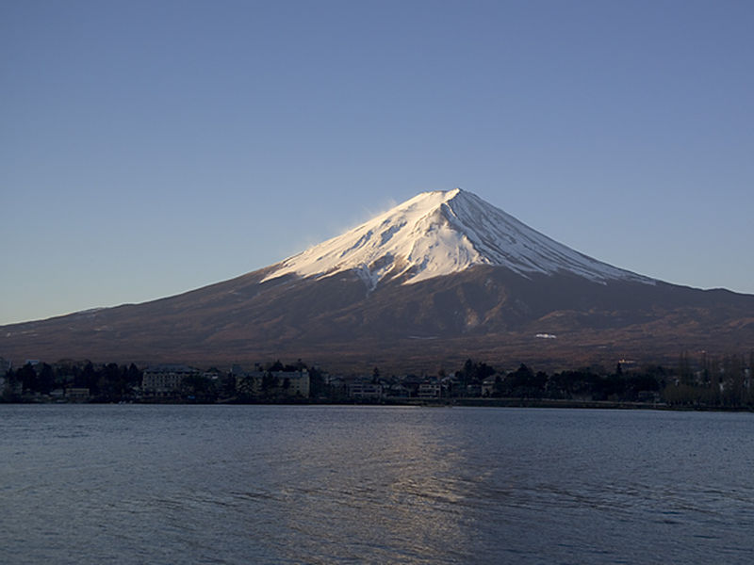
Mount Fuji

Slide 4
2. Gobi Desert
Stretches from northwest China into Mongolia
500,000 square miles
Larger than Texas & California combined
Prime area for finding dinosaur fossils

Slide 5
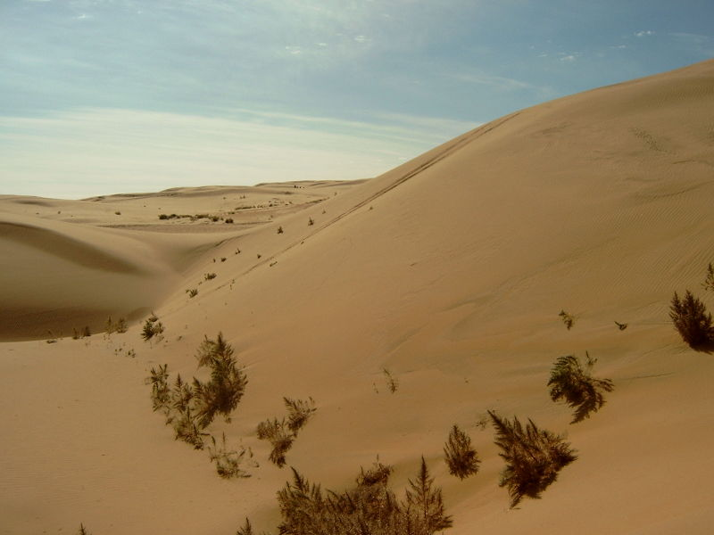
Gobi Desert

Slide 6
3. River Systems
Important for irrigation, hydroelectric power, & transportation
Huang He (Yellow River)
3,000 miles
Empties into Yellow Sea
Named from the yellow silt it carries
Also called “China’s Sorrow” because of the terrible floods it has caused

Slide 7
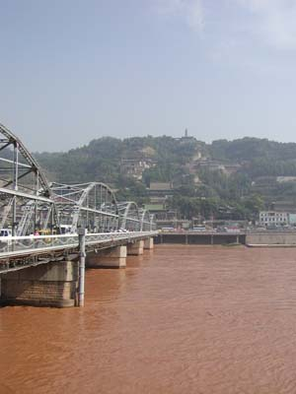
Huang He or Yellow River

Slide 8
River Systems
Chang Jiang (Yangtze River)
Longest river in all of Asia
3,900 miles
Major trade route
Also causes flooding
Xi Jiang (West River)

Slide 9
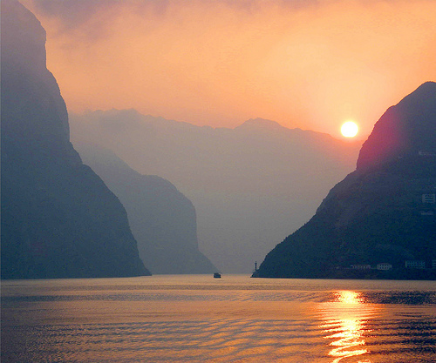
Chang Jiang

Slide 10
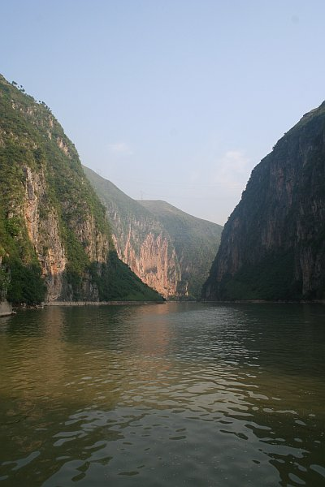
Chang Jiang (Yangtze River)

Slide 11
4. Revolutions in China
Chinese Empire came to an end in 1911 when a Nationalist revolution led by Dr. Sun Yat-sen overthrew the Manchu Dynasty
1927 – Chiang Kai-shek set up a Nationalist government, but his rival Communist Mao Zedong, gained huge support from peasants
During WWII, Nationalists & the Communists successfully together resisted Japan
At the end of the war, the 2 groups fought each other again

Slide 12
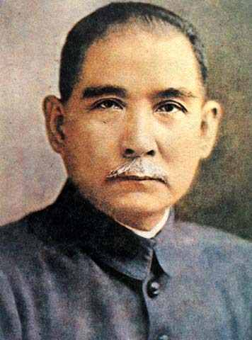
Dr. Sun Yat-sen

Slide 13
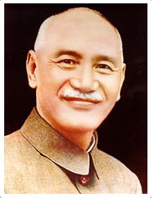
Chiang Kai-shek

Slide 14
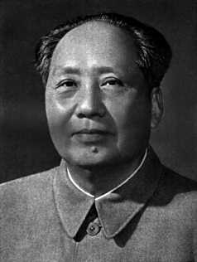
Mao Zedong

Slide 15
Revolutions in China
1949 – the Communists set up the People’s Republic of China on the mainland
The Nationalists fled to the island of Taiwan and set up the Republic of China

Slide 16
5. Japan (WWII)
By the early 20th century Japan had become a major power and continued to expand their empire
December 7, 1941 – surprise attack on U.S. naval base of Pearl Harbor in Hawaii
Brought U.S. into WWII
U.S. – dropped 2 atomic bombs on Hiroshima & Nagasaki
Ended with Japan’s defeat & surrender in 1945

Slide 17
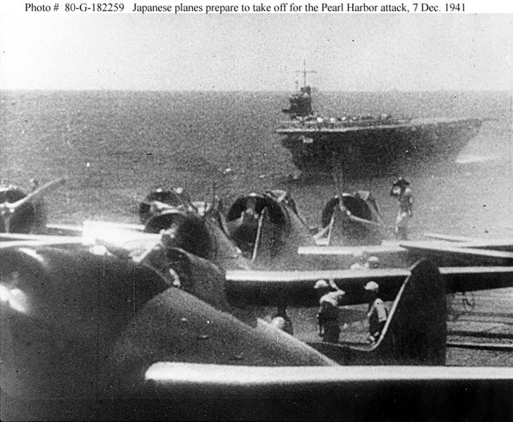
Japanese planes prepare to take off for the Pearl Harbor attack

Slide 18
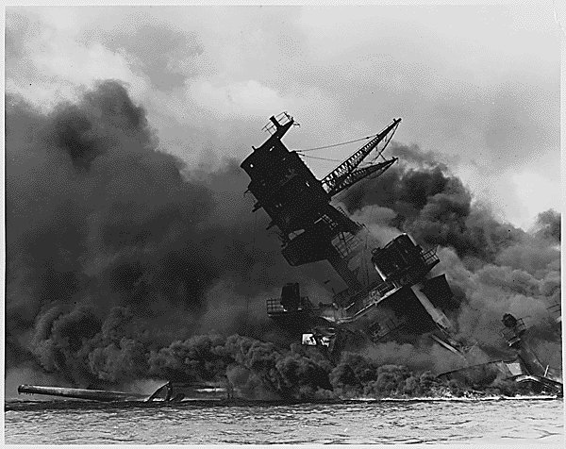
USS Arizona burned for two days after being hit by a Japanese bomb. Parts of the ship were salvaged, but the wreck remains at the bottom of Pearl Harbor to this day.

Slide 19
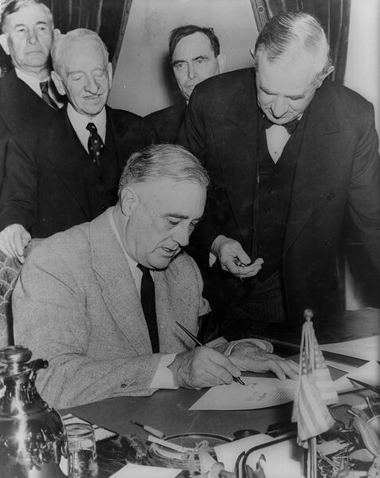
President Franklin D. Roosevelt signed the Declaration of War against Japan on the day following the attack.

Slide 20
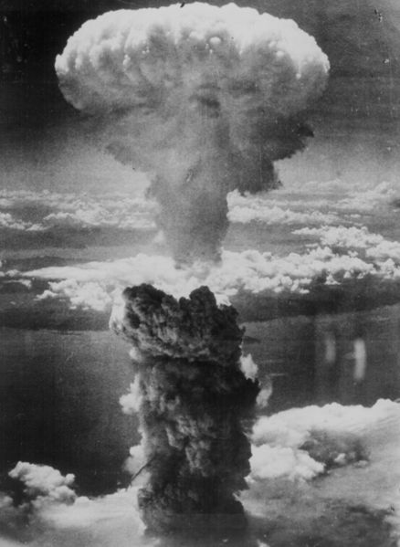
Nagasaki
The Fat Man mushroom cloud resulting from the nuclear explosion over Nagasaki.

Slide 21
6. Korea
Cultural bridge between Japan and the mainland of Asia
Kingdom of Silla ruled Korea as a unified state until 936 when it was overthrown by the Koryo Dynasty
Military rulers took power in the late 1100s, but were conquered by the Mongols

Slide 22
Korea
Peninsula
Controlled by China & Japan throughout its history
Japanese ruled Korea until they were defeated in WWII in 1945
Northern part was controlled by the Soviet Union
Southern half supported by the U.S.

Slide 23
Korea – A Divided Peninsula
1950 – Korean troops from the North invaded South Korea starting the Korean War
War ended in 1953 with a treaty that divided the peninsula
North Korea (Communist)
South Korea (Democratic)

Slide 24
7. Population
1.5 billion people
China – 1.3 billion
(Special Administrative Regions in China: Hong Kong - 6.9 million, Macao - 500,000)
Japan – 127 million
North Korea – 22.9 million
South Korea – 48 million
Mongolia – 2.6 million
Taiwan – 22.7 million

Slide 25
China - population
1 out of 5 people in the world lives in China
Most populated country in the world
94% belong to the Han ethnic group
Mainly live in eastern & southern China
The rest of the people belong to about 50 different ethnic groups
Non-Chinese peoples live in the far north & west

Slide 26
Population Distribution
CHINA
90% of the population is crowded on only 1/6ths of the land
Most live in the fertile valleys and plains of the Huang He, Chang Jiang, & Xi
In these areas, population density is more than 518 people per square mile
Population is scarcest in the west
30% live in cities

Slide 27
Population Distribution
CHINA
Impacts of 1 billion plus people
Population may grow faster than the food supply
Government encourages smaller families
One-child per couple policy (people with are rewarded with better income, reduced taxes, or the chance to go to a good school)

Slide 28
8. Largest Cities in the Region
Beijing, China
Shanghai, China
Tokyo, Japan
Osaka, Japan
Nagoya, Japan
Seoul, South Korea
Taipei, Taiwan

Slide 29
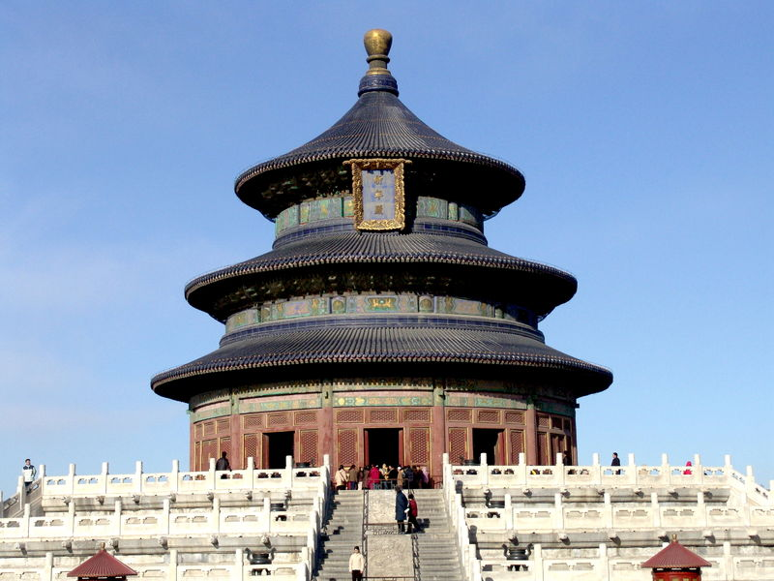
Temple of Heaven in Beijing, China

Slide 30
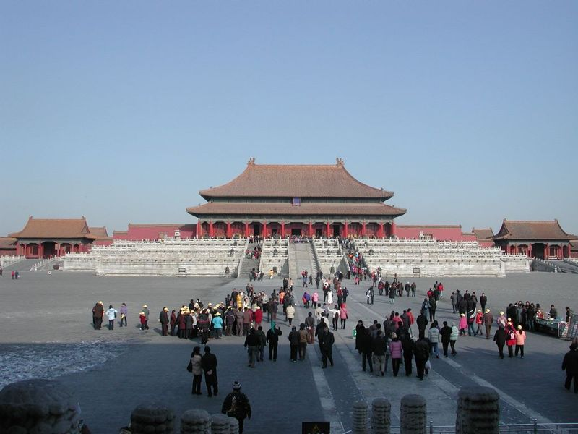
The Forbidden City, home to the emperors of the Ming and Qing dynasties in Beijing

Slide 31
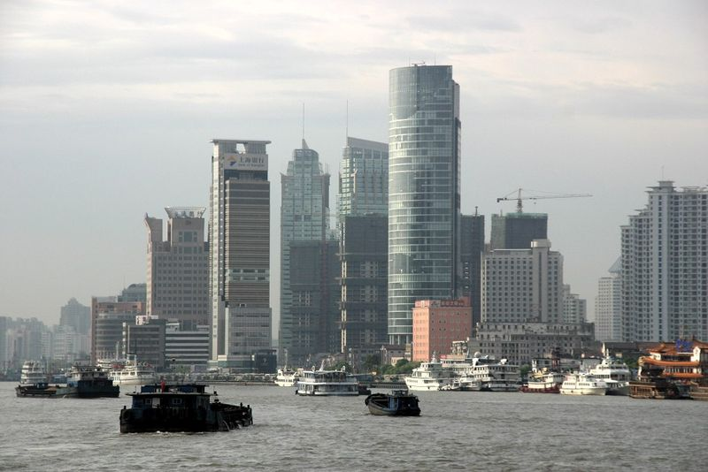
Shanghai, China

Slide 32
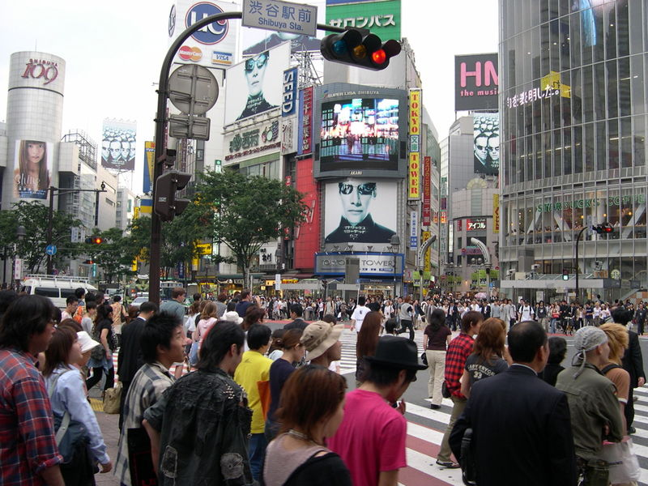
Tokyo, Japan

Slide 33
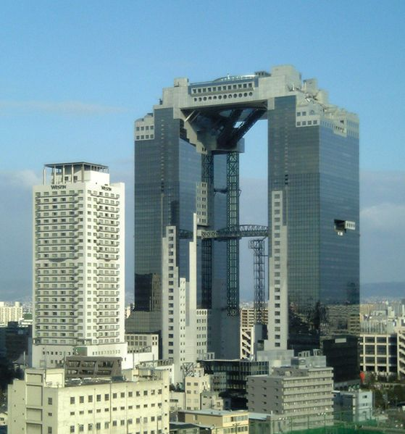
Umeda Sky Building in Osaka, Japan

Slide 34
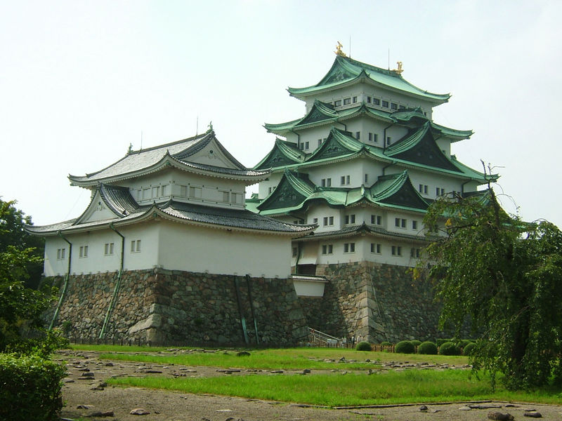
Nagoya Castle in Nagoya, Japan

Slide 35
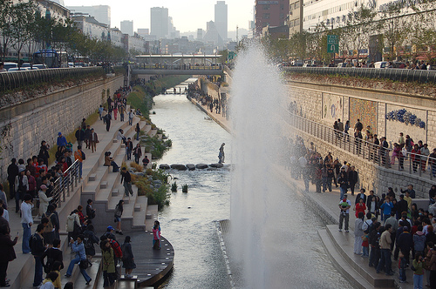
Seoul, South Korea

Slide 36
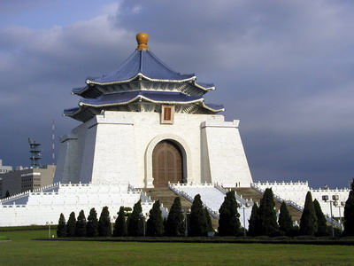
Chiang Kai-Shek Memorial Hall,Taipei,Taiwan

Slide 37
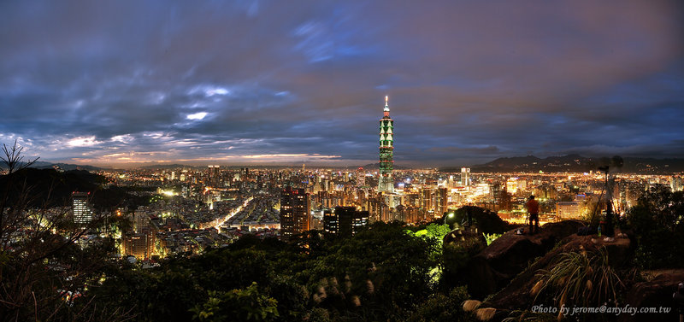
Taipei, Taiwan

Slide 38
9. Languages
Chinese has many dialects, most speak Mandarin Chinese
Written language is based on ideograms, or pictorial characters, and each one carries a meaning
To read a newspaper, need to know 2,000 – 3,000 characters
To have a solid grasp of the language need to know 25,000 characters
Japanese & Korean languages are related

Slide 39
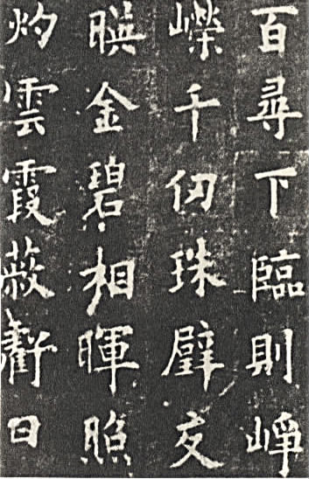
Chinese Calligraphy

Slide 40
10. Religion
Buddhism
Shintoism
Confucianism
Taoism
Christianity
Islam

Slide 41
Buddhism
Religion originated in India
Grew into an important religion in China by the 300s A.D.
Influenced by Confucianism & Taoism
Important ideas include rebirth & the end of the rebirth cycle

Slide 42
Shintoism
Native religion of Japan and was once its state religion
A form of animism
It involves the worship of kami, translated to mean "sacred spirits which take the form of things and concepts important to life, such as wind, rain, mountains, trees, rivers and fertility“

Slide 43
Shintoism
After World War II, Shinto lost its status of state religion
Some Shinto practices and teachings, once given a great deal of prominence during the war, are no longer taught nor practiced today, and others remain largely as everyday activities, like Japanese New Year, that few identify with religious connotations.

Slide 44
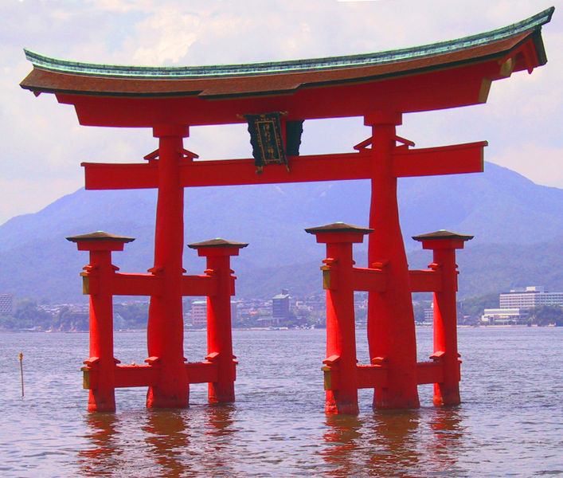
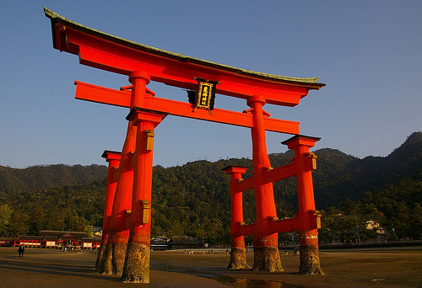
A torii, a traditional Japanese gate commonly found at the entry to a Shinto shrine
The floating torii
At low tide

Slide 45
Confucianism
Based on the teaching of Confucius
A Chinese philosopher who lived from 551-479 B.C.
Believed in respect for the past & one’s ancestors
Children should obey parents
Parents should obey government & emperor
Stressed the importance of education

Slide 46
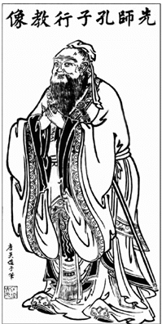
Confucius

Slide 47
Taoism
Based on the teachings of Lao-tzu (6th century B.C.)
Believed in the importance of preserving & restoring harmony in the individual & universe
Thought governments should leave the people alone & do as little as possible
Individual should seek harmony with nature

Slide 48
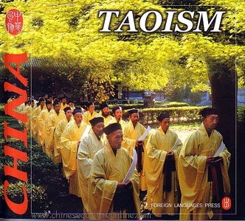

Slide 49
Religion
Communist governments in China & North Korea have discouraged religious practices, but many people have held to their beliefs

Slide 50
Miscellaneous Pictures

Slide 51
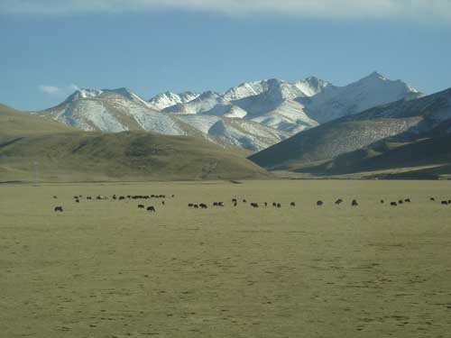
Plateau of Tibet

Slide 52
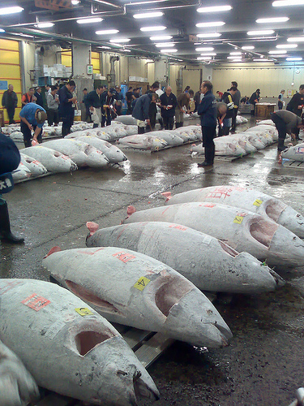
Tokyo Fish Market

Slide 53
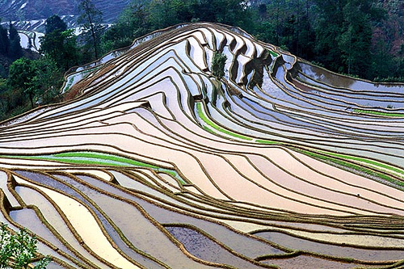
Rice fields in China

Slide 54
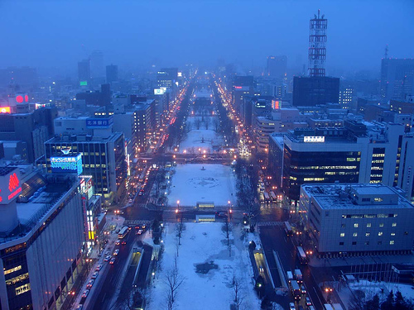
Sapporo, Japan

Slide 55
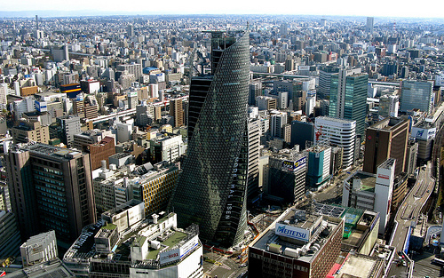
Nagoya, Japan

Slide 56
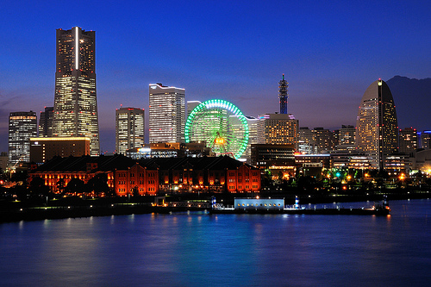
Yokohama, Japan

Slide 57
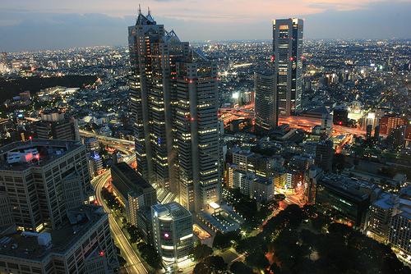
Tokyo, Japan

Slide 58
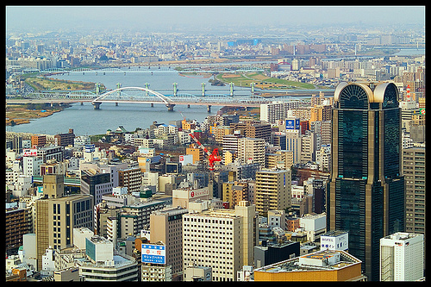
Osaka, Japan

Slide 59
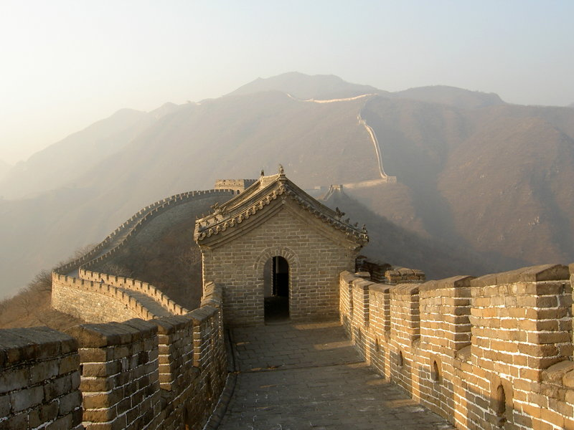
Great Wall of China

Slide 60
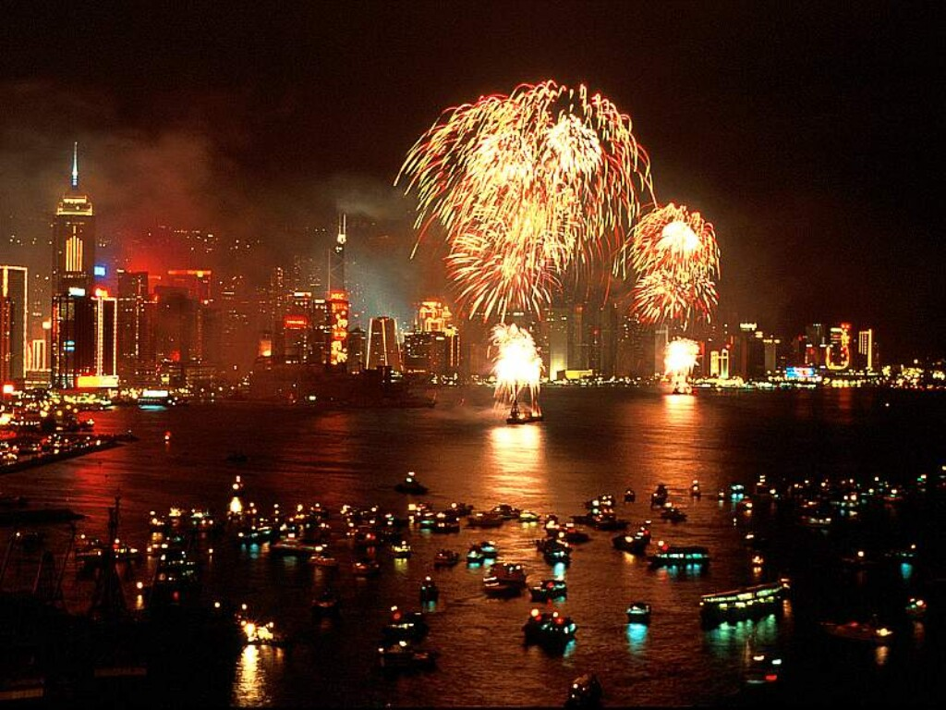
New Year’s celebration in Hong Kong

Slide 61
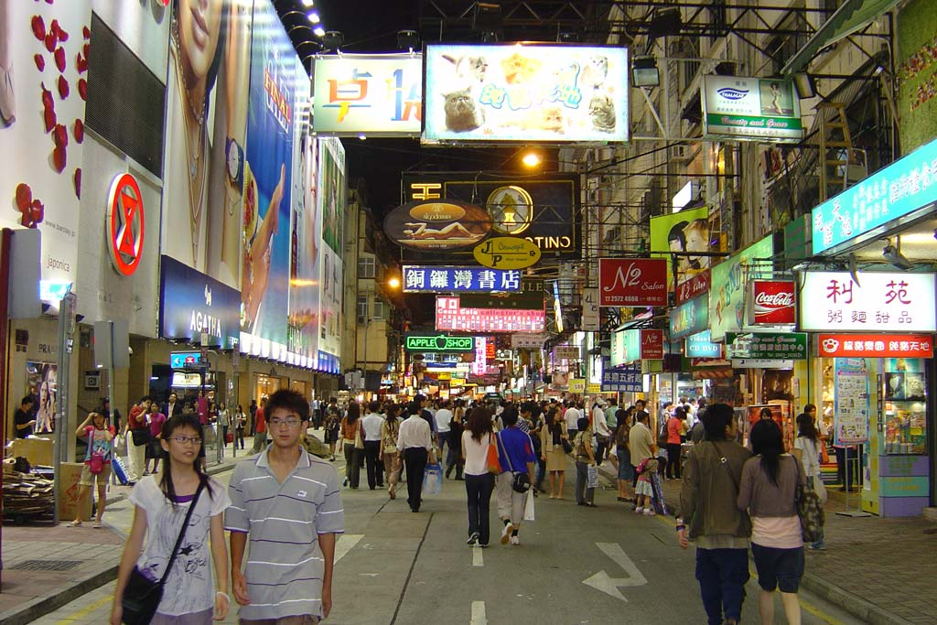
Hong Kong

