Slide 1
Early US History

Slide 2
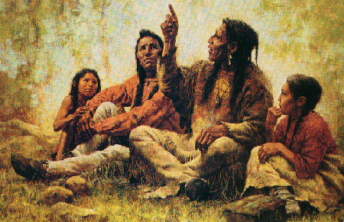
The Story Begins
America was first inhabited by immigrants from Asia via land bridge
Native Americans slowly descended from Alaska to cover all of North America.
From hunter-gatherers to more complex civilizations.
Much of U.S. geography named for “Indian” tribes in the regions.

Slide 3
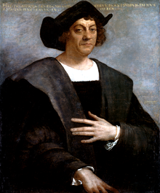
A New World
Christopher Columbus sailed for Spain.
Tried to reach the far east by sailing West.
Landed in the Caribbean and thought near India.
He had actually discovered a new hemisphere.
He has been called cruel by recent historians.

Slide 4
Conquistadors
Spanish soldiers who wished to get rich.
Often ruthless in their quest
Motives:
  Fame and Fortune
  Gain new lands for empire
  World power (mercantilism)
  Spread Christianity
Hernan Cortez vs. the Aztecs

Slide 5
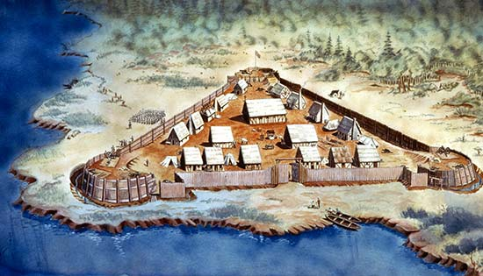
Settlement
Spaniards had discovered gold and silver in the New World during the 15th and 16th centuries.
However, Great Britain had become THE power of Europe by the 16th century.
1585 – Roanoke was the first British colony in Americas.
1607 – Jamestown, VA – first permanent British Settlement.

Slide 6
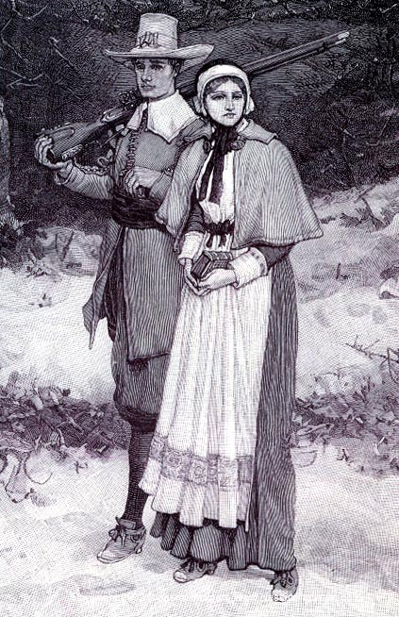
British Colonies
Jamestown nearly collapsed from starvation.
More interested in gold than food.
Tobacco became the “new gold”
Nearly all of the rest of the colonists came for religious freedom.
Pilgrims (Puritans) landed at Plymouth. (1620)

Slide 7
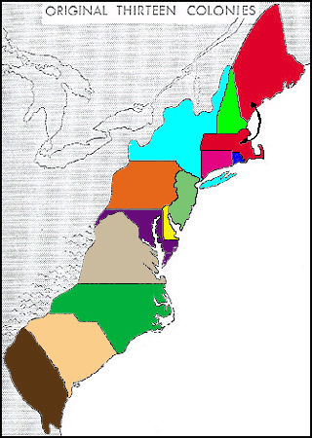
Early Colonies
British colonies divided into 3 regions.
New England
Middle colonies
Southern colonies
Colonies existed for the economic gain of the British government.
The economic system was mercantilism – competition between nations for gold.

Slide 8
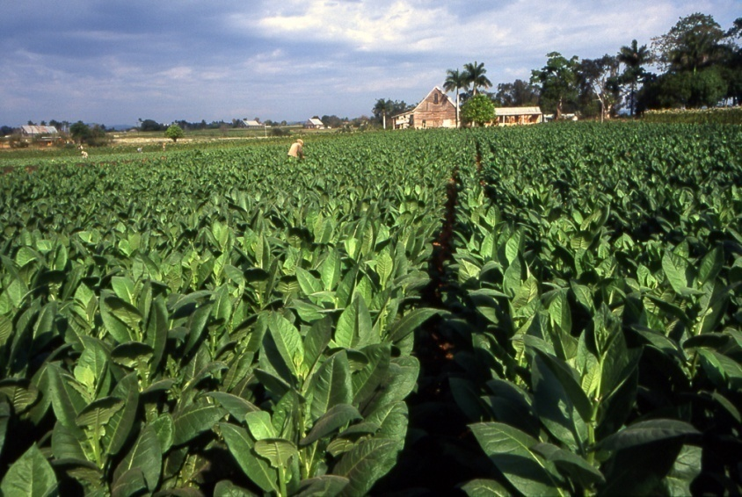
Colonial Economics
We had an agricultural economy.
New England was grains and beef, fishing, shipbuilding.
Middle colonies grew tobacco and built ships.
Southern colonies grew rice and cotton.
All items were shipped to England to sell.

Slide 9
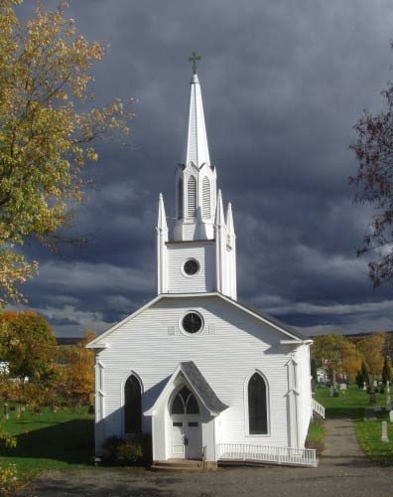
Religion in American Colonies
New England colonies were most religious.
Puritans had strict moral codes.
Middle colonies were also very religious, but more diverse.
Southern colonies least religious – strongest influence was Anglican Church.
1740’s – Religious revival in America – Great Awakening.

Slide 10

Religious Dissenters
Not everyone wanted to participate in Puritan society.
Anne Hutchinson was ostracized from the Massachusetts Bay Col.
Roger Williams founded Rhode Island as a colony of religious tolerance.
All Christian denominations were welcomed – not Catholics.

Slide 11
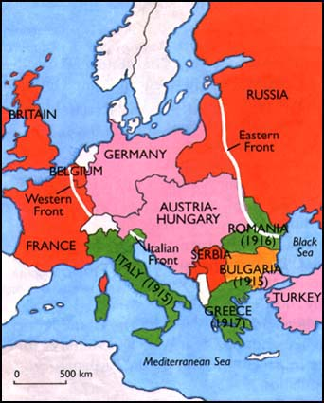
French and Indian War
Actually known as the 7 Years War in Europe.
America was the main battlefield.
The French and Indians aligned to stop Westward movement by the British colonists.
British soldiers despised colonial militiamen.
Colonel Washington was defeated in his only battles.
British won!!

Slide 12
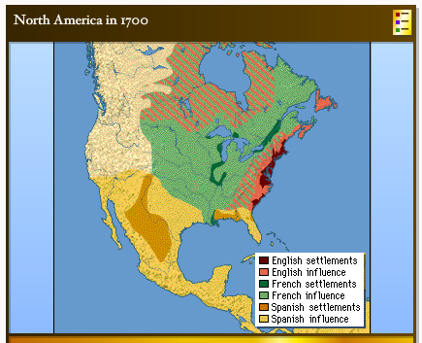
Results of Fr. And Indian War
Great Britain was the greatest power in the world.
The British incurred a huge debt.
British citizens had their taxes raised by Parliament.
There is nothing to block colonial expansion West.
Colonists thought they were bad!

Slide 13
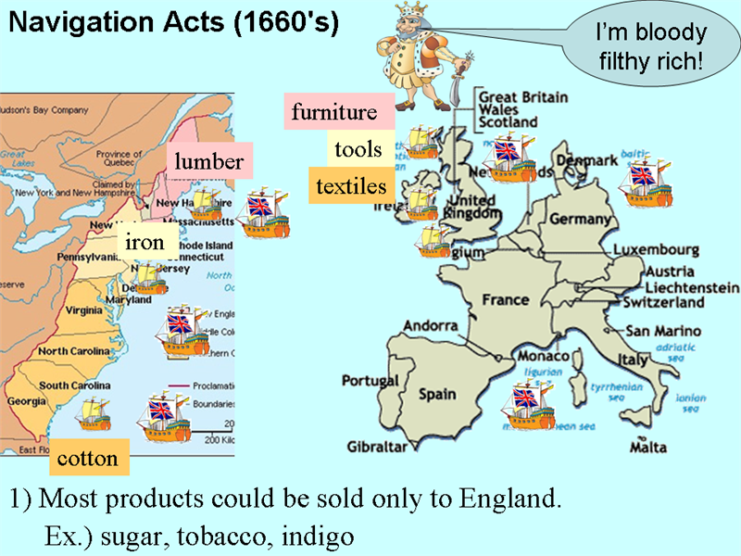
British / Colonial Tension
All goods going to or coming from colonies had to go through England.
Almost all colonial goods were “exclusive”.
The British government sent reps to make sure trade was not with other countries.
Privateers and merchants were angry.

Slide 14
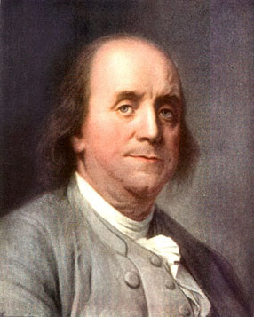
Colonial Influences
Most of the wealthy colonists were well educated.
They were all products of the Enlightenment.
The Enlightenment was an offshoot of the Renaissance.
Rousseau, Montesque, Voltaire, Locke, Diderot, etc… wrote about the rule of law.
Many colonists were feeling used

Slide 15
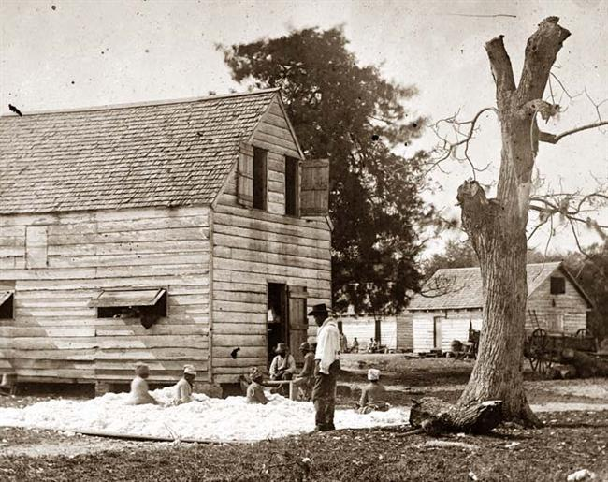
Southern Labor
Indentured servants were tried as a labor force in the South.
Agreed to work for # of yrs. In return for passage and 50 acres
Indian slaves died from disease too easily.
Indentured servants often rebelled – Bacon’s Rebellion.
Slaves from Africa sold by Portugal became the answer.

Slide 16
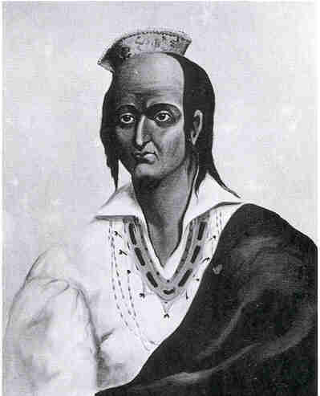
Colonists and Indians
Some Natives had begun to assimilate into Euro colonies.
However, most treaties were broken by Whites in America.
King Philip (Metacom) aligned many tribes against the colonists.
King Philip’s War was deadly for the colonists, but very deadly for him.
Metacom was beheaded, drawn, and quartered.

Slide 17
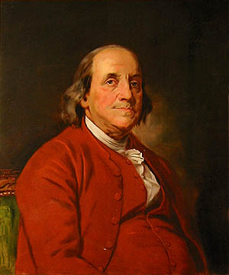
Ben Franklin
He was most famous and respected of all colonials.
Accomplishment:
  Lightning (electricity)
  Bifocals
  Lightning rod
  Franklin Stove
  Published, “Poor Richard’s Almanac”

Slide 18
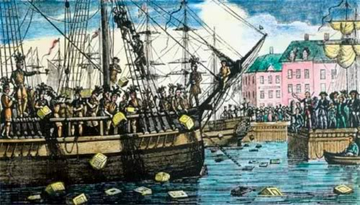
British Debt
British built huge debt in winning war.
They thought colonists should have to help pay.
Colonists disagreed.
Several taxes were tried –
Sugar
Tea
Stamp
Finally – Proclamation of 1763!! – No more West!

Slide 19
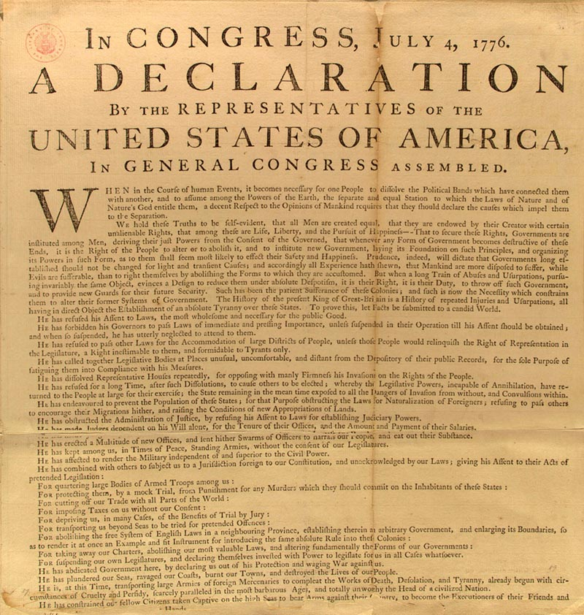
Declaration of Independence
Thomas Jefferson was asked by the Cont. Congress to draft formal letter of independence.
It was written to King George III
It was really written to ask for allies.
GB was a BA and others may want to join us.
It included a long list of grievances.

Slide 20
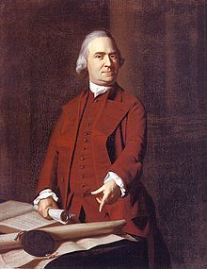
Road to Revolution
Boston Tea Party
Committees of Correspondence started to spread propaganda thru colonies.
British gov’t tried to govern a people they had allowed to govern selves.
Merchants begin bypassing Br. Trade.
Thomas Paine – Common Sense.

Slide 21
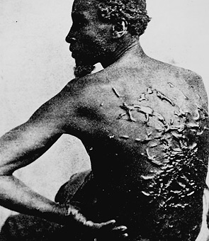
Slavery in America
Indian slaves and indentured servants from Europe had not proved effective.
Slaves were bought from European merchants or the Caribbean.
Triangular Trade was de-humanizing and deadly.
South was more dependant on slavery than other regions.

Slide 22
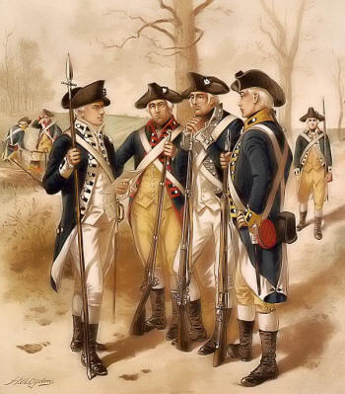
Revolutionary War
George III hired Hessian soldiers to fight colonists.
George Washington was commander of Continental Army.
All colonists had to do was extend the war.
Battle of Saratoga was first major win – secured France as ally.
Battle of Yorktown was the death-nail of the British.
We Win!!!!!!!

