Slide 1
Cold War Conflicts
03.14.11
Lesson 1
Test 12
Pgs. 602—608

Slide 2
Cold War Conflicts: Preview Assignment
Based on the details on this political cartoon, what can you tell me about the specifics of the Cold War?
Background
Clouds
Animals
Who do they symbolize?
What are the characteristics of the animals these countries are represented as?
Falling phrases
What do they say?
What does the location of “deepening suspicions” and “irresponsible statements” tell you?
Setting
What are they standing on? What does that tell you?
What is the crack a symbol of?

Slide 3
"I Can"
Define the term “Cold War” and identify the events that propelled the U.S. and the U.S.S.R into this period of hostility.
Gain an understanding of how these events started and helped to cement the Cold War period from 1945 to 1990.

Slide 4
Origins of the Cold War
After World War II, the United States and the Soviet Union emerged as two “superpowers.”
The issue was that the two countries had two extremely different political and economic systems.

Slide 5
Opposing Outlooks
the United States
the Soviet Union
Capitalism: private citizens controlled almost all economic activity.
Democratic Government: the president and a congress are elected by popular vote from competing political parties.
Communism: the state controlled all property and economic activity.
Totalitarian Government: the Communist Party establishes a totalitarian government with no opposing parties.

Slide 6
Post War Suspicion
The U.S. distrusted the Soviet Union leader, Joseph Stalin, because he had been an ally of Hitler.
Stalin did not agree with the Allies’ hesitation to attack the Germans in Europe.
Stalin disliked the United States’ attempt to hide its development of the Atomic Bomb.

Slide 7
Truman Takes Over
On April 12, 1945, Vice President Harry S. Truman took over the presidency after the death of F.D.R.
As a result, he became the key figure from the United States in the first phases of the conflict with the Soviet Union.

Slide 8
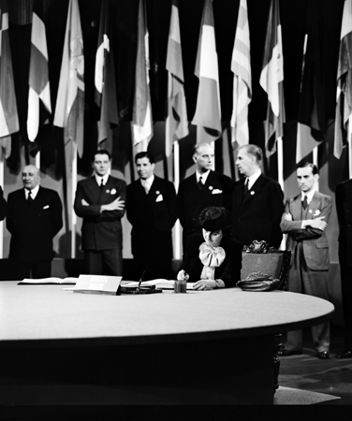
The United Nations
Despite such tension, hoping to establish world peace, on April 25, 1945, representatives of 50 nations met in San Francisco to create the United Nations.
Finally, after debating for two months, on June 26, 1945, the UN was officially established.
However, fighting for political and economic control of the world, the U.S. and the Soviet Union used the UN as an opportunity to influence others and as an arena for the arms race.

Slide 9
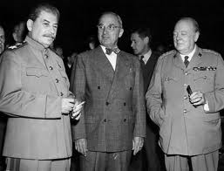
The Potsdam Conference
In July 1945, the Big Three (the U.S., Great Britain, and the Soviet Union) met at Potsdam for the final wartime conference to discuss economic and political specifics to help shape the world.
These were the same countries that were present at Yalta.
United States: Truman
Soviet Union: Stalin
Great Britain: Clement Atlee

Slide 10
Bargaining at Potsdam
Though discussions at Yalta lead the U.S. to think differently, Stalin prevented free elections in Poland and banned democratic parties.
Also, at the Yalta conference, Stalin wanted Germany to pay reparations to help reimburse Soviet wartime losses.
However, Truman did not agree and it was finally decided that each country would take reparations from their respective occupation zones.
In addition, Truman was adamant about the U.S. spreading democracy and free trade so that American businesses could obtain raw materials from and sell goods to Eastern European countries.
This would allow the U.S. to maintain its status as economic leader of the world.

Slide 11
Potsdam Conference
July 1945

Slide 12
Soviets Tighten their Grip on Eastern Europe
Though the Soviet Union also gained a great deal of economic and military strength after the war, they suffered severe devastation on their home front.
Approx. 20 million deaths
As a result, the Soviets began to dominate Eastern Europe by establishing communist rule in what were called satellite nations.

Slide 13
Satellite Nations
Satellite Nations: countries dominated by the Soviet Union.
Countries: Albania, Bulgaria, Czechoslovakia, East Germany, Hungary, Romania, and Poland.
1946: Stalin announced that communism and capitalism were incompatible –solidifying the Cold War.

Slide 14
United States Establishes a Policy of Containment
In response, in February of 1946, George F. Kennan, proposed a policy of containment.
Containment: the efforts of a country to keep another country from spreading its influence.
In this case, the U.S. would take measures to prevent the Soviets from spreading communism to other countries.

Slide 15
The Iron Curtain
Consequently, Europe was divided into two political regions: the democratic Western Europe and communist Eastern Europe.
In March of 1946, Winston Churchill described the division as the “iron curtain.”
Such conflict led to the Cold War: a state of hostility between the U.S. and Soviet Union from 1945 until 1991 where neither nation directly confronted the other on the battlefield but fought a political war of words and ideologies.

Slide 16
The Truman Doctrine
The first attempt to contain Soviet influence was in Greece and Turkey.
On March 12, 1947, Truman asked Congress for $400 million dollars in economic and military aid.
In his request, he made a statement that became known as the Truman Doctrine--that it is the policy of the United States to aid free countries who are resisting the invasion of internal or external forces.
Congress approved Truman’s request which significantly decreased the possibility of communist takeover in those particular countries.

Slide 17
The Marshall Plan
Western Europe was suffering from the destructive effects of WWII.
In June 1947, Secretary of State George Marshall suggested that the U.S. provide aid to all European countries that needed it.
This became known as the Marshall Plan.

Slide 18
The Marshall Plan
16 countries received $13 billion over the next four years.
This plan would help stop the spread of communism.
It would rebuild Eastern European countries and their economies.
The plan would also improve U.S. trade.
By 1952, Western Europe was prospering and the Communist party was losing its appeal.

Slide 19
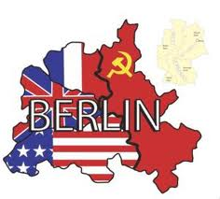
Germany
At the end of WWII, Germany was
divided into four zones occupied by the
United States, Great Britain, and France
in the west and the Soviet Union in the east.
Berlin, the capital of Germany, had also been split into two territories.
The three countries in the west combined their three zones into one country but were surrounded by Soviet occupied territories.
West Germany had no written agreement with the Soviets that guaranteed free access to Berlin by road or rail.
Stalin, wanting the others out, closed all highway and rail routes into West Berlin preventing food or fuel from reaching that part of the city. This barricade eventually became known as the Berlin Wall.

Slide 20
Germany
Division of the country in 1945

Slide 21
The Berlin Airlift
To resolve this issue, American and British officials established the Berlin airlift.
This was a 327 day operation where U.S. and British planes flew food and supplies into West Berlin.
It took 277,000 flights to take in 2.3 million tons of supplies every few minutes to allow West Berlin to survive.

Slide 22
The Berlin Airlift cont.
In May of 1949, the Soviet Union lifted the blockade realizing that they had been beaten.
That same month West Germany became an official nation—the Federal Republic of Germany—including West Berlin.
Just a few months later, the Soviet Union similarly created the German Democratic Republic, otherwise known as East Germany.

Slide 23
The NATO Alliance
On April 4, 1949, in fear of Soviet aggression, ten Western European nations, along with the U.S. and Canada, created a defense military alliance called NATO: the North Atlantic Treaty Organization .
All 12 countries vowed to supply military support to one another in the case that any member was attacked.

Slide 24
The NATO Alliance
In 1952, Greece and Turkey joined NATO, and West Germany joined in 1955.
This gave the organization a standing military force of over 500,000 troops along with thousands of planes, tanks, and other equipment.
Political cartoon pg. 608

