Slide 1
Chapter 5
Creating the Constitution

Slide 2
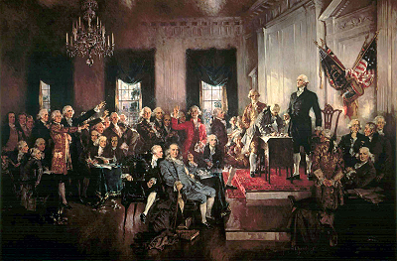
Agreement & Disagreement
The delegates debated on how to set up our government….it didn’t happen overnight.
Agreements:
a national government was needed, not just an alliance of states.
Montesquieu’s idea of three branches.
A government’s power must be limited by dividing power between the states & national government.
Disagreements:
How many representatives should each state have?
How much power should be given to the national government?

Slide 3
Getting organized
The Constitutional Convention takes place at the same place the DOI was signed: Pennsylvania State House.
July 1776 – delegates had to deal with heat, humidity and flies.
T. Jefferson joked the DOI was signed quickly because flies were biting them.
DOI was actually signed after a long debate…the convention of 1787 was bound to be a repeat.

Slide 4
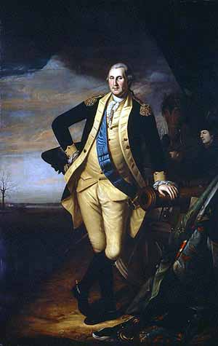
Washington is selected & Rules are set
Unanimous decision.
Clear rules were still needed.
Keep discussions secret.
Don’t talk to newspapers.
Don’t take notes out of meetings.
Keep all windows and doors shut.
One vote per state (not delegate).
No whispering, passing notes, or reading while another delegate was speaking.
Meet 6 days a week, 10-4, non-stop.
Average 40 out of 55 delegates present each day.

Slide 5
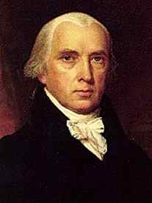
Madison’s plan
Most delegates new change was a must, but didn’t have a specific plan.
Madison proposed a strong central government with three branches.
Legislative – two parts: House of Representatives and Senate.
People elect members of House.
House would choose Senators.
Both based on state’s population.
Known as the Virginia Plan.
Delegates feared this plan would give the national government too much power.
Who would likely have a problem with this plan?

Slide 6
Sharing power
After much arguing, the delegates decided which powers would be given to the national government, which powers would be kept by the states and which powers would be shared.
One of the big issues: whether or not each state would have the power to protect or abolish the slave trade.
Who do you think wanted national government to have control?

Slide 7
Reaching compromise
How many representatives should each state have in the legislature?
Virginia Plan | Great Compromise | New Jersey Plan
Two-house (bicameral) legislature; representation based on each state’s population. | Two-house legislature; House of Representatives elected on basis of state population; two Senators for each state, regardless of population. | One-house legislature; representation equal for all states.

Slide 8
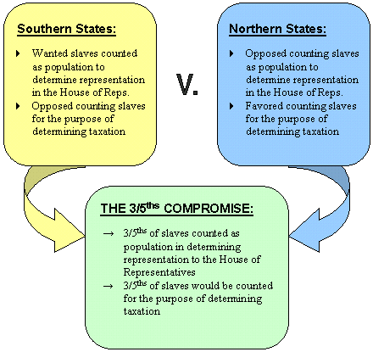
Three-fifths compromise
They still needed to settle the issue of how to count slaves in the population.
Southerners wanted to count them.
Northerners objected.
Compromise: counted each slave as three fifths of a person when a state’s population was calculated.

Slide 9
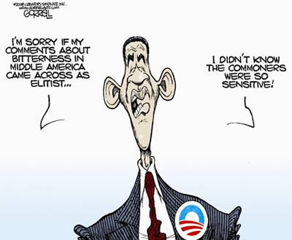
Executive and judicial branches
Under the AOC, there was only a legislative branch.
Now, delegates wanted to give executive power to one person.
They also wanted a judicial branch to interpret laws and settle conflicts between states.
Argued about who should elect the president and Congress: should it be direct or is the judgment of the people too poor?

Slide 10
Voting and elections
As part of the Great Compromise delegates decide:
White men with property would elect members of the House.
State legislatures would elect senators.
Electoral College would select the President.
Each state legislature would determine how that state’s electors would be chosen.

Slide 11
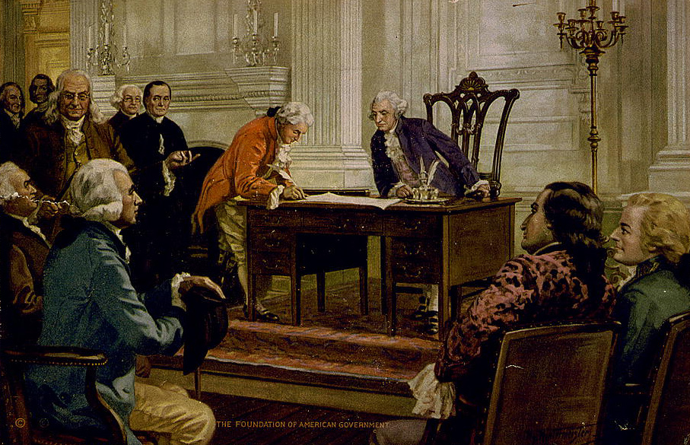
The signing
The delegates, often called the Framers, signed the Constitution on September 17, 1787.
Changes have been made but the basic plan is still there.

Slide 12
The struggle for ratification
Now that the delegates signed the Constitution, at least nine state conventions had to approve it.
The issues previously kept secret were now out in the open.
Some people supported it (Federalists).
Others opposed it (Anti-Federalists).

Slide 13
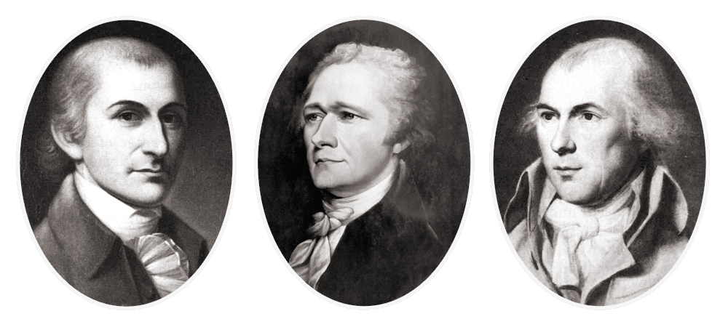
Federalists
Supported a strong federal, or national government.
Reasons:
States need protection from foreign nations.
A strong national government would:
Provide protection
Maintain order
Regulate trade
Guarantee the rights of citizens
Also ensure nation’s debts were paid and American money was stable.
Leading Federalists: John Jay, Alexander Hamilton and James Madison.

Slide 14
Anti-federalists
Feared a strong central government would endanger the people’s liberties.
Felt the representatives would meet too far away.
Disliked the statement that gave Congress the power to make laws “necessary and proper”.
Could lead to abuse of power.
Disliked that the Constitution did not include a Bill of Rights.
Leading Anti-Federalist: Patrick Henry.

Slide 15
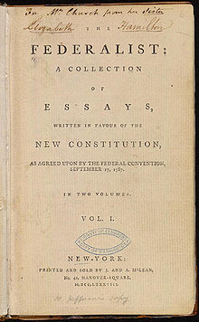
The Federalist Papers
Collection of essays outlining the need for a new government and the form it should take.
Strongly supported a national government.
We were too weak and immature.
Spain, England or France might take us over.

Slide 16
Ratification
By June 1788, 9 states had approved the Constitution, making it official.
The last 4 states contained 40% of the nation’s people.
It took a while, but eventually all 13 states ratified the new Constitution.
We now became the United States of America.

Slide 17
The goals of our government
To Form a More Perfect Union
Be better than the AOC
To Establish Justice
Legal system → fair
To Insure Domestic Tranquility
Peace
To Provide for the Common Defense
Protect citizens
To Promote General Welfare
Benefit all Americans
To Secure the Blessings of Liberty to Ourselves and Our Posterity
Freedoms

Slide 18
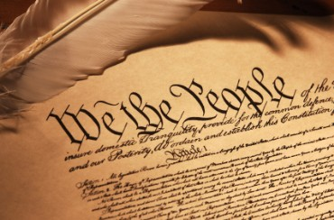
The articles
After the Preamble (We the People…), the Framers laid out the plan for our government.
Organized in seven parts called articles.
Subsections are called clauses.
The first three articles: the three branches of government.

Slide 19
Articles 1-3
Article 1: Legislative Branch
Congress
Make laws
Article 2: Executive Branch
President
Carry out laws
Article 3: Judicial Branch
Supreme Court
Interprets laws & settles disputes between states

Slide 20
Articles 4-7
Article 4: The States
Honor laws of other states.
Article 5: Amending the Constitution
Changes, or amendments, are allowed.
Article 6: The Supremacy of the Constitution
State laws can’t violate the Constitution.
Article 7: Ratification
Established procedure for approval.

Slide 21
Limited government
Constitution created a government with powers limited by the consent of the people.
Based on the idea of popular sovereignty – allowing the people to rule.
Three main principles limited the government’s power: federalism, separation of powers and checks and balances.

Slide 22
Federalism
Federalism – division of power between the states and the federal, or national, government.
Concurrent powers – powers shared by the federal and state governments.
Reserved powers – powers that the Constitution neither gives to Congress nor denies to the states.

Slide 23
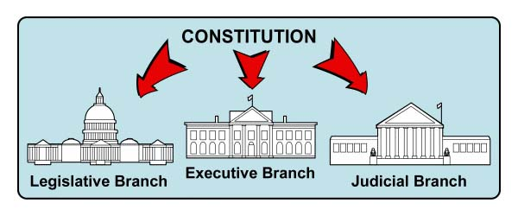
Separation of powers
Power is not only divided between the state and federal governments; it is also divided within the federal government.
Three branches → keeps one branch from abusing its power.

Slide 24
Checks and balances
Gives each branch of government ways to limit the powers of the other two.
Presidential power to veto.
Supreme Court can declare laws unconstitutional.
House can impeach, or accuse, the President or other high officials.
Can result in the removal from office.

