Slide 1
Chapter 22 & 23
Political Parties and Electing Leaders

Slide 2
How parties help the people
Everybody wants something from government
You want your rights protected, you want to be treated fairly in business, at school, you want laws passed and money spent on programs you feel strongly about
Political Parties are organizations of people who want to influence government by getting people elected to office

Slide 3
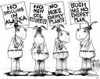
Setting Goals
Political parties establish platforms or planks
These platforms are their position or stand on a topic
www.gop.com
http://www.democrats.org/a/party/stand.html

Slide 4
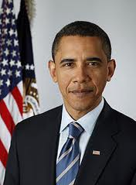
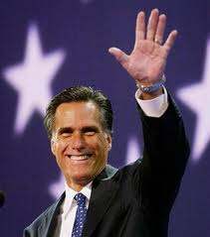
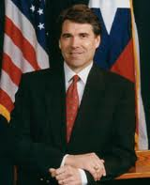
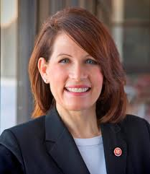
How political parties help
They may be a watchdog on the other group
They are the citizens’ voice in government
Inform citizens of facts

Slide 5
Our Two Party System
Political Parties are NOT mentioned in the Constitution
George Washington feared the conflict between parties would destroy the new democracy
Early parties were the Federalists, Anti-Federalists, Whigs

Slide 6
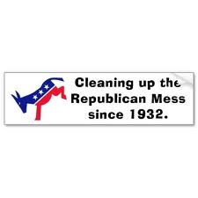
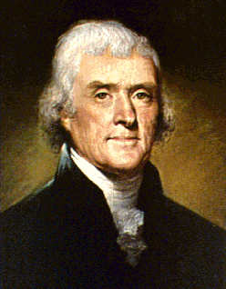
There used to be a Democratic-Republican Party
They were led by Thomas Jefferson
Opposed a strong national government
Supported power of the individual states
Farmers and Frontier Settlers supported this party
Later became known as the Democratic Party

Slide 7
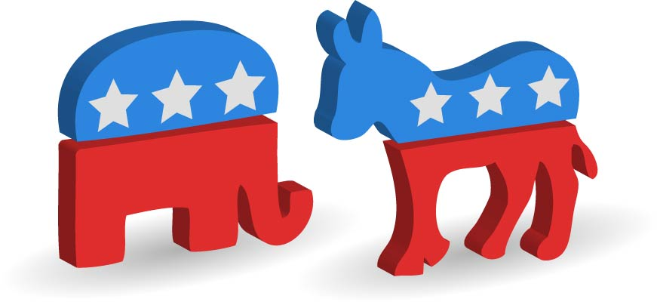
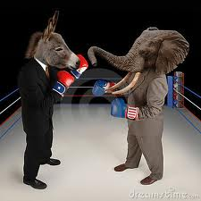
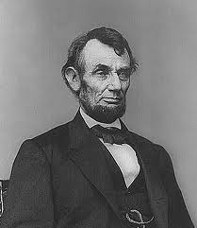
Our current two-party system began in 1854
1854 –the Republican Party was formed
Replaced the Whigs as a major party
Formed by groups who opposed slavery
Supported business interests and in the beginning was made up of people in the North
Lincoln was the 1st Rep. Pres

Slide 8
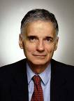
Power Continues to shift between the two parties
Most presidential elections have been dominated by one of the 2 main parties
Third Parties do exist
Third party candidates rarely win elections

Slide 9
So why do 3rd parties exist?
Sometimes are formed to back a candidate
They can draw votes away from one of the two main parties and influence the outcome
They can split the votes
In the 2000 election, Green Party candidate, Ralph Nader won votes that might have gone to Al Gore, so George Bush won the election

Slide 10
Third Parties
Let’s look at a website of political parties that exist
http://www.politics1.com/parties.htm

Slide 11
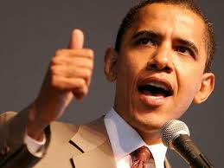
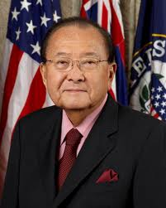
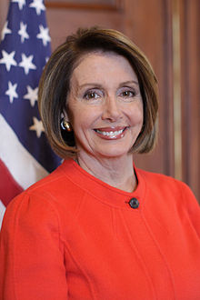
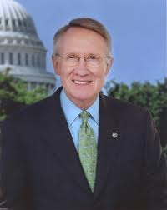
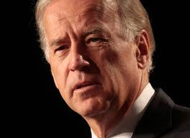
Characteristics of Democrats
More likely to support tax increases to support programs
More likely to support labor unions
Believes the federal government has the responsibility to support the poor
Favors more government regulation
Favors funding to support competitive schools

Slide 12
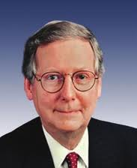
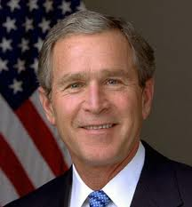
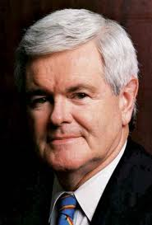
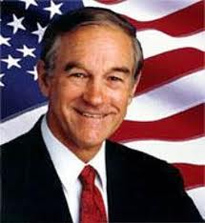
Characteristics of Republicans
Favors less government intervention in the economy
Favors tax breaks for high income earners to encourage business growth
Favors cutting back welfare benefits in order to encourage people to find work
Favors funding to allow parents to pick schools-vouchers

Slide 13
Third Parties-some of the issues
Anti-gun control
Environmental protection
Protecting rights of workers
Economic freedom
Campaign reform

Slide 14
Remember the political Spectrum
LEFT MODERATE RIGHT
LIBERAL Moderate CONSERVATIVE

Slide 15
Choosing Candidates
You can always nominate yourself if you want to.
You can write-in a candidate if they ask you to
Most offices are nominated by a group of people

Slide 16
Some things to go through
There may be a caucus (a meeting) to nominate a candidate
Direct Primary- is an election where members of a political party nominate someone to represent the part
Closed Primary-you must be a registered party member to vote for a member of that party
Open Primary- you do not need to be a member of a particular party to vote for the candidate

Slide 17
Chapter 23
Voting & Elections

Slide 18
General Elections
Election where voters make the final decision
Voters select people to represent them in offices from city council to the President of the United States
May also vote on new laws or ordinances

Slide 19
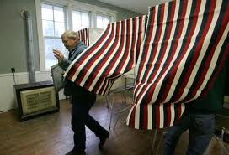
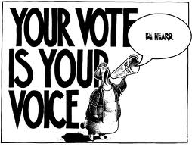
The basics of voting
Register
Must be 18 and a citizen
Vote at your assigned polling place
Need ID
Casting a vote varies
Absentee ballots
Machines/Computers
Paper Ballots/Punch Card

Slide 20
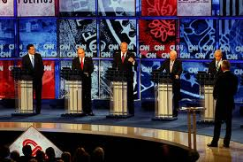
Be Informed
To vote wisely means to be informed!!
Learn about the candidates and their platform!
Research! Read! News!
Watch debates
Learn about ballot measures

Slide 21
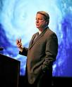
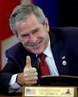
Why vote?
Most elections are not determined by one vote or even a 100
However, look at the 2000 election. It was decided by about 500 votes in Florida
Bush v. Gore (2000)

Slide 22
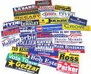
How do candidates influence the way you vote?
Messages from candidate-bumper stickers, direct mail, internet
Advertisements in the media
Interest groups

Slide 23
Recognize propaganda techniques
A message meant to influence people’s ideas, opinions, or actions
One side of the story
Can distort the truth
Appeals to your feelings

Slide 24
Type of Propaganda Techniques
Glittering Generalities
Card Stacking
Plain Folks
Name Calling
Bandwagon
Transfer

Slide 25
Election news is supposed to be unbiased, but….
Reporters, news directors, etc. have opinions
Common example: Fox News v. CNN
Opinion polls are reported by the media
Not all opinion polls are random, so be cautious with the information!

Slide 26
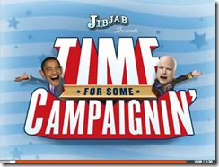
It’s time for some campaigning!
Organization-get a good campaign manager
What does the public think about issues?
Media, media, media-press secretaries make the candidate look good

Slide 27
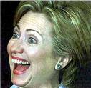
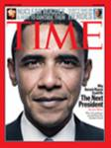
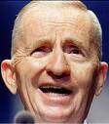
What are some factors for winning?
The best person for the job?
Do they look good on tv?
Are they a good speaker?
Do they have experience?
Are they the incumbent?

