Slide 1
Jimmy Carter v. Gerald Ford 1976

Slide 2
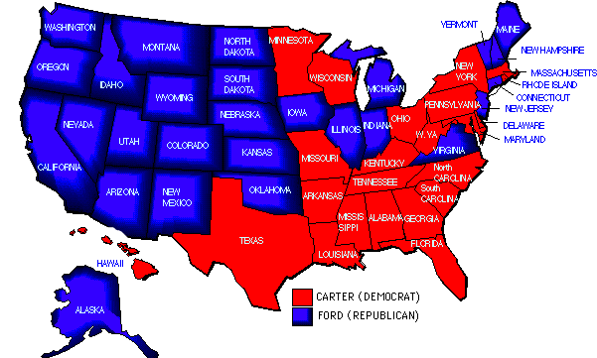

Slide 3
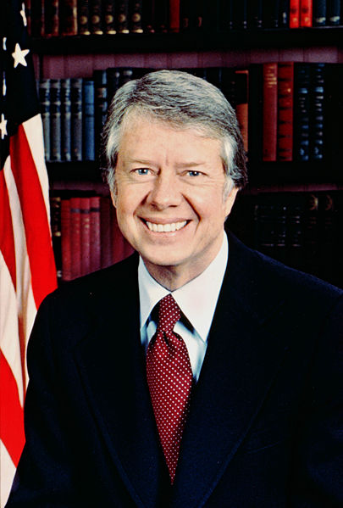
Jimmy Carter
Carter was easily elected in 1976 – bicentennial.
However, he inherited an energy crisis. OPEC had cut production.
Carter also hurt himself politically when he pardoned draft dodgers.

Slide 4
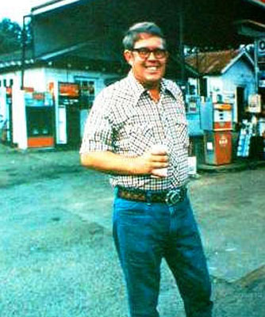
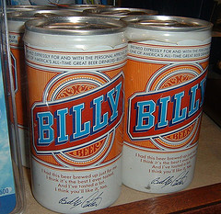
Carter
Jimmy Carter was known as a good man who meant well.
He had been a Sunday School teacher and truly cared about people
He has been accused of “not seeing the forest for the trees.”
His highlight as Pres. was the Camp David Accords – peace between Israel and Egypt.

Slide 5
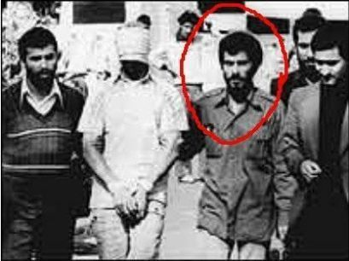
Carter
Carter was seen as weak on foreign affairs.
He was considered weak in both Afghanistan and Iran.
In Iran, Americans at the embassy in Tehran were taken hostage in 1979.
Many were held for 444 days
There was a failed rescue attempt

Slide 7
Reagan Revolution

Slide 8
End of Carter
Carter ended his admin. by fighting for his party’s nomination.
Ted Kennedy was from Massachusetts and more in line with liberalism.
Kennedy, however, had some of his own problems.
Carter and Kennedy beat each other up trying to get the Dem. nomination.

Slide 9
Ronald Reagan
Reagan started as a sports broadcaster in Iowa in the 30’s.
He moved to L.A. and made a name for himself as a B-movie actor.
Reagan became Pres. of the Screen Actors Guild during the McCarthy era.
Reagan went from being a Dem to a Rep. in the 50’s.

Slide 10
Election of 1980
Reagan was an actor and appealed to most Americans in debates.
He called for smaller government and tougher foreign policy.
He thought Americans paid too much in taxes and sought to decrease the budget.
Although it was Reagan’s election to lose, he didn’t.

Slide 11
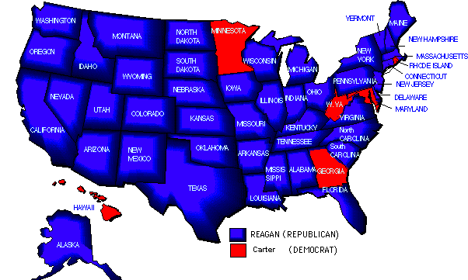

Slide 12
Hinkley
On March 30, 1981, Ronald Reagan was shot while leaving a meeting.
John Hinkley, a deranged young man, wanted the attention of Jodie Foster.
Reagan recovered rapidly and was able to use this as weight with the American people.
The Dems would be on the run for the next 6 or 7 years.

Slide 14
Reaganomics
Reagan wanted to cut the budget and lower taxes.
The Senate backed him b/c they were Rep.
The House was Dem. majority, but Reagan was able to get them on his side.
Dem leadership was befuddled with his abilities.
Deep cuts were made in the welfare state.

Slide 15
Reagan’s Agenda
Domestic policy centered on trying to cut taxes and cut the budget.
He also wanted to reduce government control of business.
Reduced restriction would give business a chance to expand.
Also a return to social conservatism.

Slide 16
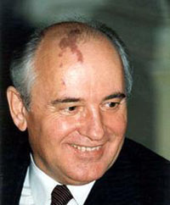
U.S. vs. Evil Empire
Reagan came into office with idea that communism would be defeated.
Mikhail Gorbachev was his chief nemesis.
Gorby sought a new openness with the world – Glasnost
1987 – INF Treaty limited intermediate nuclear warheads aimed at each other.
Reagan continued to push funding for Star Wars.

Slide 17
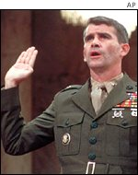
Iran-Contra
In his second term, Democrats got control of Senate and the sparks began.
Charges were made that we traded arms w/ Iran to get some hostages back.
Reagan denied.
Ollie North testified and the nation watched.
In the end, Sec. Weinberger was pardoned before trial.

Slide 18
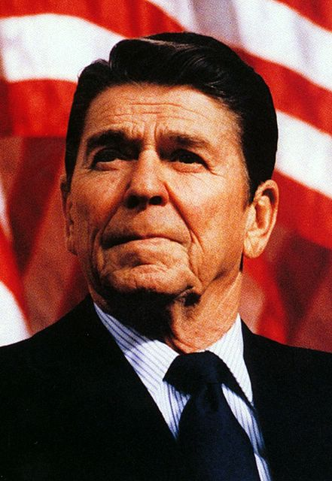
Reagan’s Policies
Reagan drove up the deficit way up with defense spending.
However, taxes were lowered twice and spending jumped.
Trade deficit also grew with Japan.
He appointed several judges to S.C.
Some conservative, some not.

Slide 19
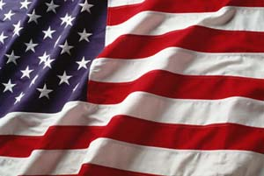
Reagan’s Legacy
Reagan is usually given the credit for destroying the USSR.
He outspent the Evil Empire and their economy collapsed.
He restored a sense of pride in America – he was optimistic.
Some deride the defense spending and deficit, but most see him as one of the best.

Slide 20
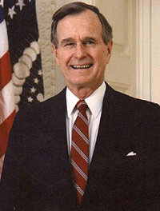
Bush Era
Reagan’s VP easily defeated Dukakis in 1988.
He had served in WWII, Congress, State Dept., U.N., and CIA.
Oversaw dismantling of USSR.
Also put together a coalition to oust Iraqis from Kuwait.
Will be remembered for Desert Storm.

Slide 21
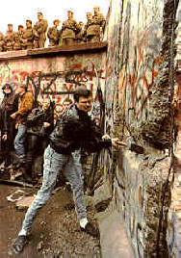
Cold War Ends
E. Germany, Czech, Poland and Romania all sought freedom.
In 1989, the Berlin Wall was toppled.
The Soviet Union was crumbling.
Freedom had a cost.
Fighting broke out in many of the old Soviet republics.
Transition to democracy was slow.

Slide 22
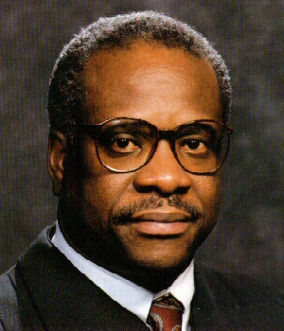
Bush I @ Home
Bush enjoyed immense popularity after Gulf War.
But, the economy was slowing and our debt growing.
A conservative, Bush appt. Clarence Thomas to S.C.
Thomas was opposed by liberals – even NAACP.
Barely confirmed.

Slide 23
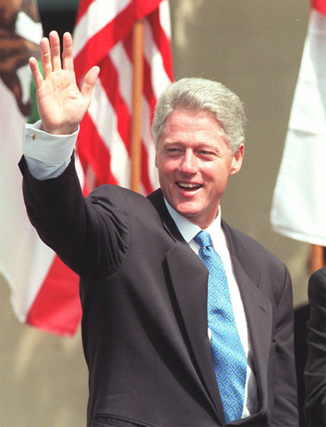
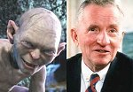
Election of 1992

Slide 24
Election Outcome
Clinton won the election with an electoral landslide even though he got <50% of votes
Ross Perot got no electoral votes, but drew crucial votes from Bush.
Pres. Clinton surrounded himself with allies and friends in Washington.
He also bragged that the voters were getting 2 for 1 – his wife Hillary.

Slide 25
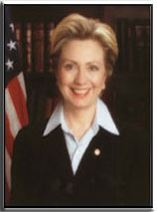
Early Problems
After 12 years of conservative Presidents, Clinton moved quickly
He miscalculated by trying to integrate gays into military.
His biggest asset became a liability.
He appointed his wife to revamp America’s health care system.
It flopped.

Slide 26
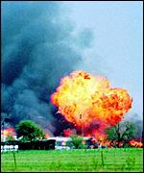
More Problems
There was an attack on the World Trade Centers in 1993.
Also in 1993, a standoff between ATF and cult in Waco, TX.
Dozens of men, women and children were killed.
There was an attack on a fed. building in Okla. City in 1995.
Anti-government attitudes grew.

Slide 27
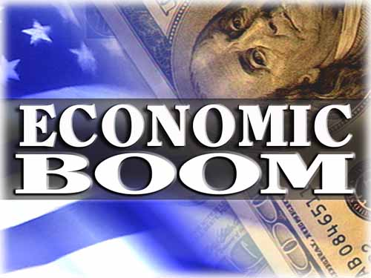
Bright Spot
Although Clinton struggled early, the economy grew.
Tech stocks rallied in the 90’s and boomed.
Middle class America also did very well.
The strong economy would prove to be his main legacy.

Slide 28
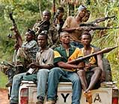
Foreign Policy
Mixed bag of foreign policy decisions.
American troops sent to Somalia to aid starving people.
Turned sour when our Blackhawk was shot down in Mogadishu.
Also invaded Haiti to support elected government.
Also had armed confrontation in Yugoslavia.

Slide 29
Troubles at Home
Whitewater land deal in Arkansas sparked investigation into the Clintons’ role.
Investors had lost a bunch of money as a few people got rich.
Clintons denied involvement, but almost all other partners were convicted.
Kenneth Starr was appointed special prosecutor.

Slide 30
Impeachment
Clinton friends were fiercely loyal and tight-lipped.
The only evidence they could find dealt with the President’s relationship w/ an intern.
Became known as Monica-gate and Pres. Clinton was impeached for lying under oath about the affair. Not convicted.
He was also disbarred for a number of years. Clinton was pardoned by George W. Bush.

