Slide 1
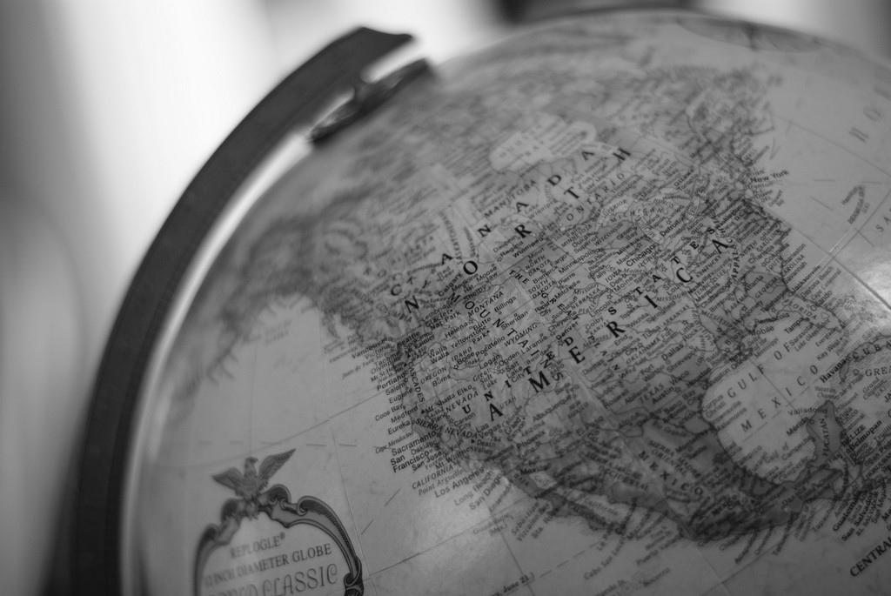
Basics of Geography

Slide 2
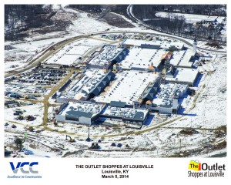
List It
How do you think the location of the new outlet mall, The Shoppes of the Bluegrass, was chosen?

Slide 3
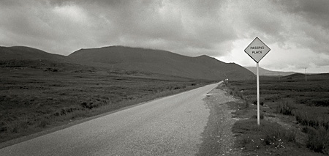
Place and location are a part of geography.
We are about the learn more about the elements and themes of geography!

Slide 4
List It
What is Geography?
Divide into pairs and brainstorm what geography is…
So…what is geography?

Slide 5
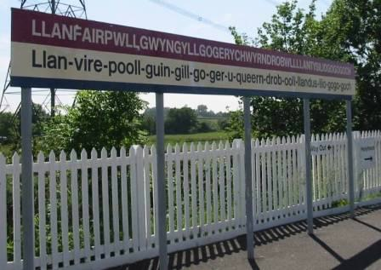
Misconceptions
Many people think geography is simply an exercise in memorizing place names.
http://www.youtube.com/watch?v=1BXKsQ2nbno

Slide 6
What it is!
A spatial science
Geographers study space in order to locate the distribution of people and objects.
Distribution has 3 properties-
Density
Concentration
Pattern
Geographers ask 2 main questions-
Where?
Why?

Slide 7
More specifically…
Geography is a way of thinking about problems, both natural & societal, which emphasize the importance of spatial relationships.
Take any social, environmental, or physical question or problem and ask yourself whether there is a spatial aspect to it.
Chances are that space and place play a role in the explanation and distribution of that question.
FOR EXAMPLE—
Why do there always seem to be so many wars in Africa?
Why is corn such an important part of a traditional Mexican diet?

Slide 8
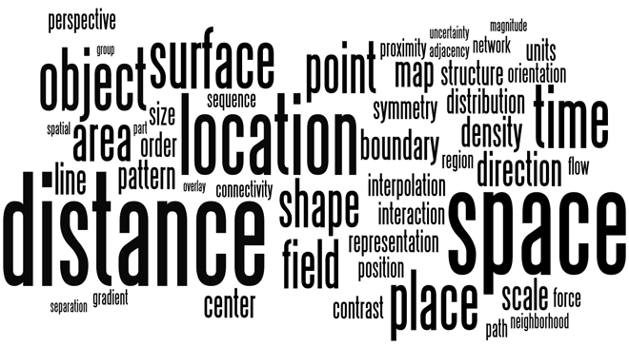
The World in Spatial Terms
Using patterns in where things are located and how they are arranged.
Using maps to study people, places, & environments.

Slide 9
So basically…
Geography is the study of EVERYTHING ON EARTH.
What is where and how it got there.

Slide 10
List It
How do we use geography in our everyday lives?

Slide 11
Why Geography Matters
You need to know geography so you won’t be like this…
http://www.youtube.com/watch?v=Cey35bBWXls
http://www.youtube.com/watch?v=WJpDEwSqw_I

Slide 12
Where do we find geography?
Geography exists in the global issues that affect all of us---
Population growth
Terrorism
Globalization
Income gap
Pollution
Industrialization

Slide 13
Who uses geography?
Everyone
Subfields include---
Cartography – study of maps and mapmaking
Meteorology – study of the weather
Geotechniques – GIS, GPS, Remote sensing

Slide 14
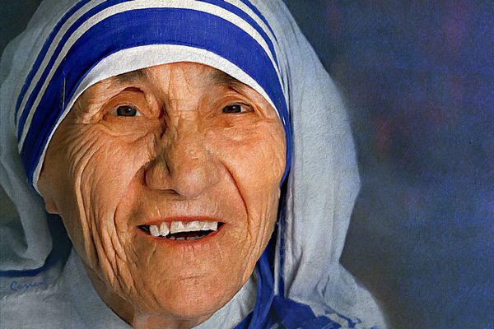
Famous Geography Students
Mother Teresa – taught Geography & History in Calcutta for 15 years
Prince William of Wales – Majored in Geography at University of Saint Andrews, Scotland
Michael Jordan – Majored in Cultural Geography at University of North Carolina, Chapel Hill

Slide 15
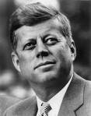
Quotes
“I like geography. I like to know where places are.” Tom Felton (Draco Malfoy – Harry Potter movies)
“Geography has made us neighbors. History has made us friends. Economics has made us partners, and necessity has made us allies. Those whom God has so joined together, let no man put asunder.” John F. Kennedy (35th president)

Slide 16
2 main branches of Geography
Human Geography – studies people
Physical Geography – studies natural environment
How do they relate to each other?

Slide 17
5 Themes of Geography
Movement
Region
Location
Interaction (Human-Environment)
Place
Aka MR. LIP

Slide 18
Movement
Humans move, a lot!
Ideas, fads, goods, resources, and communication all travel distances to.
So this includes the movement of goods & ideas and migration (people) across the planet.

Slide 19
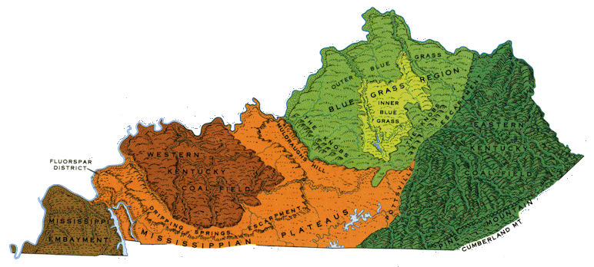
Region
Divides the world into manageable units for geography study.
Regions have some sort of characteristic that unifies the area. (what places have in common)

Slide 20
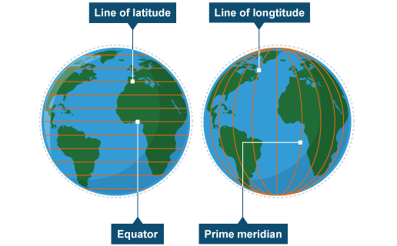
Location
Most geographic study begins with learning the location of places.
Absolute – latitude & longitude or s street address
Relative – described by landmarks, time, direction or distance

Slide 21
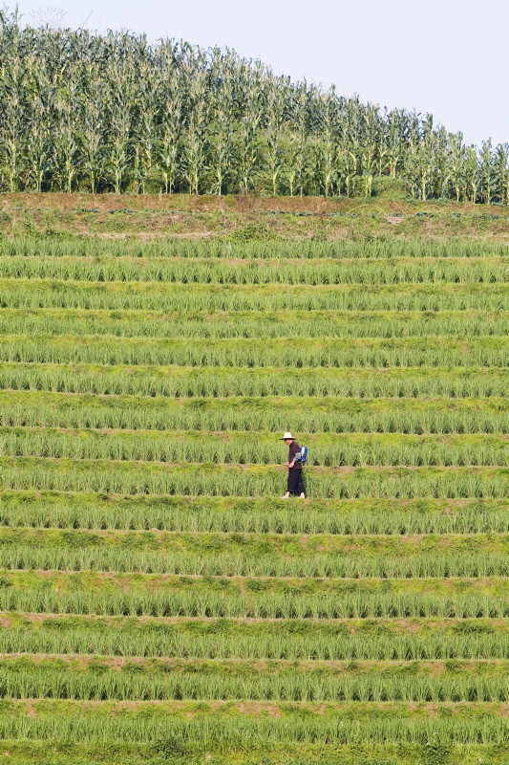
Interaction – Human/Environment
We impact every area of the Earth, but in varying ways.
The geography of places is influenced by the degree to which humans have impacted their local environment.
We depend on, modify, and adapt the environment.

Slide 22
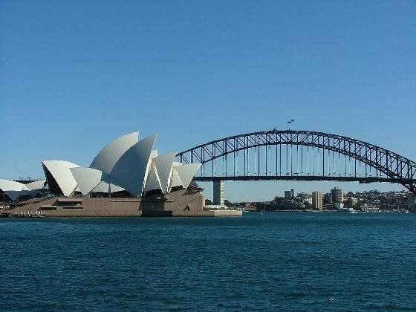
Place
Places have physical and human characteristics that make them what they are.
Physical – mountains, rivers, beaches, topography, and the animal/plant life of a place
Human – land use, architecture, forms of livelihood, religion, food, folk ways, transportation networks, communication networks
Geography emphasizes the understanding of both of these factors and their integration together.

Slide 23
List it
List examples for each of the 5 themes of geography.
Movement—
Region—
Location—
Interaction (Human/Environment)—
Place--

